Slide 1
Teacher’s slide
Key lesson information
Recommended time | 60 minutes
Recommended age | 7 - 8
Objectives | By the end of the session, children should be able to: Explain different types of unkind behaviour Explain the difference between bullying and one-off unkind behaviours. Explain some of the long-term impacts of bullying.
Main student tasks | Discuss what unkind behaviour and bullying are. Listen to the scenarios and decide whether they are showing bullying or unkind behaviour. Match key words with their definitions. Discuss how to get help if someone is being unkind or bullying. Look at scenarios and decide which type of unkind behaviour is being shown. Listen to a scenario about bullying and discuss the long-term impact of bullying.
Keywords | Bullying, unkind behaviour, teasing, name calling, excluding others, harassment, trusted adult.
Benchmarks and standards
PSHE Association | Respecting self and others
DfE RSHE | Respectful, kind relationships General wellbeing
Skills | Caring, communication, learning, listening.
SEND / additional needs / TA support
Our optional, editable, and printable worksheets are designed to support all children including those with additional needs. You could adapt these to suit the needs of your class, as required. For the audio scenario on slide 19, provide printed copies of the scenario for children with hearing difficulties, found in the teacher notes. Some children with autism or additional emotional needs may find some scenarios upsetting or distressing. A teaching assistant could work in a small group to unpick these scenarios together.
Teacher preparation
Resources | Pencils, pens, paper, exercise books.
Print | Worksheet (optional).
Assessment | Click here for assessment materials (optional).
Notes:
Teacher’s notes:
Our objectives are designed to be child friendly so please share these with your classes in way that suits you.
Our lessons are editable so you can adapt the slides and/or worksheet to suit the needs of your class.

Slide 2
Teacher slide - Creating a safe learning environment
Why it matters:
Every PSHE topic may be sensitive or personal.
Children must feel safe, respected, and supported to fully engage.
Build a supportive environment:
Create an anonymous question box.
Be sensitive to diverse needs and experiences.
Be mindful that someone in the class might be affected by topics covered.
Use provided stories, scenarios, or clips to depersonalise discussions.
Make it clear that discrimination is never acceptable.
Share balanced, factual information.
Signpost trusted support in and out of school (relevant support organisations provided at the end of this presentation).
Establish ground rules with children, every lesson, like:
Be open, but don’t share our own personal/private lives directly (don’t use names we can identify people with).
Respect others’ views even if they might be different to ours.
Use appropriate, respectful language, and avoid slang.
Take part in activities, but you have the right to pass on questions.
Ask questions, but not questions intended to embarrass others.
No personal stories will be repeated outside of the lesson, unless we are at risk from harm.
Notes:
Teacher’s notes:
Adapt the ground rules based on your school and classroom setting.
Be careful with sharing your own personal view and remember that you are in an influential position.
Remember: Always follow school safeguarding and confidentiality policies.

Slide 3
Teacher slide – hurtful behaviour and bullying guidance
Bullying is very common across the globe. A study by UNESCO found that around one third of the globe’s youth has experienced bullying. The percentage of young people who have been bullied is as low as 7% in some countries and as high as 74% in others.
Bullying takes many forms. Bullying can be verbal (being the target of rumours or lies, being made fun of, called names, or insulted), physical (being pushed, shoved, tripped, or spit on, having property destroyed on purpose) or social (being left out or excluded, being coerced into doing something). Bullying can take place in-person or online (cyberbullying).
Bullying has lifelong effects for both victims and bullies. The physical, emotional, and academic side effects on the victims of bullying are explored in this lesson. However, some studies have found that bullies themselves also suffer consequences into adulthood. Young people who bully are more likely to abuse alcohol and other drugs in adolescence and as adults, get into fights, vandalise property, drop out of education, engage in early sexual activity, have criminal convictions, and be abusive toward their romantic partners, spouses, or children.
Know the law and the policies of your school. Reassuring the children that schools have a legal obligation to stop and prevent bullying may make them feel more comfortable speaking to trusted person or member of staff in school. For example, in the UK, Section 89 of the Education and Inspections Act 2006 states that maintained schools must have ‘measures to encourage good behaviour and prevent all forms of bullying amongst pupils’. You may find it helpful to refer to your school anti-bullying policy and remind children of the process they should follow to report incidents of bullying in your setting.
Some young people are more likely to experience bullying than others. Bullying can happen to anyone, but some groups may be at more risk than others. LGBTQ+ young people, young people with disabilities, and socially isolated youth may be at an increased risk of being bullied. Young people from immigrant families in wealthy countries are more likely to be bullied in school than locally-born young people. In the UK, the Equality Act 2010 makes it illegal to harass someone based on protected characteristics (age, gender reassignment, marriage/civil partnership, pregnancy/maternity leave, disability, race, religion/belief, sex, and sexual orientation). Children should know they should always report all types of bullying, and that bullying based on their protected characteristics will be taken extremely seriously.
Notes:
Teacher’s notes:
This slide contains key facts and statistics about the theme of the lesson. These are not designed to be shared with children.

Slide 4
Teacher slide – FAQs
I saw someone being bullied, but they told me not to say anything – what should I do?
Talk to a teacher or trusted adult who can help you and your friend without anyone needing to know who said what. They can help in a quiet, safe way.
Can adults bully people too?
Yes, sadly bullying can happen at any age. If an adult is being unkind or unfair, talk to another trusted adult straight away.
Are bullies always mean people?
No - people who bully sometimes feel sad, angry, or unsure about how to act. That doesn't make it right, and they still need to stop. Adults can help them change and learn better ways to behave.
What if my friend is bullying someone?
Friends should help each other do the right thing. If you think your friend is bullying someone, speak to a trusted adult. Your friend doesn’t need to know you reported them. It’s helping everyone feel safe.
What if I’m being bullied, but I can’t prove it?
You don’t need proof to get help. Tell a trusted adult what’s happening even if no one else sees the bullying. Adults can help you stay safe and make a plan to support you.
What if people are unkind to me because I’m different?
Everyone should be treated with respect, no matter who they are. If someone is mean because of how you look, speak, feel, or who you are, tell a trusted adult. It’s never okay, and you deserve to be safe. In the UK, there are ‘protected characteristics’. This means it’s illegal to discriminate against someone because of their age, gender reassignment, marriage/civil partnership, pregnancy/maternity leave, disability, race, religion/belief, sex, or sexual orientation.
Notes:
Teacher’s notes:
This slide contains model answers to questions that children might ask about the theme of the lesson.

Slide 5

Can I spot unkind behaviour and bullying?

Slide 6
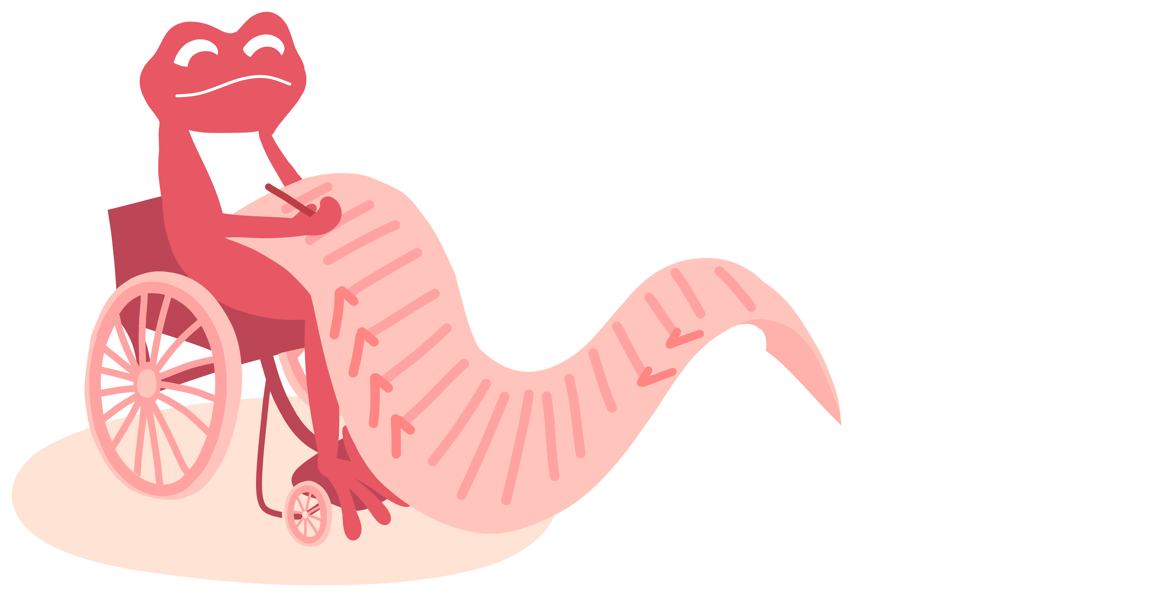
Ground rules (5 mins)
Let’s create some ground rules for our lesson.
_________________________________________
_________________________________________
_________________________________________
_________________________________________
_________________________________________
Notes:
Teacher’s notes:
At the start of the lesson, agree on some ground rules as a class. Some suggestions are provided on the ‘creating a safe learning environment’ teacher slide.
If you’re using a question box in your class, let children know that it’s available during and after the lesson. Explain that if anyone has a question or worry they don’t feel comfortable sharing out loud, they can write or draw it on a piece of paper, with their name or anonymously, and place it in the box. This way, everyone has a safe way to share their thoughts.

Slide 7

Unkind behaviour and bullying (10 mins)
Discuss the questions in pairs.
What is unkind behaviour?
What is bullying?
Notes:
Teacher’s notes:
Suggested answers are provided on the next slide.

Slide 8
Unkind behaviour and bullying
Discuss the questions in pairs.
What is unkind behaviour?
A one-off hurtful action.
What is bullying?
Being unkind many times on purpose.
Notes:
Teacher’s notes:

Slide 9

Unkind behaviour and bullying
Is it bullying or unkind behaviour?
In an art lesson, Toby knocked over Leo’s paint pot by accident. Leo shouted at Toby and said, “Why are you so clumsy?!” Toby felt upset.
It is unkind behaviour: It was a one-off action. It may have been rude, but it didn’t keep happening. Unkind behaviours are never okay.
Unkind behaviour: A one-off hurtful action.
Bullying: Being unkind many times on purpose.
Notes:
Teacher’s notes:
Suggested answers:
It is unkind behaviour: it was a one-off action. It may have been rude, but it didn’t keep happening. Unkind behaviours are never okay.

Slide 10

Unkind behaviour and bullying
Is it bullying or unkind behaviour?
At lunch time, Sen asked if she could sit with Flora, but Flora didn’t let her. Flora started calling Sen names behind her back. The next day Flora hid Sen’s pencil case and at break time she pushed her over. Flora continued her unkind behaviour for the next few weeks.
It is bullying: Flora is being unkind many times on purpose, and it’s meant to hurt Sen’s feelings. Bullying is never okay.
Unkind behaviour: A one-off hurtful action.
Bullying: Being unkind many times on purpose.
Notes:
Teacher’s notes:
Suggested answers:
It is bullying: Flora is being unkind many times on purpose, and it’s meant to hurt Sen’s feelings. Bullying is never okay.

Slide 11

Unkind behaviour and bullying
Is it bullying or unkind behaviour?
Esther tells Charles and Eliza to push over Cam every morning and put her bag in the mud. Charles and Eliza listen to Esther as they are scared Esther will hurt them.
It is bullying: Esther, Charles and Eliza are all involved in bullying Cam even if Esther is only telling them to do it. Charles and Eliza are also victims of bullying. People can influence others to bully. Violence and bullying are never okay.
Unkind behaviour: A one-off hurtful action.
Bullying: Being unkind many times on purpose.
Notes:
Teacher’s notes:
This is a good opportunity to discuss how bullying can be influenced by others and that everyone involved is culpable.
Suggested answers:
It is bullying: Esther, Charles and Eliza are all involved in the bullying even if Esther is only telling them to do it. People can influence others to bully. Violence and bullying are never okay.

Slide 12
Unkind behaviours (10 mins)
Match the word with the definition.
a) Teasing
1) When someone makes someone else feel scared or upset because of who they are like their age, sex, or a disability they have.
b) Name calling
2) Making fun of someone in a way that might seem like a joke.
c) Excluding others
3) Using unkind or rude words to talk about someone.
d) Harassment
4) Leaving someone out on purpose.
Notes:
Teacher’s notes:
Vocabulary:
Age: how old a person is.
Sex: whether a person is male or female.
Disability: a condition that can make some activities or tasks more difficult for a person.
Answers (revealed on the next slide):
Teasing: 2) Making fun of someone in a way that might seem like a joke.
Name calling: 3) Using unkind or rude words to talk about someone.
Excluding others: 4) Leaving someone out on purpose.
Harassment: 1) When someone makes someone else feel scared or upset because of who they are like their age, sex, or a disability they have.

Slide 13
Unkind behaviours
Match the word with the definition.
a) Teasing
2) Making fun of someone in a way that might seem like a joke.
b) Name calling
3) Using unkind or rude words to talk about someone.
c) Excluding others
4) Leaving someone out on purpose.
1) When someone makes someone else feel scared or upset because of who they are like their age, sex, or a disability they have.
d) Harassment
Notes:
Teacher’s notes:
Vocabulary:
Age: how old a person is.
Sex: whether a person is male or female.
Disability: a condition that can make some activities or tasks more difficult for a person.
Answers:
Teasing: 2) Making fun of someone in a way that might seem like a joke.
Name calling: 3) Using unkind or rude words to talk about someone.
Excluding others: 4) Leaving someone out on purpose.
Harassment: 1) When someone makes someone else feel scared or upset because of who they are like their age, sex, or a disability they have.

Slide 14
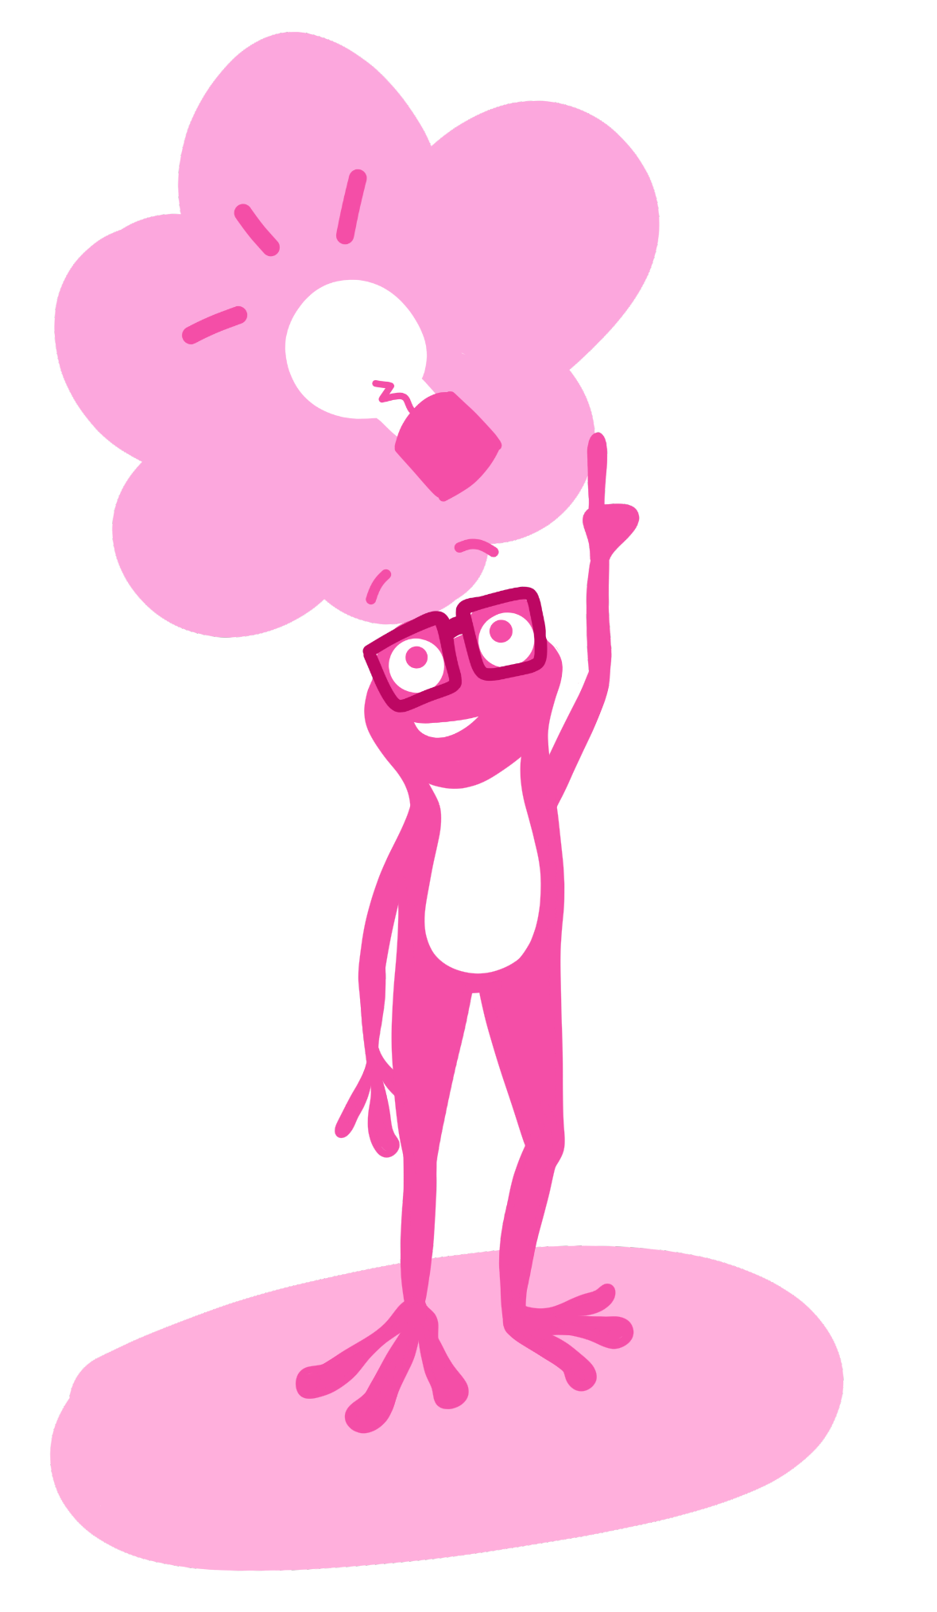
Unkind behaviours
What should someone do if they’re being bullied or see someone else being bullied?
Speak to a trusted adult. They might say:
I’m being bullied. Can you help me?
I’ve noticed someone being bullied. Can you help?
Can you help me with something important?
Challenge: Think of three trusted adults someone could tell.
Notes:
Teacher’s notes:
Suggested answers:
If someone is being bullied (or sees someone else being bullied) they can get help by speaking to a trusted adult like a:
Teacher
Teaching assistant
Headteacher
Family member like auntie, uncle, or grandparent
Parent or caregiver
Playground supervisor
Learning mentor / pastoral staff

Slide 15


Which behaviour is it? (20 mins)
Which unkind behaviour is being shown?
Every day at break, Soren keeps following Carys and telling her, ‘girls are annoying’. Carys has asked him to stop, but he carries on doing it. Soren won’t leave her alone, which makes Carys feel scared and she doesn’t want to go out for break time anymore.
Teasing
Harassment
Excluding others
How can Carys get help?
Harassment
Name calling
Notes:
Teacher’s notes:
Suggested answers:
Harassment: Carys could get help by speaking to a trusted adult and asking for Soren to stop.

Slide 16

Which behaviour is it?
Which unkind behaviour is being shown?
Idris calls Mabli “crybaby” when she gets upset, which makes her feel worse.
Teasing
Name calling
Excluding others
How can Mabli get help?
Harassment
Name calling
Notes:
Teacher’s notes:
Suggested answers:
Name calling: Mabli could get help by speaking to a trusted adult and asking Idris to stop.

Slide 17
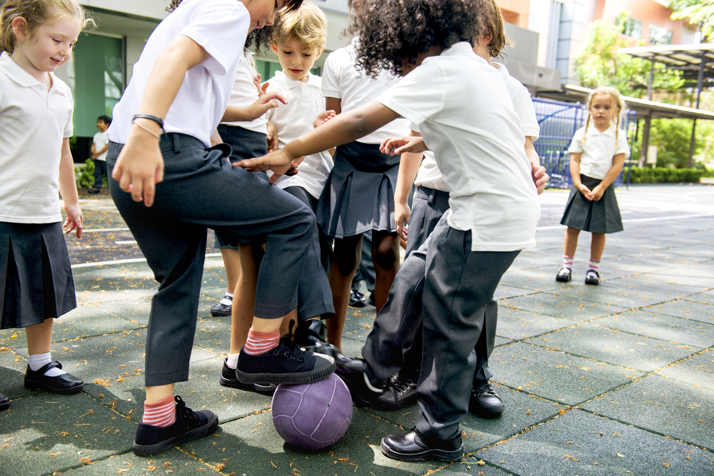
Which behaviour is it?
Which unkind behaviour is being shown?
At lunchtime, Anna notices her friends don’t let Lucy play a game. Lucy seems sad. Anna feels bad for her.
Teasing
Excluding others
Excluding others
How can Anna help Lucy?
Harassment
Name calling
Notes:
Teacher’s notes:
Suggested answers:
Excluding others: Anna could get help by speaking to a trusted adult and including Lucy in her games.

Slide 18
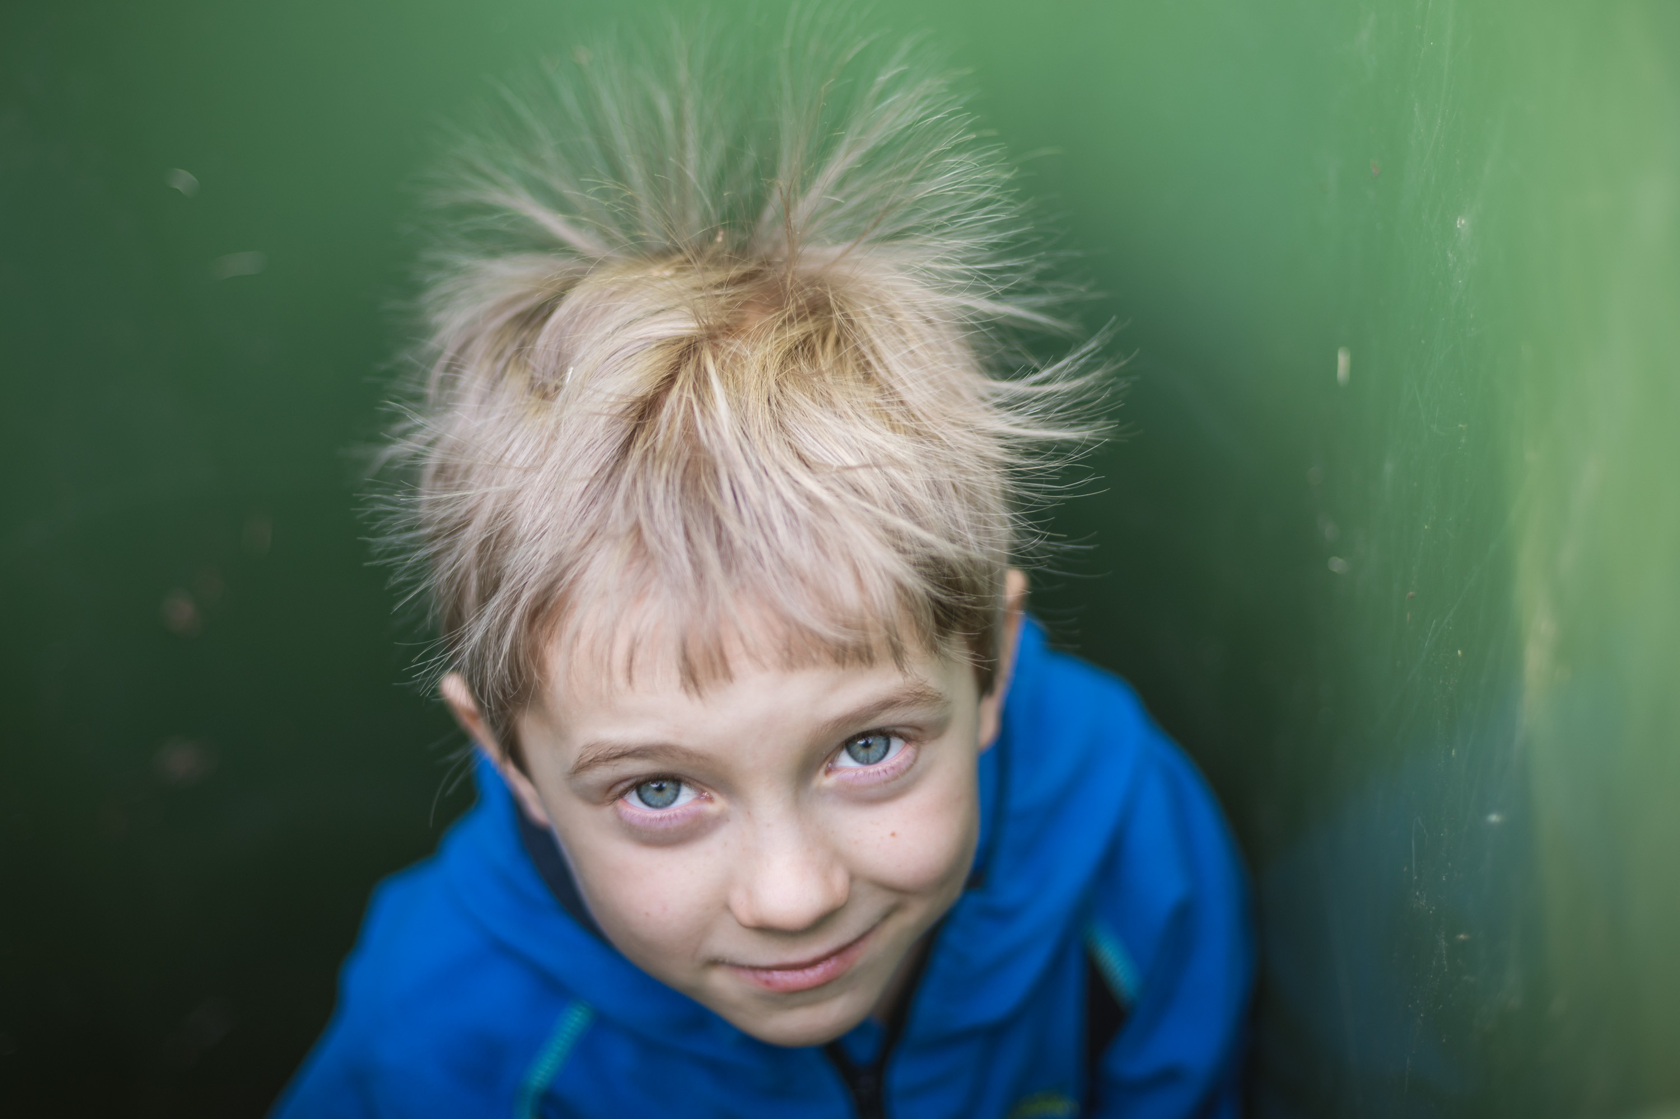
Which behaviour is it?
Which unkind behaviour is being shown?
Yara keeps making fun of Jasper’s new haircut, saying it makes him look like a hedgehog, even though Jasper asked her to stop.
Teasing
Teasing
Excluding others
How can Jasper get help?
Harassment
Name calling
Notes:
Teacher’s notes:
Suggested answers:
Teasing: Jasper could get help by speaking to a trusted adult and asking Yara to stop.

Slide 19



The long-term impact of bullying (15 mins)
Listen to how bullying has had a long-term impact on Kaia.
Notes:
Teacher’s notes:
Transcript:
When I was at school, some children bullied me. They pushed me, called me names, and chased me everyday. I felt very scared, worried, and lonely.
Now I’m an adult and I work as a robotics engineer. I design and build robots that help people.
Sometimes, I feel nervous when I have to work with someone new because I remember how scared I felt at school.
I also worry about making new friends in case they won’t like me. I talk to my family about how I feel. I also try to be kind to people at work who might feel left out, so they don’t feel like I did.
I wish I had asked for help when I was at school.

Slide 20
The long-term impact of bullying
How was Kaia bulled?
Name calling: They called her names.
Harassment: They chased her everyday which made her feel scared.
Pushing: They pushed her.
Notes:
Teacher’s notes:
Click to reveal suggested answers.

Slide 21
The long-term impact of bullying
What could have Kaia done to get help at school?
Speak to a trusted adult like a teacher, teaching assistant, parent, carer, family member, or playground supervisor.
Notes:
Teacher’s notes:
Click to reveal suggested answers.

Slide 22
The long-term impact of bullying
How does the bullying still make Kaia feel as an adult?
She feels nervous about working with new people.
She worries about making new friends.
Notes:
Teacher’s notes:
Click to reveal suggested answers.

Slide 23
The long-term impact of bullying
How might Kaia get support as an adult?
Ask for help at work, like her boss or a kind workmate.
See a counsellor or therapist who can help her with her feelings.
Talk to someone she trusts, like a friend or family member.
Notes:
Teacher’s notes:
Click to reveal answers.

Slide 24





Where can I find out more or get support?
Childline: 0800 1111 (Free, 24/7)
Kidscape: kidscape.org.uk/i-am-a-young-person
BBC Bitesize: bbc.co.uk/teach/articles/zm66b7h
National Bullying Helpline: nationalbullyinghelpline.co.uk/children.html
YoungMinds: youngminds.org.uk/young-person/coping-with-life/bullying/
Notes:
Teacher’s notes:
This slide has information on organisations that can offer more information or support.
You may choose to refer to these organisations if questions/issues arise during the teaching of this lesson. Remember to always follow your school’s safeguarding and confidentiality policies.
For older children, you may encourage them to visit these websites themselves.

Slide 25


