Slide 1




Teacher’s slide
Key lesson information
Recommended time | 60 minutes
Objectives | By the end of the session, children should be able to: List some unkind behaviours, online and offline. Explain how unkind behaviour can make others feel. Explain how they can get help when people are unkind.
Main student tasks | Discuss ways that Joaquin can help other children. Listen to the story about Joaquin and answer the questions. Listen to the scenarios about unkind behaviour online and discuss what unkind behaviours are happening, how they’re making the person feel, and how they can get help. Identify a kind and unkind behaviour and say how they can get support for unkind behaviour. Optional: Discuss why kindness at work is important and some jobs which need to show kindness.
Keywords | Kind, unkind, internet, offline, behaviour, feeling, help, doctor, teaching assistant, builder.
Benchmarks and standards
PSHE Association | Managing hurtful behaviour and bullying
DfE RSHE | That bullying (including cyberbullying) has a negative and often lasting impact on mental wellbeing. Where and how to report concerns and get support with issues online. That the internet can also be a negative place where online abuse, trolling, bullying and harassment can take place, which can have a negative impact on mental health
Skills | Caring, communication, learning, listening, reading, reflectiveness, speaking.
SEND / additional needs / TA support
Our optional, editable, and printable worksheets are designed to support all children including those with additional needs. You could adapt these to suit the needs of your class, as required. You may choose to read the story on slides 8-18 to the class before the lesson so children become familiar with the story and language. Some children with autism or additional emotional needs may find some scenarios upsetting or distressing. A teaching assistant could work in a small group to unpick these scenarios together.
Teacher preparation
Resources | Pencils, pens, paper, exercise books, toy (to pass around)
Print | Worksheet (optional)
Notes:
Teacher’s notes:
Our objectives are designed to be child friendly so please share these with your classes in way that suits you.
Our lessons are editable so you can adapt the slides and/or worksheet to suit the needs of your class.

Slide 2
Teacher slide – creating a safe learning environment
Why it matters:
Every PSHE topic may be sensitive or personal.
Children must feel safe, respected, and supported to fully engage.
Build a supportive environment:
Create an anonymous question box.
Be sensitive to diverse needs and experiences.
Be mindful that someone in the class might be affected by topics covered.
Use provided stories, scenarios, or clips to depersonalise discussions.
Make it clear that discrimination is never acceptable.
Share balanced, factual information.
Signpost trusted support in and out of school (relevant support organisations provided at the end of this presentation).
Establish ground rules with children, every lesson, like:
Be open, but don’t share our own personal/private lives directly (don’t use names we can identify people with).
Respect others’ views even if they might be different to ours.
Use appropriate, respectful language, and avoid slang.
Take part in activities, but you have the right to pass on questions.
Ask questions, but not questions intended to embarrass others.
No personal stories will be repeated outside of the lesson, unless we are at risk from harm.
Notes:
Teacher’s notes:
Adapt the ground rules based on your school and classroom setting.
Be careful with sharing your own personal view and remember that you are in an influential position.
Remember: Always follow school safeguarding and confidentiality policies.

Slide 3
Teacher slide – hurtful behaviour and bullying guidance
Bullying is very common across the globe. A study by UNESCO found that around one third of the globe’s youth has experienced bullying. The percentage of young people who have been bullied is as low as 7% in some countries and as high as 74% in others.
Bullying takes many forms. Bullying can be verbal (being the target of rumours or lies, being made fun of, called names, or insulted), physical (being pushed, shoved, tripped, or spit on, having property destroyed on purpose) or social (being left out or excluded, being coerced into doing something). Bullying can take place in-person or online (cyberbullying).
Bullying has lifelong effects for both victims and bullies. The physical, emotional, and academic side effects on the victims of bullying are explored in this lesson. However, some studies have found that bullies themselves also suffer consequences into adulthood. Young people who bully are more likely to abuse alcohol and other drugs in adolescence and as adults, get into fights, vandalise property, drop out of education, engage in early sexual activity, have criminal convictions, and be abusive toward their romantic partners, spouses, or children.
Know the law and the policies of your school. Reassuring the children that schools have a legal obligation to stop and prevent bullying may make them feel more comfortable speaking to trusted person or member of staff in school. For example, in the UK, Section 89 of the Education and Inspections Act 2006 states that maintained schools must have ‘measures to encourage good behaviour and prevent all forms of bullying amongst pupils’. You may find it helpful to refer to your school anti-bullying policy and remind children of the process they should follow to report incidents of bullying in your setting.
Some young people are more likely to experience bullying than others. Bullying can happen to anyone, but some groups may be at more risk than others. LGBTQ+ young people, young people with disabilities, and socially isolated youth may be at an increased risk of being bullied. Young people from immigrant families in wealthy countries are more likely to be bullied in school than locally-born young people. In the UK, the Equality Act 2010 makes it illegal to harass someone based on protected characteristics (age, gender reassignment, marriage/civil partnership, pregnancy/maternity leave, disability, race, religion/belief, sex, and sexual orientation). Children should know they should always report all types of bullying, and that bullying based on their protected characteristics will be taken extremely seriously.
Notes:
Teacher’s notes:
This slide contains key facts and statistics about the theme of the lesson. These are not designed to be shared with children.

Slide 4
Teacher slide – FAQs
I saw someone being bullied, but they told me not to say anything – what should I do?
Talk to a teacher or trusted adult who can help you and your friend without anyone needing to know who said what. They can help in a quiet, safe way.
Can adults bully people too?
Yes, sadly bullying can happen at any age. If an adult is being unkind or unfair, talk to another trusted adult straight away.
Are bullies always mean people?
No - people who bully sometimes feel sad, angry, or unsure about how to act. That doesn't make it right, and they still need to stop. Adults can help them change and learn better ways to behave.
What if my friend is bullying someone?
Friends should help each other do the right thing. If you think your friend is bullying someone, speak to a trusted adult. Your friend doesn’t need to know you reported them. It’s helping everyone feel safe.
What if I’m being bullied, but I can’t prove it?
You don’t need proof to get help. Tell a trusted adult what’s happening even if no one else sees the bullying. Adults can help you stay safe and make a plan to support you.
What if people are unkind to me because I’m different?
Everyone should be treated with respect, no matter who they are. If someone is mean because of how you look, speak, feel, or who you are, tell a trusted adult. It’s never okay, and you deserve to be safe. In the UK, there are ‘protected characteristics’. This means it’s illegal to discriminate against someone because of their age, gender reassignment, marriage/civil partnership, pregnancy/maternity leave, disability, race, religion/belief, sex, or sexual orientation.
Notes:
Teacher’s notes:
This slide contains model answers to questions that children might ask about the theme of the lesson.

Slide 5

What is unkind behaviour?

Slide 6
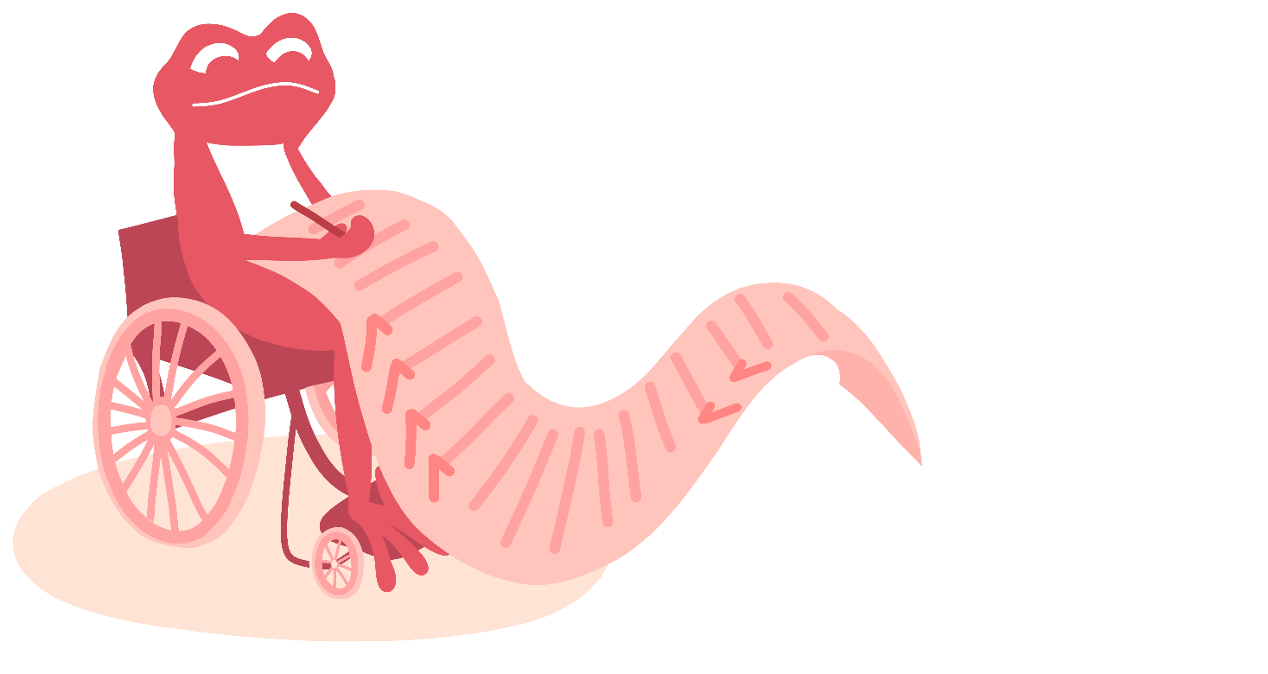
Ground rules (5 mins)
Let’s create some ground rules for our lesson.
_________________________________________
_________________________________________
_________________________________________
_________________________________________
_________________________________________
Notes:
Teacher’s notes:
At the start of the lesson, agree on some ground rules as a class. Some suggestions are provided on the ‘creating a safe learning environment’ teacher slide.
If you’re using a question box in your class, let children know that it’s available during and after the lesson. Explain that if anyone has a question or worry they don’t feel comfortable sharing out loud, they can write or draw it on a piece of paper, with their name or anonymously, and place it in the box. This way, everyone has a safe way to share their thoughts.

Slide 7

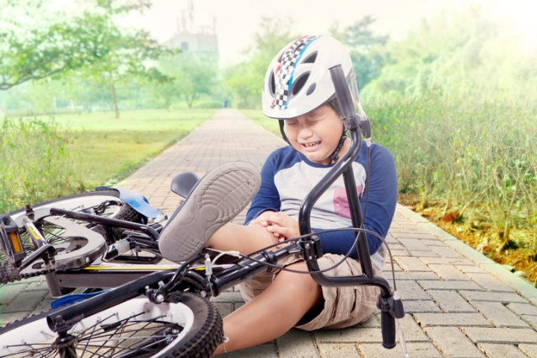


Being kind (10 mins)
Joaquín loves to be kind. How could he show kindness to each person?
Matisse has fallen off his bike.
Bethel is feeling sad.
Rafael has just got a new haircut
Challenge: List three other ways he can be kind.
Notes:
Teacher’s notes:
Suggested answers:
Matisse has fallen off his bike.
Help Matisse stand up
Get an adult to help
Ask, “Are you okay?”
Stay with Matisse so he isn’t alone
Bethel is feeling sad.
Ask, “Do you want to talk?”
Sit with Bethel
Offer a hug or a smile
Say something kind like, “I’m here for you”
Rafael has just got a new haircut.
“I like your new haircut!”
“You look really nice!”
Give a big smile
Ask, “Did you go to a new hairdresser?”
Challenge: List three other ways he can be kind
Help someone tidy up
Ask someone new to play with him
Say “please” and “thank you”
Share his toys or pencils
Listen when someone is talking
Let someone go first in line

Slide 8


Unkind behaviour in a story (25 mins)
Listen to the story and answer the questions that follow.
Notes:
Teacher’s notes:
On slide 12, there are three boxes on the slide that you can click to see different endings to the story, based on a decision that the main character has to make.

Slide 9
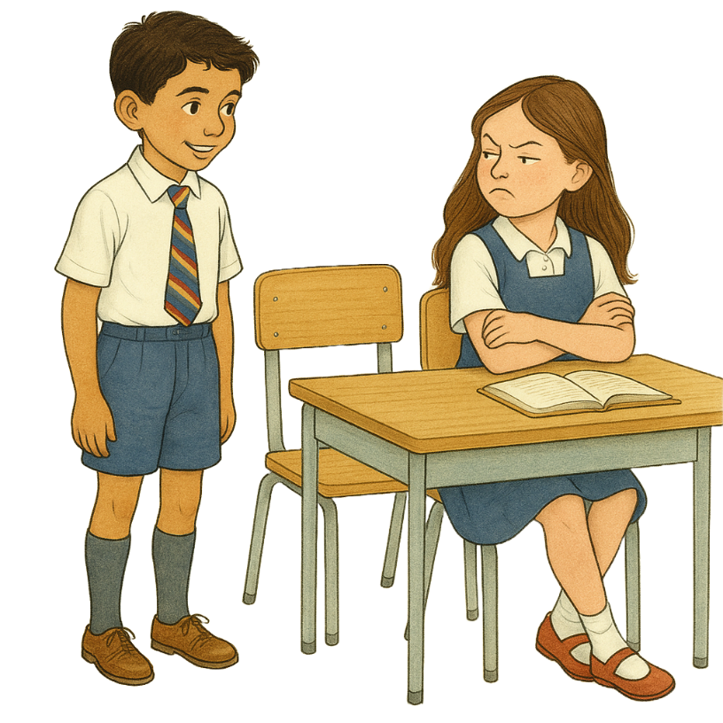
Unkind behaviour in a story
One morning, the teacher had some news. “Everyone’s moving seats today!” he said.
Joaquín felt excited. “I might make a new friend!” he smiled.
The teacher said, “Joaquín, can you move next to Rosa, please?”
Joaquín walked over, sat down and said, “Hi!”
But Rosa pulled a mean face and turned away. Joaquín felt a little sad.
Notes:
Teacher’s notes:

Slide 10
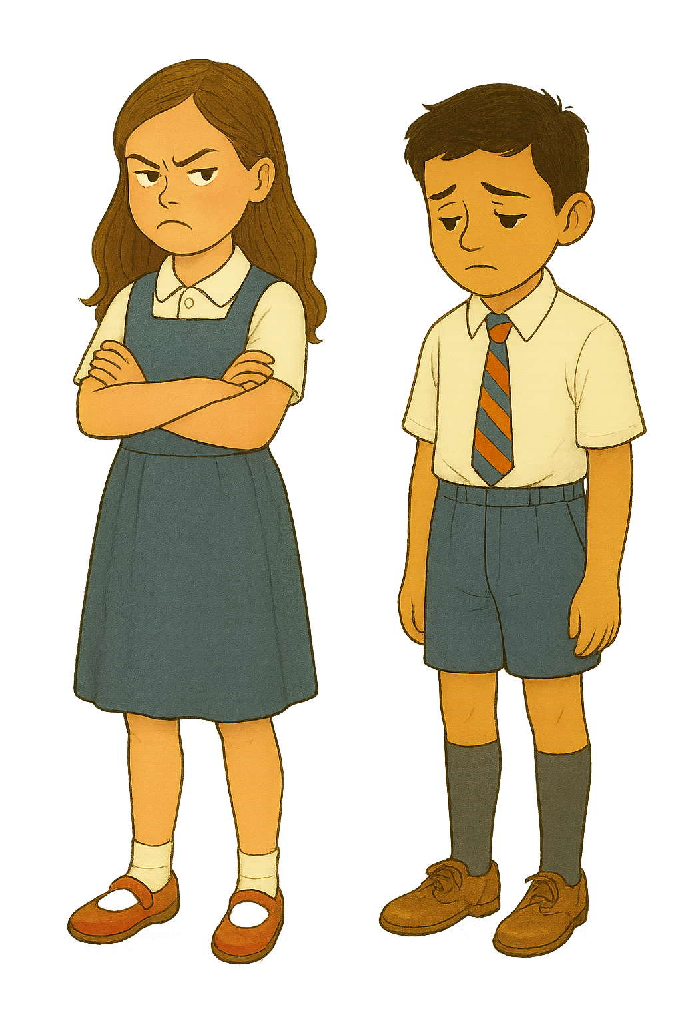
Unkind behaviour in a story
At playtime, Joaquín saw Rosa playing by herself.
He went over and said, “Do you want to play?”
“Go away! I don’t want to play with you!” Rosa snapped.
Now Joaquín felt even sadder.
Maybe Rosa was just having a bad day, he thought. I’ll try again tomorrow.
Notes:
Teacher’s notes:

Slide 11
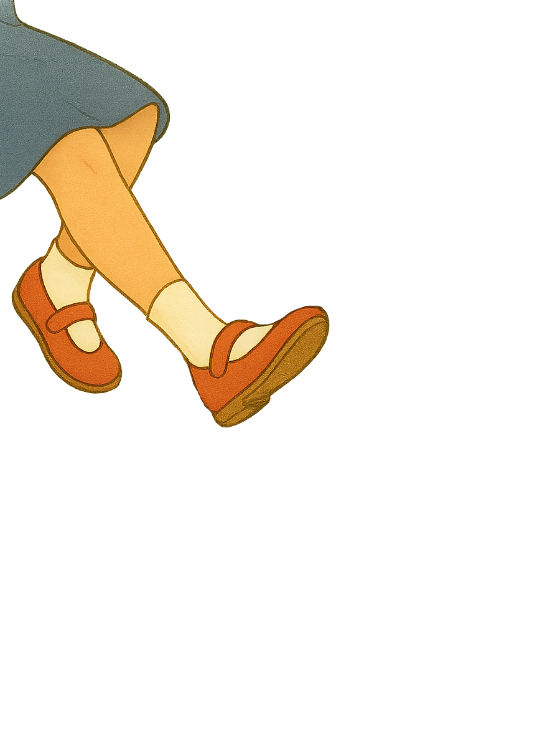
Unkind behaviour in a story
The next day...
Joaquín sat down next to Rosa again. “Hi,” he said kindly.
But Rosa didn’t say anything. She just ignored him. Joaquín felt sad again.
Then, during maths, something hurt his leg. “Ouch!” he thought. “What was that?”
It happened again. It really hurt! He looked down and saw Rosa was kicking him.
“Stop that!” he said. Rosa stopped but stuck her tongue out at him.
Joaquín felt very, very sad. He didn’t understand why Rosa was being so mean.
Notes:
Teacher’s notes:

Slide 12
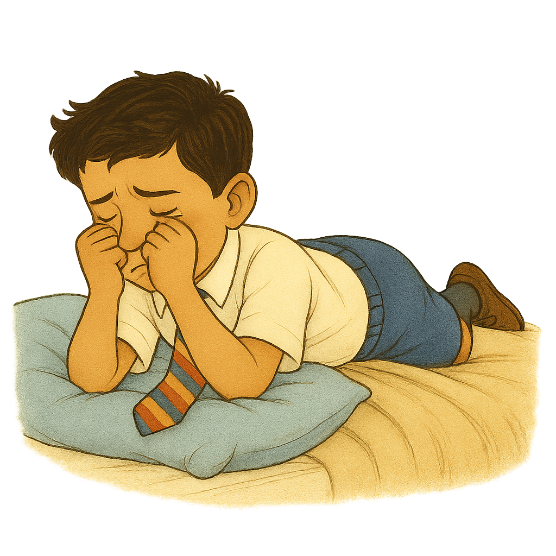
Unkind behaviour in a story
After school, it was time for swimming, but Joaquín didn’t want to go. He was too upset. He went upstairs and cried. He felt very alone.
The next morning...
Joaquín didn’t want to go to school. He was scared Rosa would be mean again. He didn’t know what to do.
What should Joaquín do?
A. Tell his teacher
B. Tell his dad
C. Do nothing
Click an option above to find out what happens next!
Notes:
Teacher’s notes:
Ask the children: ‘what should Joaquín do?’ and allow them to vote between options A, B, and C.
Then click the relevant box on the slide (tell his teacher, tell his dad, or do nothing) to continue the story. You’ll have the chance to explore the impact of the other choices afterwards.

Slide 13
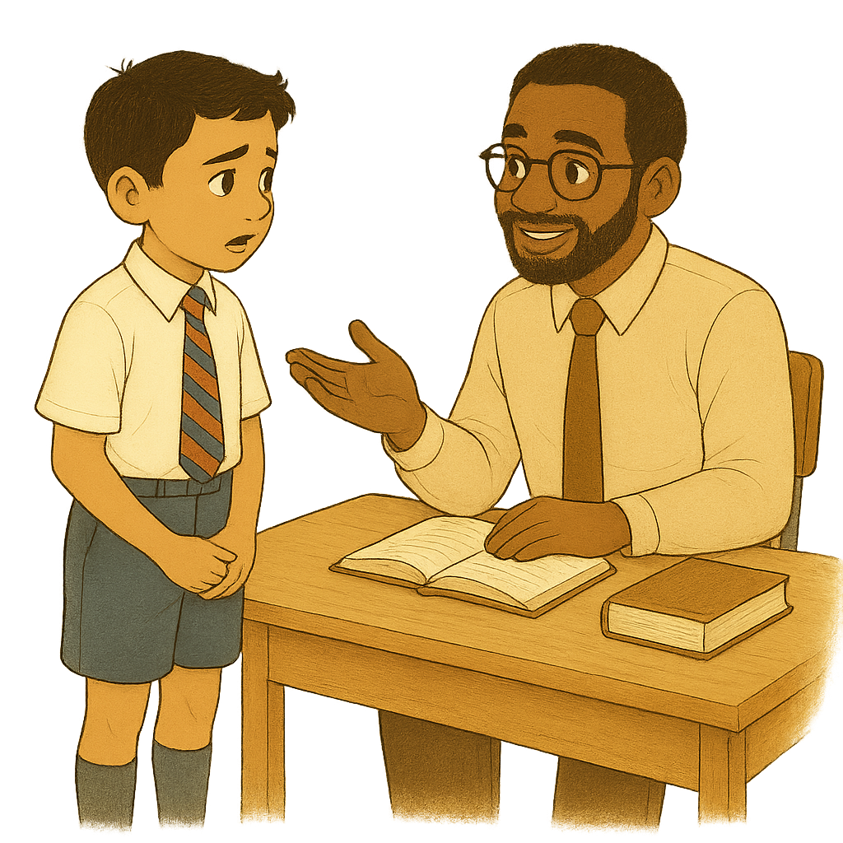
Unkind behaviour in a story
You chose: A. Tell his teacher
Joaquín was brave. He went to tell his teacher what happened.
“I’m so proud of you for telling me. Rosa shouldn’t be treating you like this,” the teacher said. “Would you like to move seats?”
Joaquín said yes.
“I’ll talk to Rosa and tell her to stop, and speak to her parents too,” said the teacher. “Please tell me again if anything else happens.”
Notes:
Teacher’s notes:

Slide 14
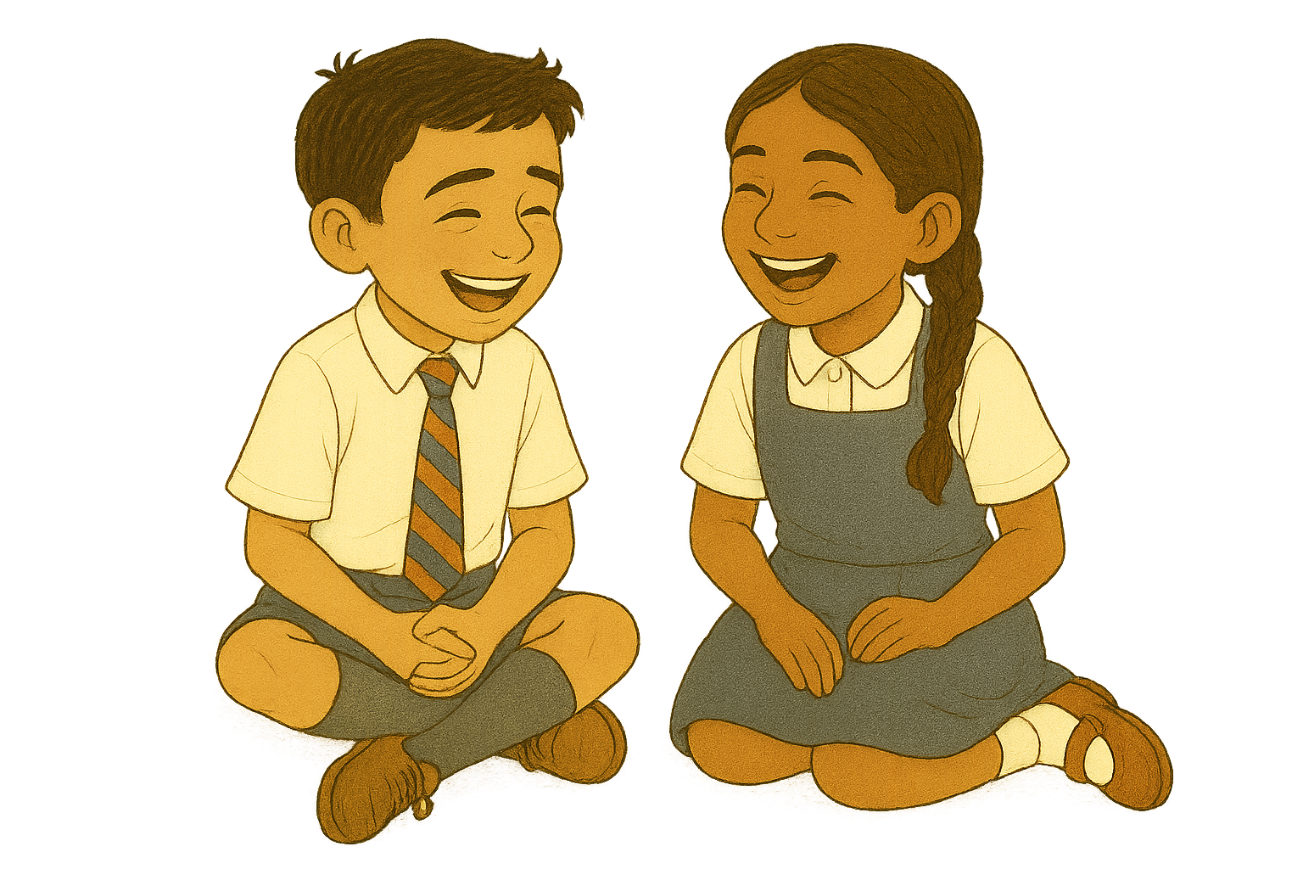
You chose: A. Tell his teacher
Unkind behaviour in a story
Joaquín moved seats and sat next to a kind girl called Francis. They became good friends.
Rosa didn’t become his friend, but she did stop being unkind.
Joaquín felt much better. He was glad he was brave and told his teacher.
Click below to explore the other endings to the story:
A. Tell his teacher
B. Tell his dad
C. Do nothing
If you’ve explored all options, click here to end the story.
Notes:
Teacher’s notes:
Click the relevant box on the slide (tell his dad or do nothing) to explore the alternative endings to the story.
Once you’ve explored all three options (tell his teacher, tell his dad, and do nothing) click the link at the bottom of the slide to jump to slide 19.

Slide 15
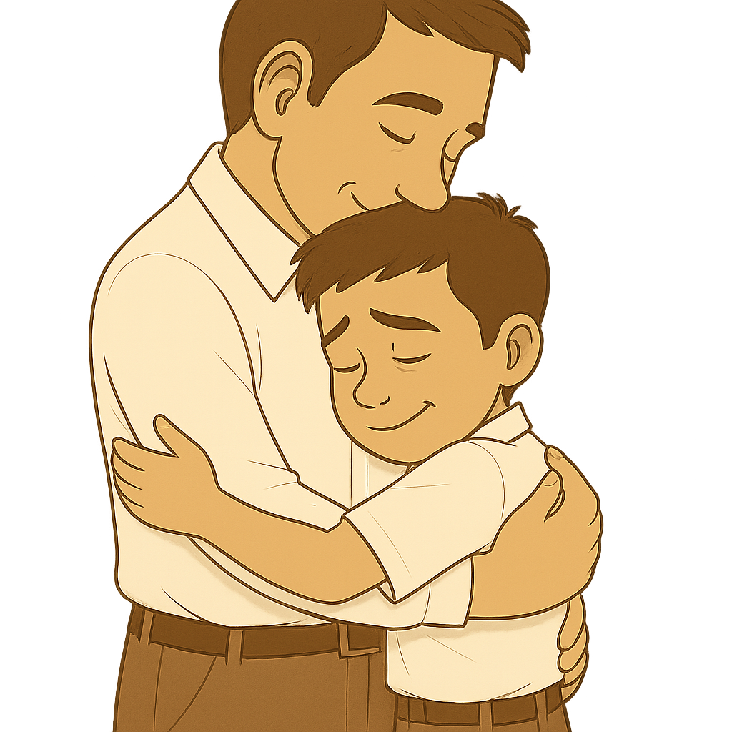
Unkind behaviour in a story
You chose: B. Tell his dad
Joaquín told his dad everything that had happened. His dad gave him a big hug.
“It’s OK to feel sad when someone is unkind,” he said. “But we need to make it stop.”
He said he would talk to the teacher at school.
At school, the teacher called Joaquín over.
“I’m really sorry this happened,” he said. “Would you like to move seats?”
Notes:
Teacher’s notes:

Slide 16
You chose: B. Tell his dad
Unkind behaviour in a story
Joaquín nodded.
The teacher also said he would speak to Rosa and her parents to help her learn to be kind.
Joaquín moved seats and sat next to a kind girl called Francis. They became good friends.
Rosa never became a good friend, but she stopped being unkind. Joaquín felt much happier again. He was glad he was brave enough to tell his dad.
Click below to explore the other endings to the story:
A. Tell his teacher
B. Tell his dad
C. Do nothing
If you’ve explored all options, click here to end the story.
Notes:
Teacher’s notes:
Click the relevant box on the slide (tell his teacher or do nothing) to explore the alternative endings to the story.
Once you’ve explored all three options (tell his teacher, tell his dad, and do nothing) click the link at the bottom of the slide to jump to slide 19.

Slide 17
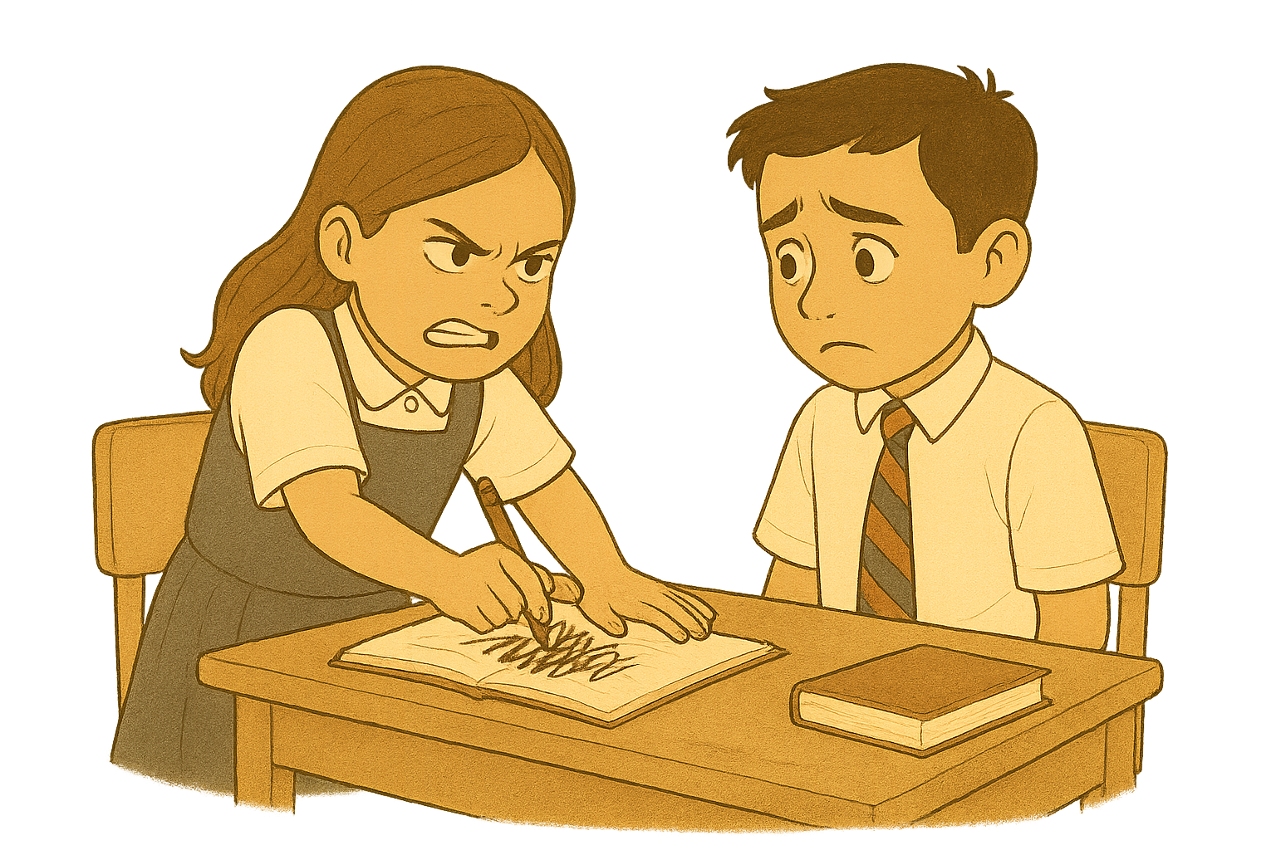
Unkind behaviour in a story
You chose: C. Do nothing
Joaquín didn’t tell anyone. He went to school feeling worried.
Rosa was mean again.
She pushed him in the playground.
She scribbled on his work.
She even called him names.
Notes:
Teacher’s notes:

Slide 18
You chose: C: Do nothing
Unkind behaviour in a story
Joaquín felt so sad. He didn’t want to go to school anymore. He just wanted to stay in his room and cry.
Click below to explore the other endings to the story:
A. Tell his teacher
B. Tell his dad
C. Do nothing
If you’ve explored all options, click here to end the story.
Notes:
Teacher’s notes:
Click the relevant box on the slide (tell his teacher or tell his dad) to explore the alternative endings to the story.
Once you’ve explored all three options (tell his teacher, tell his dad, and do nothing) click the link at the bottom of the slide to jump to slide 19.

Slide 19
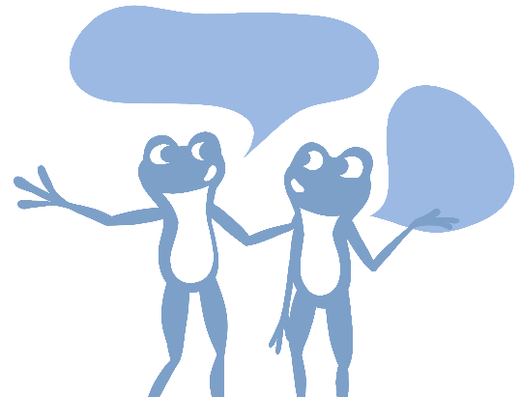



Unkind behaviour in a story
Discuss the questions about the story as a class.
How was Rosa unkind to Joaquín?
How did Joaquín feel when Rosa was unkind to him?
How did Joaquín get Rosa to stop being unkind?
Notes:
Teacher’s notes:
Suggested answers: 1. How was Rosa unkind to Joaquín?
She pulled a mean face at him
She told him to go away and not play with her
She ignored him when he spoke to her
She kicked him under the table
She stuck her tongue out at him
She pushed him in the playground
She scribbled on his work
She called him names
2. How did Joaquín feel when Rosa was unkind to him?
He felt sad
He felt confused
He felt lonely
He felt too upset to go swimming
He didn’t want to go to school
He wanted to cry
3. How did Joaquín get Rosa to stop being unkind?
He told his mum what had happened
His mum spoke to the teacher
The teacher helped by talking to Rosa and her parents
Joaquín moved seats and sat with someone kind
The teacher said Joaquín should always tell someone if it happens again

Slide 20
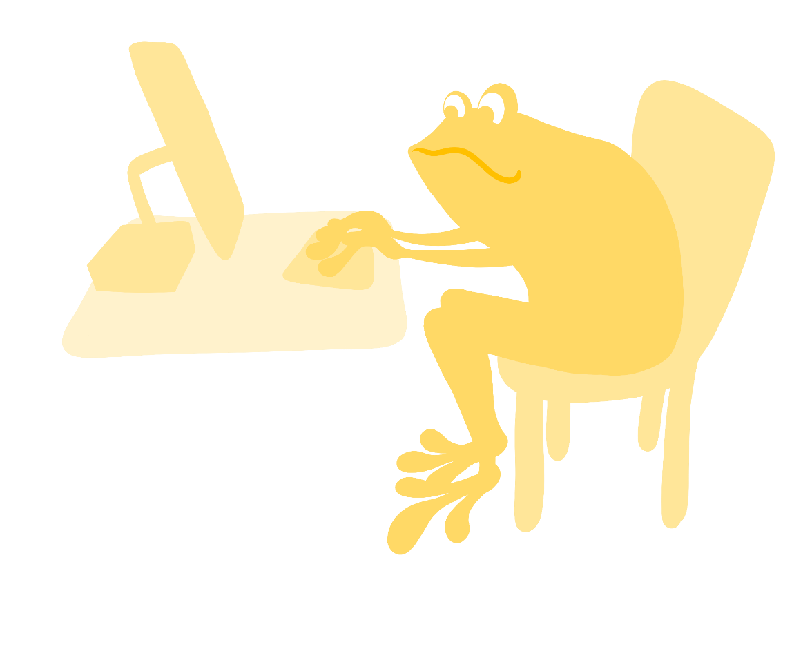
Being unkind online (10 mins)
Being online means using the internet. People can also be unkind to others online.
Listen to the scenarios and answer the questions.
Notes:
Teacher’s notes:
You may choose to go into more detail about what being online might involve.
Scenarios are presented on the following slides.

Slide 21
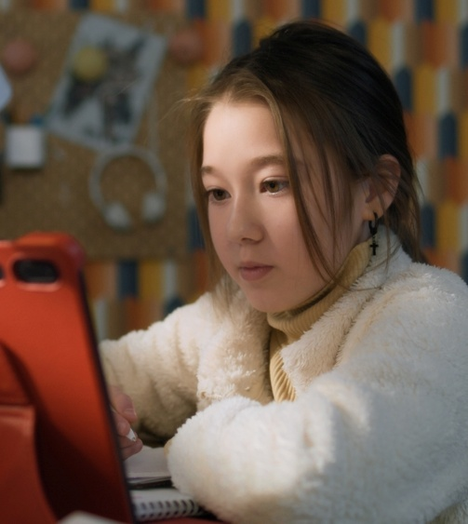
Being unkind online
Listen to the scenario and answer the questions.
What is the unkind behaviour?
Lena was playing a drawing game on the tablet. She drew a picture of a cat and sent it to her friend, Amina. Amina sent a message back that said, “That’s an ugly picture. You’re bad at drawing.”
How might Lena be feeling?
How can Lena get help?
Notes:
Teacher’s notes:
Discuss the answers to each question as a class.
Suggested answers:
What is the unkind behaviour?
Anima sent a mean message.
How might Lena be feeling?
Sad and upset.
How can Lena get help?
She can tell an adult, like her parent/carer or teacher.

Slide 22

Being unkind online
Listen to the scenario and answer the questions.
What is the unkind behaviour?
Omar wanted to play a game online with two of his friends. When he asked to join in, one friend said, “No, we don’t want you in our game,” and they kept playing without him.
How might Omar be feeling?
How can Omar get help?
Notes:
Teacher’s notes:
Discuss the answers to each question as a class.
Suggested answers:
What is the unkind behaviour?
Omar was left out on purpose.
How might Omar be feeling?
Lonely and left out.
How can Omar get help?
He can talk to a trusted adult and tell them what happened.

Slide 23
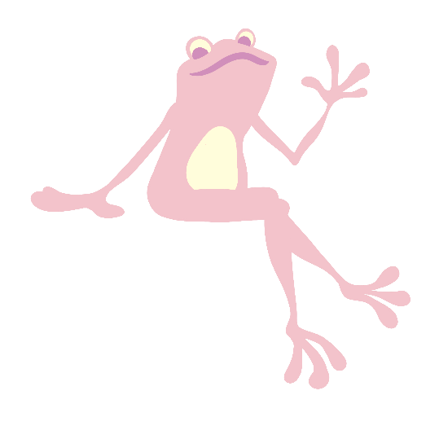
Circle time (5 mins)
Let’s sit in a circle.
Pass around a toy. When you get the toy, say one way you can be kind.
Pass around the toy again. This time, say one unkind behaviour
Pass around the toy one more time. Say who to ask for help if someone is being unkind.
Notes:
Teacher’s notes:
If there isn't enough space to sit in a circle, you can simply pass the toy around the classroom instead.
If time is limited, reduce the number of discussion points from the slide and focus on the one you think is needed the most for the class.

Slide 24
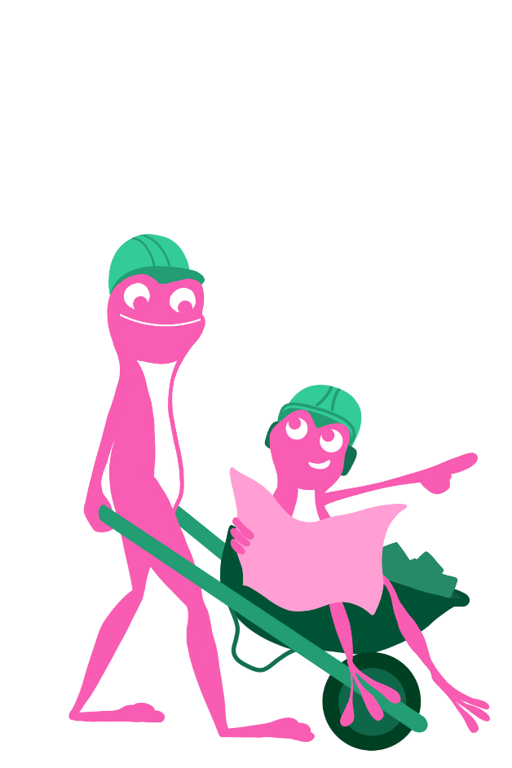



Kindness and careers (5 mins)
Kindness is really important, not just at school, but when you grow up and go to work too! In all jobs, you need to know how to be kind to other people. People don’t like working with unkind people! That’s why learning to be kind is so important.
Doctor
Teaching assistant
Builder
These roles all need to use kindness to get the job done.
Can you think of another job where being kind helps?
Notes:
Teacher’s notes:
Optional slide: Careers slides are designed to link the topics explored in PSHE to careers to allow children to see how they may get support with these issues when they begin their careers. They are also designed broaden horizons with potential future jobs they might be interested in.
You may choose to spend some time discussing how the roles on the slides need to use kindness to get their job done. See suggested discussion points below:
Doctor: they help people feel better and must be gentle and kind.
Teaching assistant: they listen carefully and help children learn.
Builders: they often work in teams and need to be kind to help each other get the job done.
Extension: How could kindness make work better?
Suggested answers:
Nurse: they help people who are hurt or sick. Kindness helps people feel safe and cared for.
Teacher: they help children learn. Kind teachers make school a happy place.
Chef: they give out food and make sure everyone is fed. Being kind makes lunchtime nice for everyone.
Police officer: they keep people safe. Kindness helps them listen and help others.
Firefighter: they rescue people. Being kind helps people feel calm and not scared.
Shop worker: they help customers. Being kind makes shopping a better experience.
Vet: they care for poorly animals. Being kind helps animals (and owners) feel better.

Slide 25





Where can I find out more or get support?
Childline: 0800 1111 (Free, 24/7)
Kidscape: kidscape.org.uk/i-am-a-young-person
BBC Bitesize: bbc.co.uk/teach/articles/zm66b7h
National Bullying Helpline: nationalbullyinghelpline.co.uk/children.html
YoungMinds: youngminds.org.uk/young-person/coping-with-life/bullying/
Notes:
Teacher’s notes:
This slide has information on organisations that can offer more information or support.
You may choose to refer to these organisations if questions/issues arise during the teaching of this lesson. Remember to always follow your school’s safeguarding and confidentiality policies.
For older children, you may encourage them to visit these websites themselves.

Slide 26


