Slide 1




Teacher’s slide
Key lesson information
Recommended time | 60 minutes
Objectives | By the end of the session, children should be able to: Explain what discrimination is. List the nine protected characteristic in the UK. Explain ways of getting support for discrimination. Explain how they can challenge discrimination.
Main student tasks | Listen to the scenario and identify the behaviours shown. List the nine protected characteristics in the UK and discuss why these need to be protected. Define discrimination and decide if scenarios are showing discrimination or not. Discuss ways they can challenge discrimination and act out challenging discrimination in a calm and respectful way. In response to scenarios, decide what is being discriminated against and how they can get support. Optional: Match the careers which help to stop discrimination with their job roles.
Keywords | Discrimination, bullying, protected characteristics, age, gender reassignment, marriage, civil partnership, pregnancy, maternity leave, disability, race, religion, belief, sex, sexual orientation.
Benchmarks and standards
PSHE Association | Managing hurtful behaviour and bullying
DfE RSHE | That the internet can also be a negative place where online abuse, trolling, bullying and harassment can take place, which can have a negative impact on mental health
Skills | Caring, communication, learning, open-mindedness, principles, reading, reflectiveness, speaking.
SEND / additional needs / TA support
Our optional, editable, and printable worksheets are designed to support all children including those with additional needs. You could adapt these to suit the needs of your class, as required. For the audio scenario on slide 7, provide a printed copy of the scenario for children with hearing difficulties (transcript provided in the teacher’s notes). For children with dyslexia, provide printed copies of scenarios and coloured overlays. For those with visual impairments, provide text to voice software to read out scenarios to children.
Teacher preparation
Resources | Pencils, pens, paper, exercise books.
Print | Worksheet (optional)
Notes:
Teacher’s notes:
Our objectives are designed to be child friendly so please share these with your classes in way that suits you.
Our lessons are editable so you can adapt the slides and/or worksheet to suit the needs of your class.

Slide 2
Teacher slide – creating a safe learning environment
Why it matters:
Every PSHE topic may be sensitive or personal.
Children must feel safe, respected, and supported to fully engage.
Build a supportive environment:
Create an anonymous question box.
Be sensitive to diverse needs and experiences.
Be mindful that someone in the class might be affected by topics covered.
Use provided stories, scenarios, or clips to depersonalise discussions.
Make it clear that discrimination is never acceptable.
Share balanced, factual information.
Signpost trusted support in and out of school (relevant support organisations provided at the end of this presentation).
Establish ground rules with children, every lesson, like:
Be open, but don’t share our own personal/private lives directly (don’t use names we can identify people with).
Respect others’ views even if they might be different to ours.
Use appropriate, respectful language, and avoid slang.
Take part in activities, but you have the right to pass on questions.
Ask questions, but not questions intended to embarrass others.
No personal stories will be repeated outside of the lesson, unless we are at risk from harm.
Notes:
Teacher’s notes:
Adapt the ground rules based on your school and classroom setting.
Be careful with sharing your own personal view and remember that you are in an influential position.
Remember: Always follow school safeguarding and confidentiality policies.

Slide 3
Teacher slide – discrimination guidance
Discrimination is a serious issue faced by people all over the world. It means treating someone unfairly because of who they are or because they belong to a certain group. Discrimination can have deep and lasting effects on a person’s mental health, self-esteem, and sense of safety and belonging, especially for young people.
Discrimination can happen in many ways. It might be direct, like calling someone names because of their religion or refusing to include someone because of their race. It might also be indirect, like having school rules or systems that unfairly disadvantage certain groups, even if not done on purpose. Discrimination can also take the form of microaggressions. These are subtle, often unintentional comments or actions that reinforce stereotypes or make someone feel unwelcome.
Discrimination can happen in person or online. It can occur between pupils, but it can also happen between pupils and adults. It can happen anywhere: in classrooms, on the playground, during clubs or trips, and on social media. Importantly, young people may not always realise they are being discriminated against, which is why education and awareness are key.
Some groups of young people are more likely to experience discrimination than others. These may include people of colour, LGBTQ+ people, people with disabilities, religious minorities, people from immigrant backgrounds, people with English as an additional language, and people from low-income households. No person should ever feel that they are being treated as ‘less than’ because of who they are.
Discrimination is against the law. In the UK, the Equality Act 2010 protects individuals from discrimination, harassment and victimisation based on protected characteristics. These include age, gender reassignment, marriage/civil partnership, pregnancy/maternity leave, disability, race, religion/belief, sex, or sexual orientation.
Schools are legally required to prevent discrimination and promote equality. Every maintained school and academy trust must comply with the Public Sector Equality Duty, which means they must actively work to eliminate unlawful discrimination and foster good relations among all pupils. Many schools have their own equality, diversity, and inclusion (EDI) policies alongside anti-bullying policies.
Educators should remind children that they have the right to feel safe, included, and respected at school. If a pupil feels that they or someone else is being discriminated against, they should be encouraged to speak up. This could be to a trusted adult, a teacher, or via a school reporting system. Schools must take these concerns seriously, follow procedures to investigate and respond appropriately.
Notes:
Teacher’s notes:
This slide contains key facts and statistics about the theme of the lesson. These are not designed to be shared with children.

Slide 4
Teacher slide – FAQs
Is discrimination the same as bullying?
They can be similar, but they’re not always the same. Discrimination is when someone is treated unfairly because of a part of their identity. Bullying is when someone is being unkind many times on purpose. Someone can be bullied through discrimination.
What should I do if I see someone being treated unfairly?
Tell a trusted adult, like a teacher, straight away. You don’t have to handle it alone. Even if the person doesn’t want help, it’s still right to speak up.
Who discriminates against others?
Children can say or do things that are unfair. Sometimes they don’t realise it, but it still needs to stop. Adults should set a good example, but some adults can also discriminate. If an adult makes you feel uncomfortable or left out, speak to another trusted adult.
What if someone says something is ‘just a joke’?
If it hurts someone or makes them feel small or left out, then it’s not a joke. Even if someone laughs, it can still be unkind. You can speak up or get help from an adult.
Can people change if they’ve said something discriminatory?
Yes. Sometimes people say or do things without thinking. They can learn, understand, and do better with help. Telling an adult gives everyone a chance to make things right.
Is it wrong to speak up for myself or someone else?
No, it’s brave and the right thing to do. Standing up to discrimination helps make your school a kinder and fairer place for everyone.
What if people are unkind to me because I’m different?
Everyone should be treated with respect, no matter who they are. If someone is mean because of how you look, speak, feel, or who you are, tell a trusted adult. It’s never okay, and you deserve to be safe. In the UK, there are ‘protected characteristics’. This means it’s illegal to discriminate against someone because of their age, gender reassignment, marriage/civil partnership, pregnancy/maternity leave, disability, race, religion/belief, sex, or sexual orientation.
Notes:
Teacher’s notes:
This slide contains model answers to questions that children might ask about the theme of the lesson.

Slide 5

What is discrimination?

Slide 6
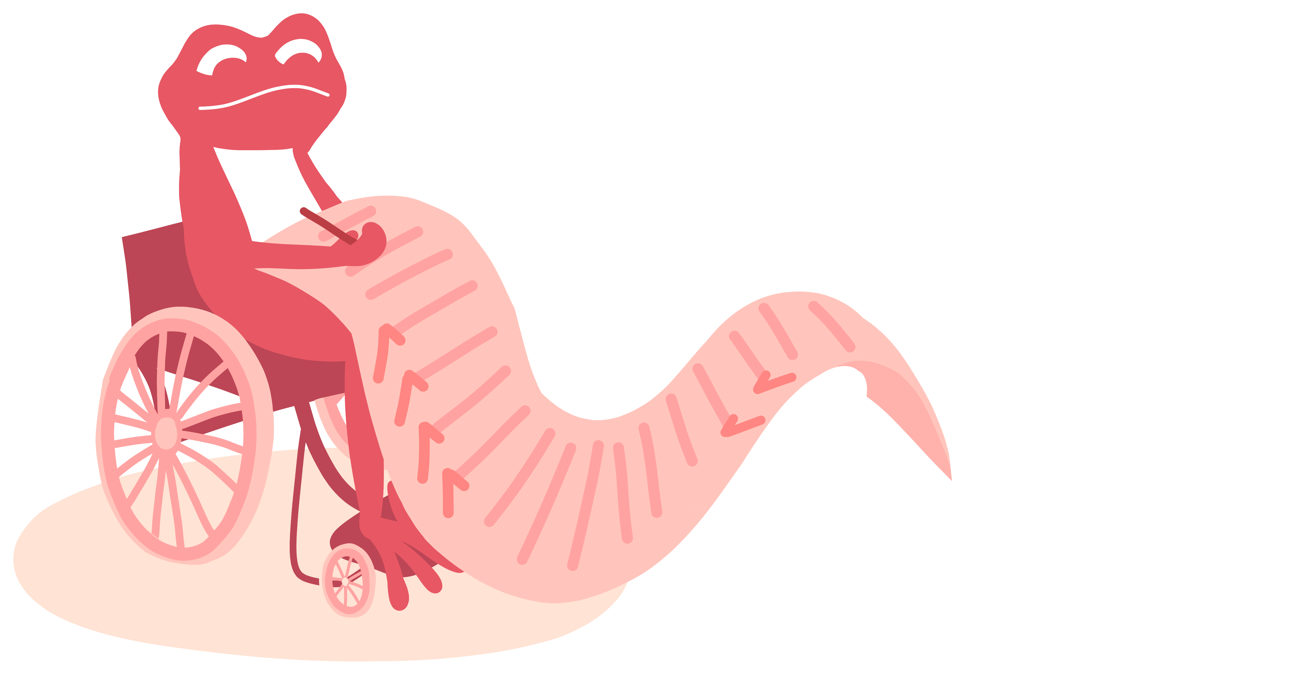
Ground rules (5 mins)
Let’s create some ground rules for our lesson.
_________________________________________
_________________________________________
_________________________________________
_________________________________________
_________________________________________
Notes:
Teacher’s notes:
At the start of the lesson, agree on some ground rules as a class. Some suggestions are provided on the ‘creating a safe learning environment’ teacher slide.
If you’re using a question box in your class, let children know that it’s available during and after the lesson. Explain that if anyone has a question or worry they don’t feel comfortable sharing out loud, they can write or draw it on a piece of paper, with their name or anonymously, and place it in the box. This way, everyone has a safe way to share their thoughts.

Slide 7
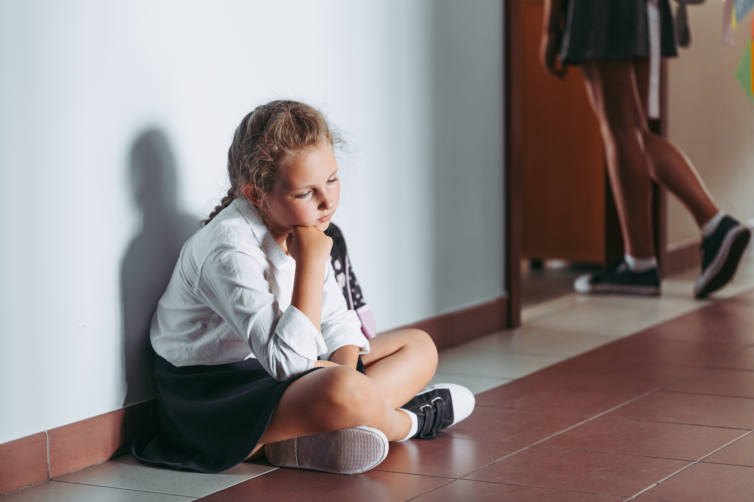

Unkind behaviour (10 mins)
Listen to the scenario about Quinn.
Which of the behaviours listed below are happening in the scenario?
Bullying Cyberbullying Sharing
Catfishing Harassment Helping
Notes:
Teacher’s notes:
Click on the speaker symbol to listen to the scenario, or read the transcript below.
Transcript:
School’s been really hard lately. Children in my class keep bumping into me on purpose and laughing when I fall. Last week, some person even pushed me into a wall.
Online, it’s even worse. I’ve been messaging someone, who I thought were my friend, but now they’re sending me mean messages and sharing things I told them not to. I actually found out it’s one of the children at my school pretending to be someone else. I feel trapped, like I can’t escape, scared to tell anyone in case it gets worse.
Suggested answers:
Bullying: Quinn is being hurt and laughed at repeatedly in person.
Cyberbullying: mean messages and catfishing online.
Catfishing: someone pretended to be a friend, but wasn’t who they said they were.
Harassment: Quinn is feeling scared by the behaviours.

Slide 8


Unkind behaviour
What is the impact of these behaviours on Quinn?
How can Quinn get help?
Notes:
Teacher’s notes:
Suggested answers:
1. What is the impact?
Quinn feels trapped and unsafe at school and online.
Quinn feels scared, worried, and possibly alone.
Quinn’s mental health and confidence may be affected.
Quinn feels like they can’t speak up or trust anyone.
2. How can Quinn get support?
Speak to a trusted adult, like a teacher, parent or carer, teaching assistant, or family member.
Block the person being unkind online.
Screenshot any evidence.
Report the unkind behaviour using the report button on the social media platform being used.

Slide 9
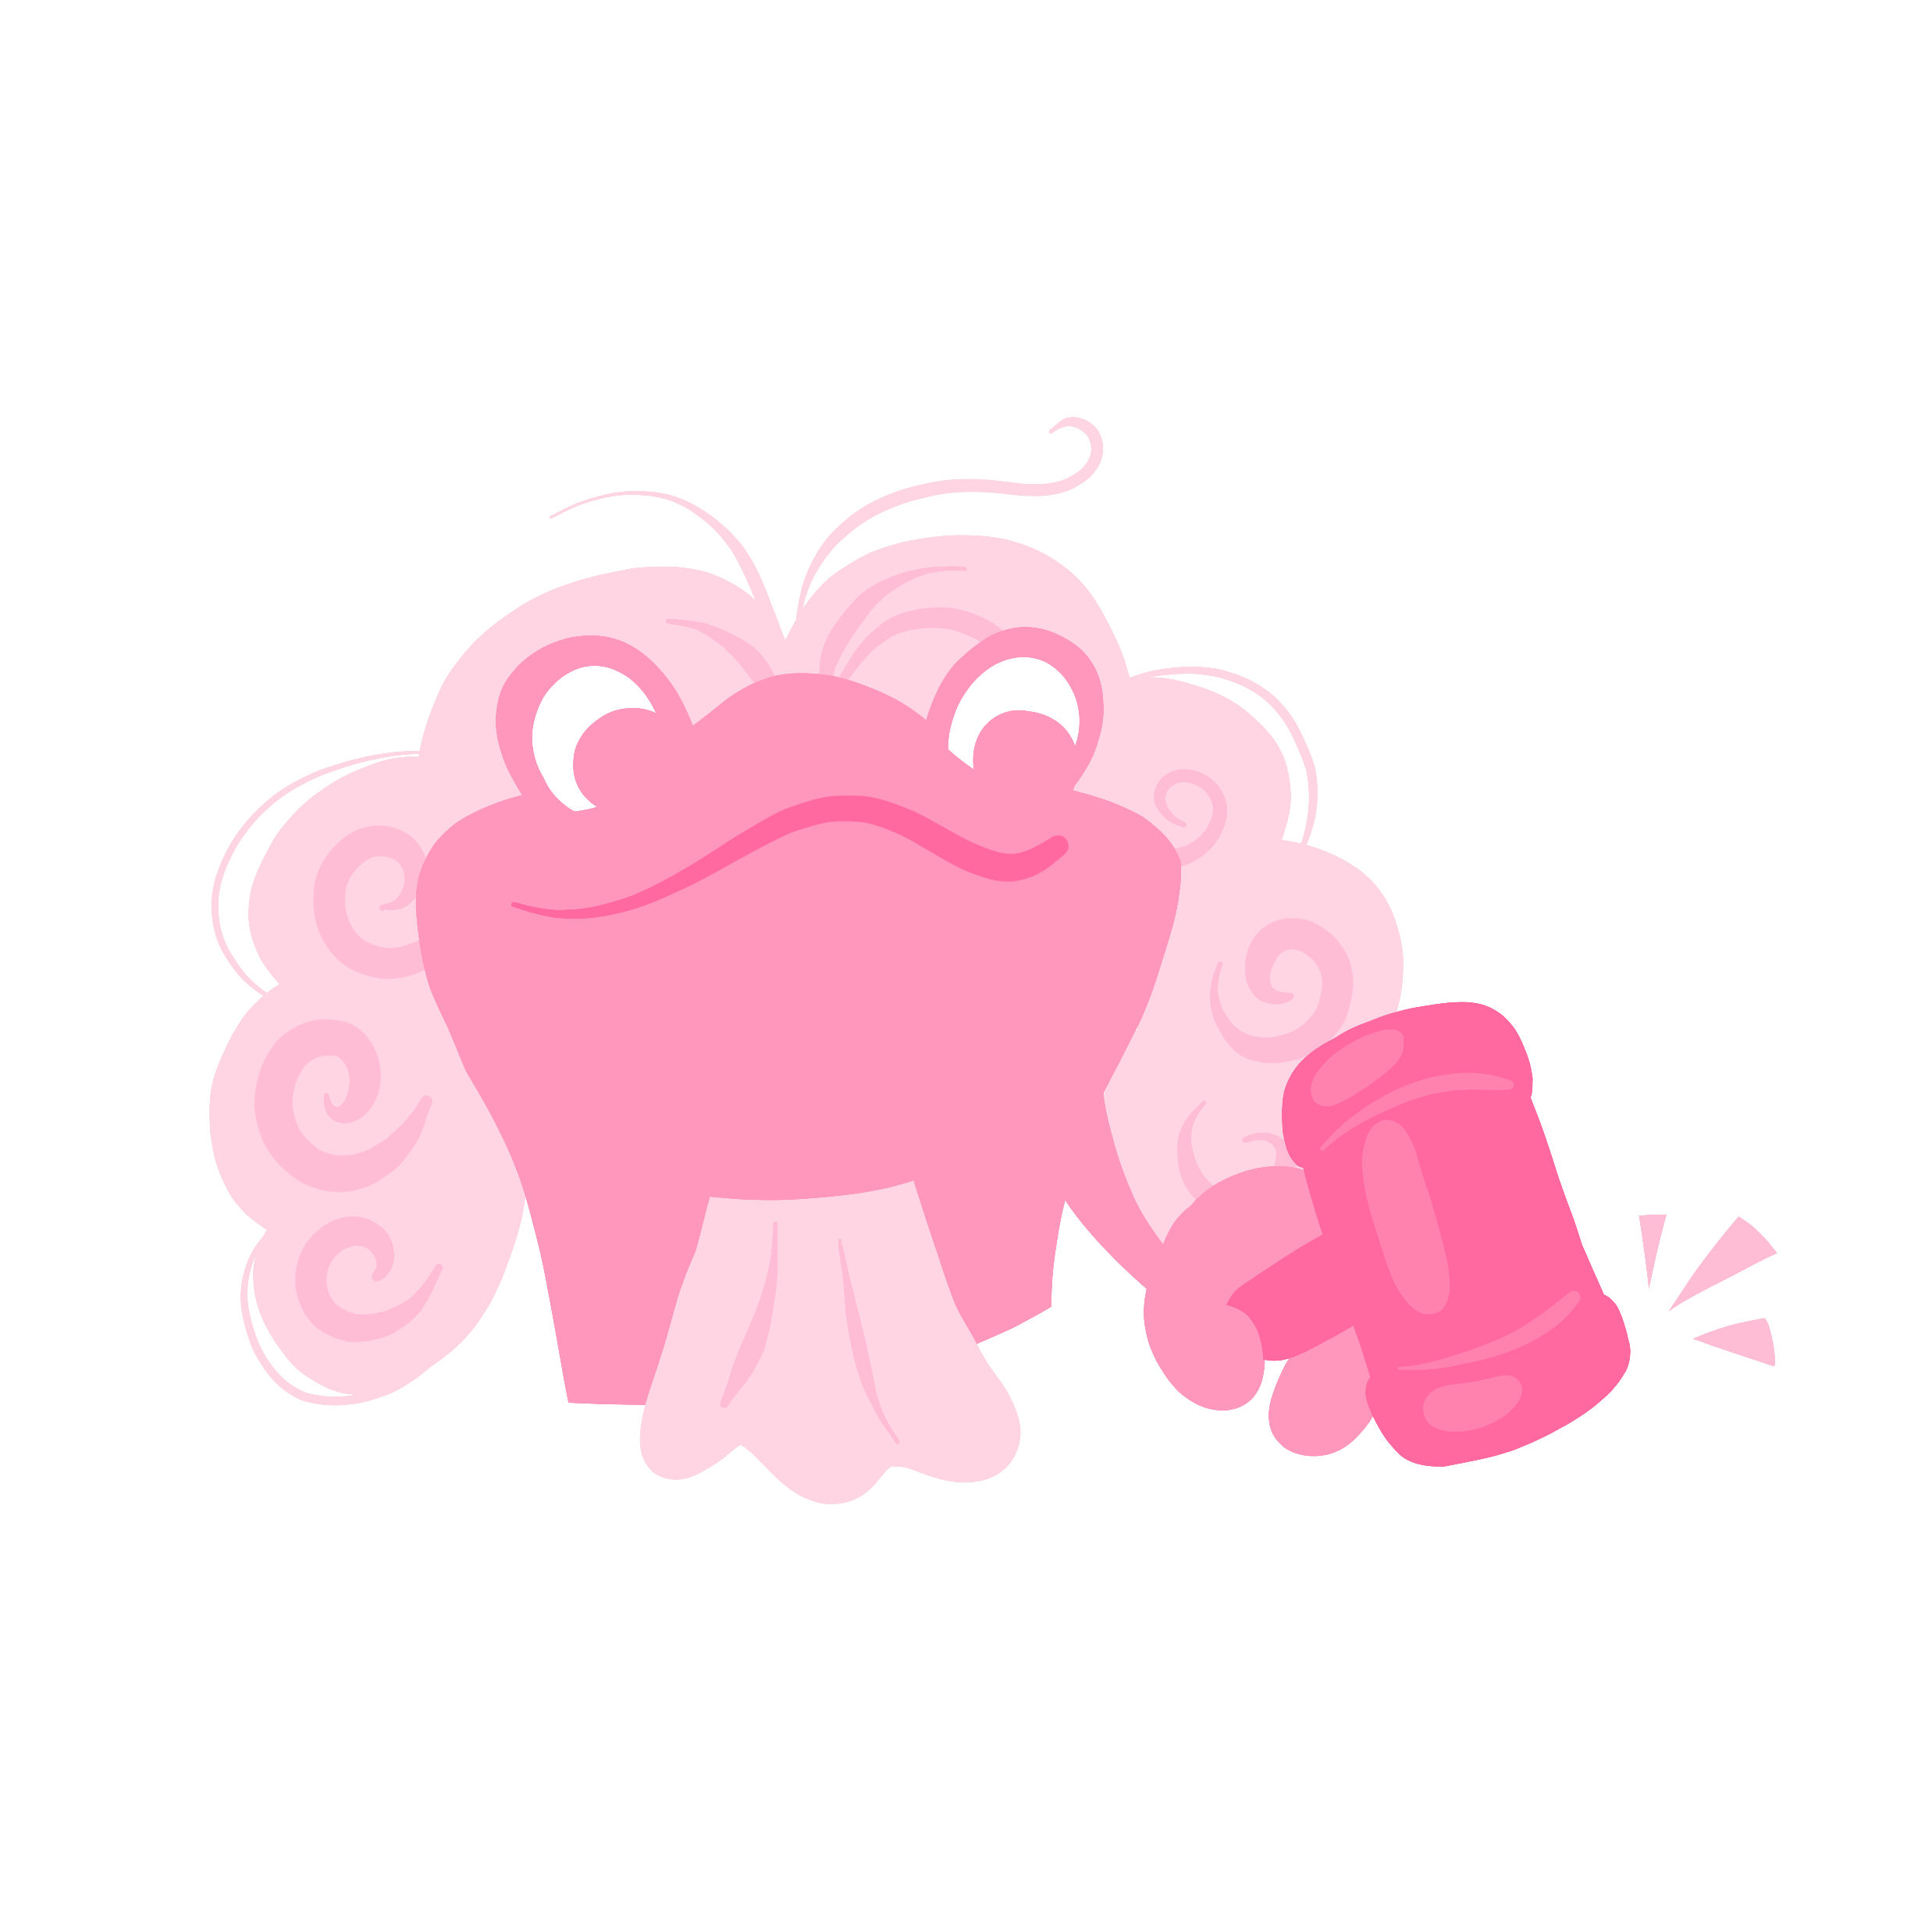
What are protected characteristics? (10 mins)
In the UK, there are laws to help protect people from being treated unfairly. These laws say that no one should be bullied or treated badly because of certain things about them. These are called protected characteristics.
List the nine protected characteristics.
Notes:
Teacher’s notes:
You may choose to provide examples of some of the protected characteristics to help get children started (listed below).
Vocabulary:
Gender: whether someone feels like a boy, a girl, both, or neither.
Sex: whether someone is born male or female based on their body parts and biology.
Suggested answers:
Age: how old someone is.
Disability: when someone has a condition or difference that makes some activities harder for them than for other people like vision or hearing difficulties, an illness, a health difficulty like asthma, or physical mobility difficulties.
Gender reassignment: when someone lives as a different gender from the sex they were given at birth.
Marriage: when two people make a legal and loving commitment to share their lives, which includes sharing vows.
Civil partnership: a legal way for two people to show they are in a committed relationship, like marriage, but does not have to include any sharing of vows.
Pregnancy and maternity: if someone is having a baby or has recently had one.
Race: a person’s skin colour, nationality, or where their family comes from.
Religion or belief: what someone believes in (like a religion or no religion at all).
Sex: whether someone is male or female based on their body parts and biology.
Sexual orientation: who someone loves or has feelings for (like males, females, or both).

Slide 10
What are protected characteristics?
List the nine protected characteristics.
Age
Marriage and
civil partnership
Religion or belief
Disability
Pregnancy and maternity
Sex
Gender reassignment
Race
Sexual orientation
Notes:
Teacher’s notes:
You could adapt this slide based on the protected characteristics your school has chosen to teach about at the age group you are teaching to.
Vocabulary:
Gender: whether someone feels like a boy, a girl, both, or neither.
Sex: whether someone is born male or female based on their body parts and biology.
Suggested answers:
Age: how old someone is.
Disability: when someone has a condition or difference that makes some activities harder for them than for other people like vision or hearing difficulties, an illness, a health difficulty like asthma, or physical mobility difficulties.
Gender reassignment: when someone lives as a different gender from the sex they were given at birth.
Marriage: when two people make a legal and loving commitment to share their lives, which includes sharing vows.
Civil partnership: a legal way for two people to show they are in a committed relationship, like marriage, but does not have to include any sharing of vows.
Pregnancy and maternity: if someone is having a baby or has recently had one.
Race: a person’s skin colour, nationality, or where their family comes from.
Religion or belief: what someone believes in (like a religion or no religion at all).
Sex: whether someone is male or female based on their body parts and biology.
Sexual orientation: who someone loves or has feelings for (like males, females, or both).

Slide 11

What are protected characteristics?
As a class, discuss why you think we have laws to protect people from being treated unfairly.
Notes:
Teacher’s notes:
Suggested answers:
To make sure everyone is treated fairly and with respect.
To help people feel safe at school, work, and in the community.
To stop people from being bullied or excluded because of who they are.
To celebrate differences and make sure everyone can be themselves.
To make sure everyone has the same opportunities to learn, be happy, and succeed.
To create a community where people feel valued and included.
To prevent unfair rules or actions that hurt certain people.
Because everyone deserves to live without fear of discrimination or unfair treatment.

Slide 12

What is discrimination? (15 mins)
Discrimination means treating someone unfairly because of who they are. This could be because of a protected characteristic, or for other reasons, like the way someone speaks, how they look, the way they dress, or how they act.
Discrimination is never okay as everyone deserves to be treated with respect and kindness.
On the next slide, decide whether the statements are examples of discrimination.
Notes:
Teacher’s notes:
Activity follows on the next slide.

Slide 13

What is discrimination?
In pairs, discuss whether the statements are examples of discrimination or not, and why you think that.
A teacher praises a student who worked hard. IS NOT
A woman is told she doesn’t get the job she applied for because she is pregnant. IS
Someone is excluded from a game because of the colour of their skin. IS
A person is paid less for doing their job because they are a woman. IS
A student is bullied online because they have two mums. IS
A teacher praises a student who worked hard.
A woman is told she doesn’t get the job she applied for because she is pregnant.
Someone is excluded from a game because of the colour of their skin.
A person is paid less for doing their job because they are a woman.
A student is bullied online because they have two mums.
This IS discrimination because… This IS NOT discrimination because…
Notes:
Teacher’s notes:
For scenario 5, make it clear that discrimination can also be about people connected to the person like parents or carers.
Suggested answers: (click to reveal)
Not discrimination because no one is being unfairly treated.
Discrimination because she is being treated unfairly because her sex is female.
Discrimination because they are being treated unfairly because of the colour of their skin.
Discrimination because she is being treated unfairly because her sex is female.
Discrimination because they are being treated unfairly because of the sexual orientation of their parents.

Slide 14
What is discrimination?
In pairs, discuss whether the statements are examples of discrimination or not, and why you think that.
A classmate helps translate for a new student who speaks little English. IS NOT
A school trip doesn’t allow children with allergies to come. IS
A child is laughed at because they speak a different language. IS
A man is told he is too old to apply for the job. IS
Someone is told their parents are strange as they aren’t married. IS
A classmate helps translate for a new student who speaks little English.
A school trip doesn’t allow children with allergies to come.
A child is laughed at because they speak a different language.
A man is told he is too old to apply for the job.
Someone is told their parents are strange as they aren’t married.
This IS discrimination because… This IS NOT discrimination because…
Notes:
Teacher’s notes:
For scenario 10, make it clear that discrimination can also be about people connected to the person like parents or carers.
Suggested answers: (click to reveal)
Not discrimination because no one is being unfairly treated.
Discrimination because they are being treated unfairly because they have allergies.
Discrimination because they are being treated unfairly because of the language they speak.
Discrimination because he is being treated unfairly because of his age.
Discrimination because they are being treated unfairly because their parents aren’t married.

Slide 15

What is discrimination?
In pairs, discuss whether the statements are examples of discrimination or not, and why you think that.
A boy is told he can't become a singer because he's not a girl.
A transgender girl is told she must wear boys’ uniform by her school.
A boy with a visual impairment is told by another child that it isn’t fair that he always gets to sit near the front of the class.
Someone who is deaf is told they can’t join in the game.
A boy is told he can't become a singer because he's not a girl. IS
A transgender girl is told she must wear boys’ uniform by her school. IS
A boy with a visual impairment is told by another child that it isn’t fair that he always gets to sit near the front of the class. IS
Someone who is deaf is told they can’t join in the game. IS
This IS discrimination because… This IS NOT discrimination because…
Notes:
Teacher’s notes:
Vocabulary:
Transgender: someone who feels a different gender from the one they were given at birth.
Deaf: someone who finds it more difficult to hear compared to others or can’t hear at all.
Suggested answers: (click to reveal)
Discrimination because he is being treated unfairly because his sex is male.
Discrimination because she are being treated unfairly because of her gender reassignment.
Discrimination because he is being treated unfairly because he is visually impaired. Extra accommodations should be made for people with disabilities.
Discrimination because they are being treated unfairly because they are deaf.

Slide 16
Challenging discrimination (10 mins)
It’s important to challenge discrimination. This can be done by:
Explaining to people that they are discriminating against someone.
Challenging our own discrimination of people by being willing to learn about them.
Challenging discrimination can sometimes be a difficult topic for people to talk about.
We need to tackle this in a calm and respectful way. How can we do this?
Notes:
Teacher’s notes:
Suggested answers:
We can do this by:
Explaining to people that they are discriminating if we see it.
Challenging our own thoughts by being willing to learn about different groups of people.
Other ways you can challenge discrimination are:
Including others: invite people to join in games or activities, especially if they seem left out.
Asking questions: if you don’t understand something about someone’s difference, ask politely and listen carefully.
Telling an adult: if you see bullying or discrimination, tell a teacher or trusted grown-up so they can help.
Being a good friend: support others by standing with them and showing you care.
Learning about differences: read books or watch videos that help you understand different people’s lives and experiences.
Using respectful language: always use people’s correct names and pronouns, and avoid words that might hurt feelings.
Remember fairness: treat everyone as you would want to be treated, with kindness and respect.

Slide 17


Challenging discrimination
Read the scenario and, in pairs, complete both role play tasks.
A new boy called Seth has started at school and wears clothes that show his religious beliefs. Luthien tells Sara that he doesn’t want to play with Seth at lunchtime as his clothes look different.
Act out how Sara could challenge Luthien’s discrimination in a calm and respectful way.
Act out how Luthien could challenge his own thinking in a calm and respectful way.
Notes:
Teacher’s notes:
Suggested answers:
What could Sara say?
Sara could calmly explain to Luthien that just because someone looks or dresses differently, it doesn’t mean they’re not kind or fun to be around. She could suggest that Luthien gives Seth a chance, as he might turn out to be a great friend.
What could Luthien challenge his own thinking?
Luthien could remind himself that someone’s clothes or beliefs don’t define who they are. He might think about how it would feel if someone judged him unfairly. By keeping an open mind and getting to know Seth, he could find they have things in common and enjoy spending time together.

Slide 18


Is it discrimination? (5 mins)
Read the scenarios and answer the questions.
Tyler needs support with reading and uses a coloured overlay to help. Another student tells him he doesn’t need to use it and hides it from him.
Is it discrimination?
What is being discriminated against?
How can Tyler get support?
Notes:
Teacher’s notes:
Suggested answers:
Is it discrimination? Yes
What is being discriminated against? Disability (learning difficulty)
How can they get support ?
Speak to the SENCO/SENDCO or class teacher
Ask for help from a parent or carer
Get support from friends

Slide 19
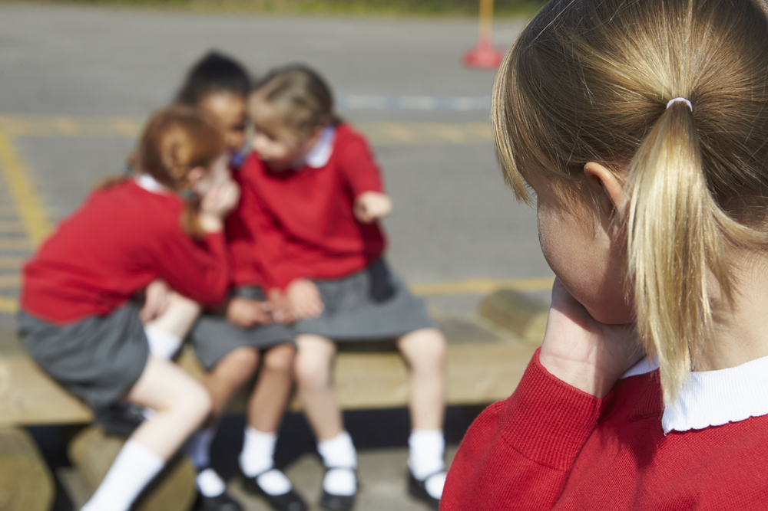
Is it discrimination?
Read the scenarios and answer the questions.
Angelica says she doesn’t follow any religion. At lunchtime, some children say she’s “wrong” and that she must believe in something. They stop including her in their conversations.
Is it discrimination?
What is being discriminated against?
How can Angelica get support?
Notes:
Teacher’s notes:
Suggested answers:
Is it discrimination? Yes
What is being discriminated against? Religion or belief
How can they get support?
Speak to a teacher or trusted adult
Ask for help from a parent or carer
Use class discussions or circle time to remind everyone that people have different beliefs, and some have none, and that’s OK

Slide 20

Careers and discrimination (5 mins)
These jobs help to stop discrimination.
Match the job to the way they help to challenge discrimination.
A) Human rights lawyer
1) Investigates hate crimes or unfair treatment and makes sure people who break the law are held responsible.
B) Equality and diversity officer
2) Helps people who have been treated unfairly take legal action and fights for their rights in court.
C) Police officer
3) Makes sure everyone is treated fairly at work, writes policies to stop discrimination, and gives training to staff.
Notes:
Teacher’s notes:
Optional slide: Careers slides are designed to link the topics explored in PSHE to careers to allow children to see how they may get support with these issues when they begin their careers. They are also designed broaden horizons with potential future jobs they might be interested in.
Answers revealed on next slide.
Answers:
A) Human rights lawyer: 2) Helps people who have been treated unfairly take legal action and fights for their rights in court.
B) Equality and diversity officer: 3) Makes sure everyone is treated fairly at work, writes policies to stop discrimination, and gives training to staff.
C) Police officer: 1) Investigates hate crimes or unfair treatment and makes sure people who break the law are held responsible.

Slide 21
Careers and discrimination
These jobs help to stop discrimination.
Match the job to the way they help to challenge discrimination.
A) Human rights lawyer
2) Helps people who have been treated unfairly take legal action and fights for their rights in court.
B) Equality and diversity officer
3) Makes sure everyone is treated fairly at work, writes policies to stop discrimination, and gives training to staff.
C) Police officer
1) Investigates hate crimes or unfair treatment and makes sure people who break the law are held responsible.
Notes:
Teacher’s notes:
Answers:
A) Human rights lawyer: 2) Helps people who have been treated unfairly take legal action and fights for their rights in court.
B) Equality and diversity officer: 3) Makes sure everyone is treated fairly at work, writes policies to stop discrimination, and gives training to staff.
C) Police officer: 1) Investigates hate crimes or unfair treatment and makes sure people who break the law are held responsible.

Slide 22




Where can I find out more or get support?
Childline: 0800 1111 (Free, 24/7)
Stonewall: stonewall.org.uk/young-futures
Kick It Out: kickitout.org
BBC Bitesize: https://www.bbc.co.uk/bitesize/articles/z8yjdp3
Notes:
Teacher’s notes:
This slide has information on organisations that can offer more information or support.
You may choose to refer to these organisations if questions/issues arise during the teaching of this lesson. Remember to always follow your school’s safeguarding and confidentiality policies.
For older children, you may encourage them to visit these websites themselves.

Slide 23


