Slide 1




Teacher’s slide
Key lesson information
Recommended time | 30 minutes
Objectives | By the end of the session, children should be able to: define harmful work identify harmful work in practice identify how to reduce harmful work
Main student tasks | Decide which screenshot is a more trustworthy source. Learn what harmful work is and answer questions about harmful work within a story. Look at the images and decide whether harmful work is happening. Complete the harmful work quiz.
Keywords | Trusted sources, harmful work, physically, mentally, the environment, tree surgeon, protective equipment, marine protected area.
Benchmarks and standards
Gatsby Benchmarks | 4. Linking curriculum learning to careers
CDI Framework | See the big picture
PSHE Association | Living in the wider world
National Curriculum | Science: recognise that environments can change and that this can sometimes pose dangers for living things.
Skills | Critical thinking, reading, learning, listening, speaking, communication, caring.
SEND / additional needs / TA support
Our optional, editable, and printable worksheets are designed to support all children including those with additional needs. You could adapt these to suit the needs if your class, as required. You could print slide 3 so children have examples in front of them. You could read the scenario on slide 5 prior to the lesson ad pre-teach unfamiliar vocabulary. You could provide examples on slide 15 for children to choose from.
Teacher preparation
Resources | Pencils, pens, paper, exercise books.
Print | Worksheet (optional)
Notes:
Teacher’s notes:
Whilst Gatsby Benchmarks are designed for use with secondary schools and colleges, we’ve provided a best match for this lesson, for reference.
Our objectives are designed to be child friendly so please share these with your classes in way that suits you.
Our lessons are editable so you can adapt the slides and/or worksheet to suit the needs of your class.

Slide 2

How can we prevent harmful work?

Slide 3
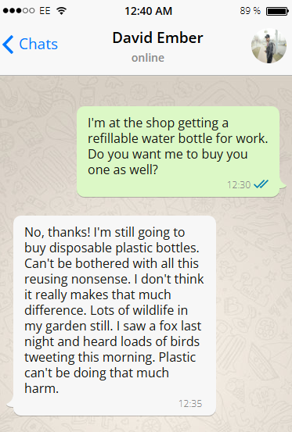
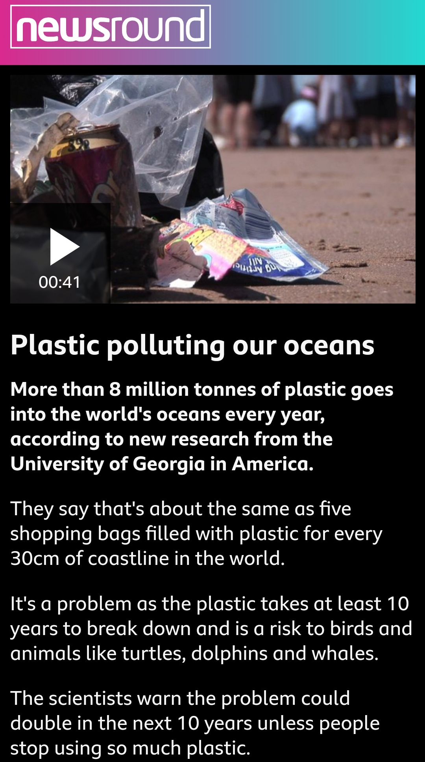
Trusted sources (5 mins)
The screenshots contain information about plastic and the environment.
Which screenshot is more likely to be a trusted source and why?
Challenge: What might happen if everyone agreed with David?
Source A
Source B
Notes:
Teacher’s notes:
Challenge: What might happen if everyone agreed with David?
Suggested answers:
The news article (source B) is more likely to be reliable. It includes statistics and references to university research, and the BBC (Newsround) are generally known as a more reliable source.
The WhatsApp message (source A) doesn’t really show any information backed up with facts and is mostly based on opinion.
Challenge: What might happen if everyone agreed with David?
Plastic pollution would increase
More waste
Could impact environment further
Could spread misinformation further

Slide 4
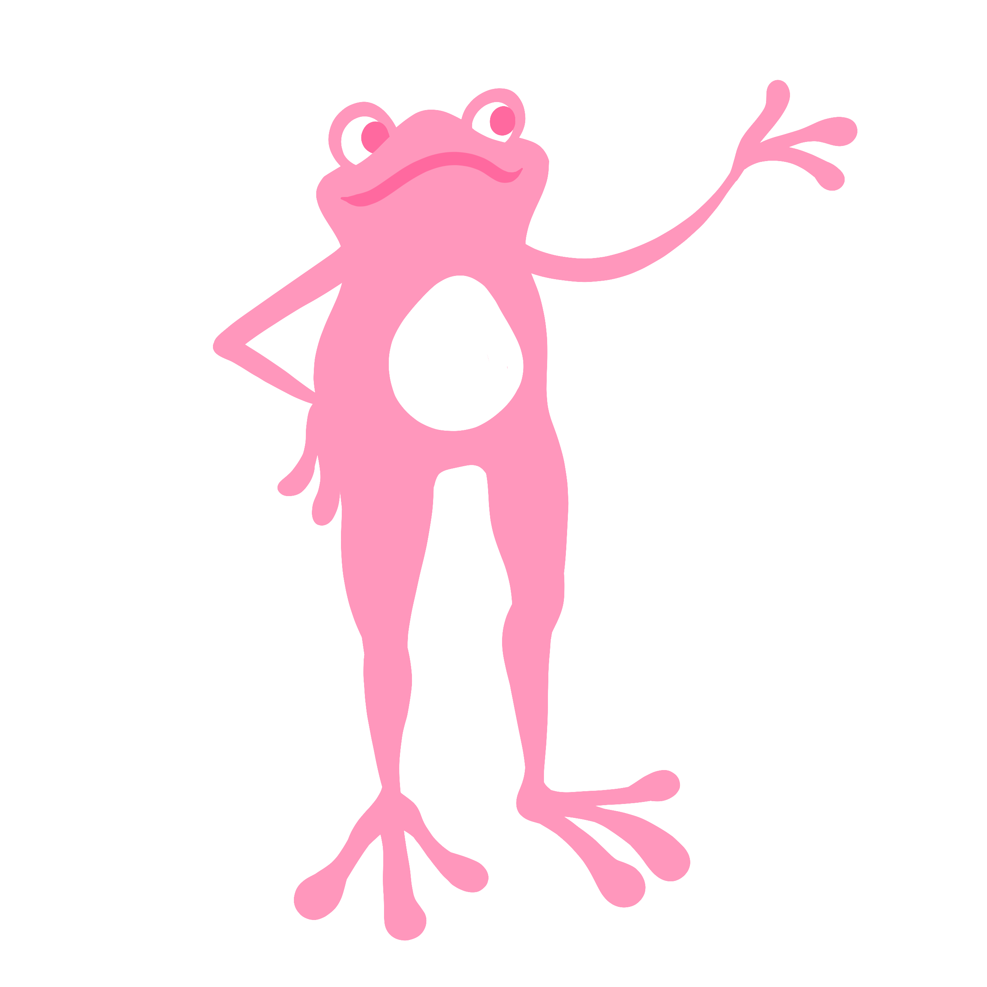




What is harmful work? (5 mins)
Harmful work:
Any work which causes harm to a person physically or mentally or causes harm to other things, including the environment.
Physically
Mentally
The environment
Listen carefully to the story about Mia on the next slide.
Think about whether any harmful work is happening in the story.
Notes:
Teacher’s notes:
Key words:
Physically: relating to the body.
Mentally: relating to the mind.
The environment: the natural world around us, made up of all living and non-living things, including the air, water, land, soil, plants, and animals.

Slide 5
What is harmful work?
Mia is a tree surgeon. This involves cutting down trees. One day, she sees a bird’s nest full of eggs in a tree she needs to cut down. She calls her boss to ask what to do, but her boss doesn’t answer their phone. Mia feels uneasy, but thinks she must do what she’s been told to do. She also forgot her eye protection and ear defenders, but she decides to cut down the tree anyway because she doesn’t want to get in trouble.
How could Mia’s work cause harm to someone physically?
How could Mia’s work cause harm to someone mentally?
How could Mia’s work cause harm to the environment?
Notes:
Teacher’s notes:
The aim of this slide is to get children to think about how work can be harmful to people, both mentally and physically, but also to the environment.
Challenge: What could Mia do to avoid harmful work?
Suggested answers:
How could Mia’s work harm someone physically?
Mia isn’t using her protective equipment so she could harm herself when cutting down the tree.
How could Mia’s work harm someone mentally?
Mia’s know it’s wrong to cut down the tree with eggs in, but she doesn’t want to get in trouble for not doing what she’s been told to do. She may feel stressed about this or become anxious. These are examples of how mental health can be harmed.
How could Mia’s work harm the environment?
If Mia cuts down the tree, the eggs will more than likely die. If the bird species is an endangered species this could have a serious impact on populations.
Challenge: What could Mia do to avoid harmful work?
Use her protective equipment.
Not cut down the tree and later explain the situation to her boss.
If she is struggling with her mental health, seek support from a doctor.

Slide 6
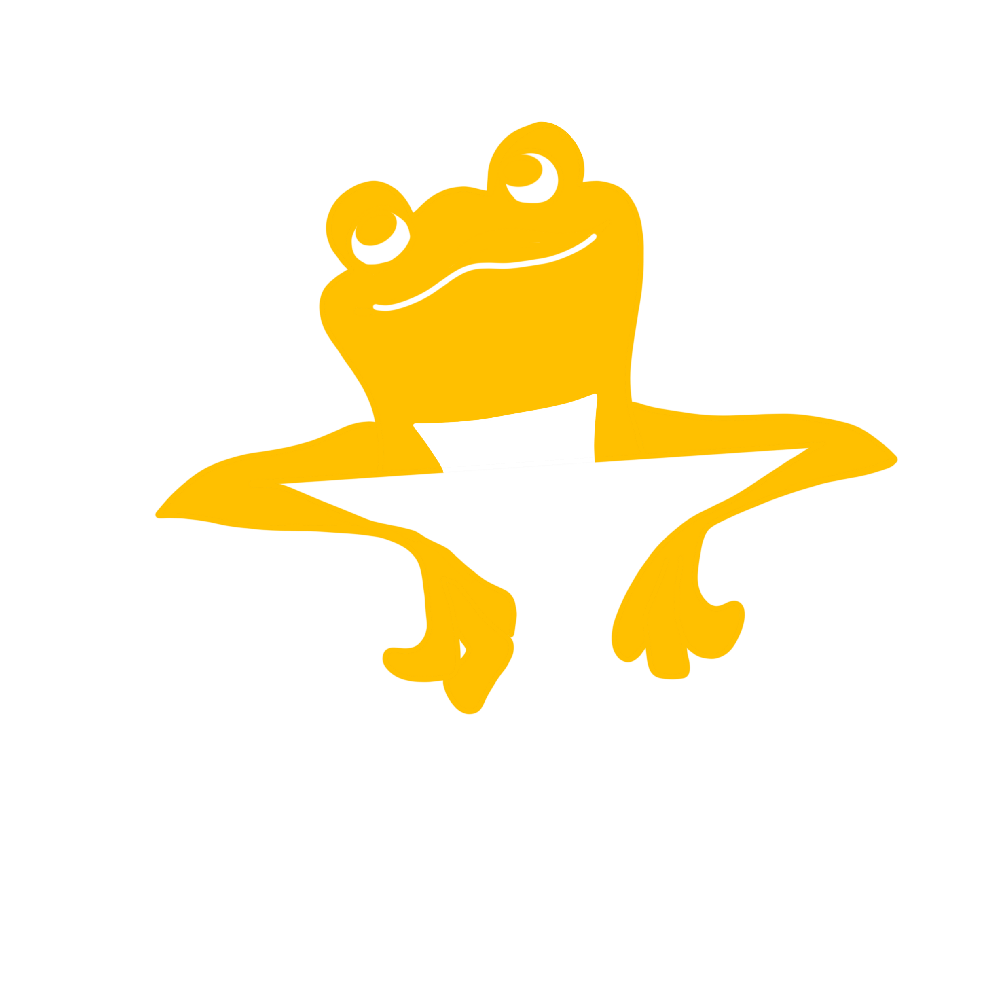


Is this harmful work? (10 mins)
Is this harmful work? If so, why do you think that?
Remember: Harmful work is work that can…
Harm someone physically.
Harm someone mentally.
Harm the environment.
Notes:
Teacher’s notes:
The image shows an office worker tripping over wires.
Click to reveal answer on the slide.
Challenge: How can we make it as safe as possible?
Suggested answers:
Yes, the wires are a tripping hazard. It could be made safe by placing wires under the desk. Cable ties could also safely tie up loose cables.

Slide 7
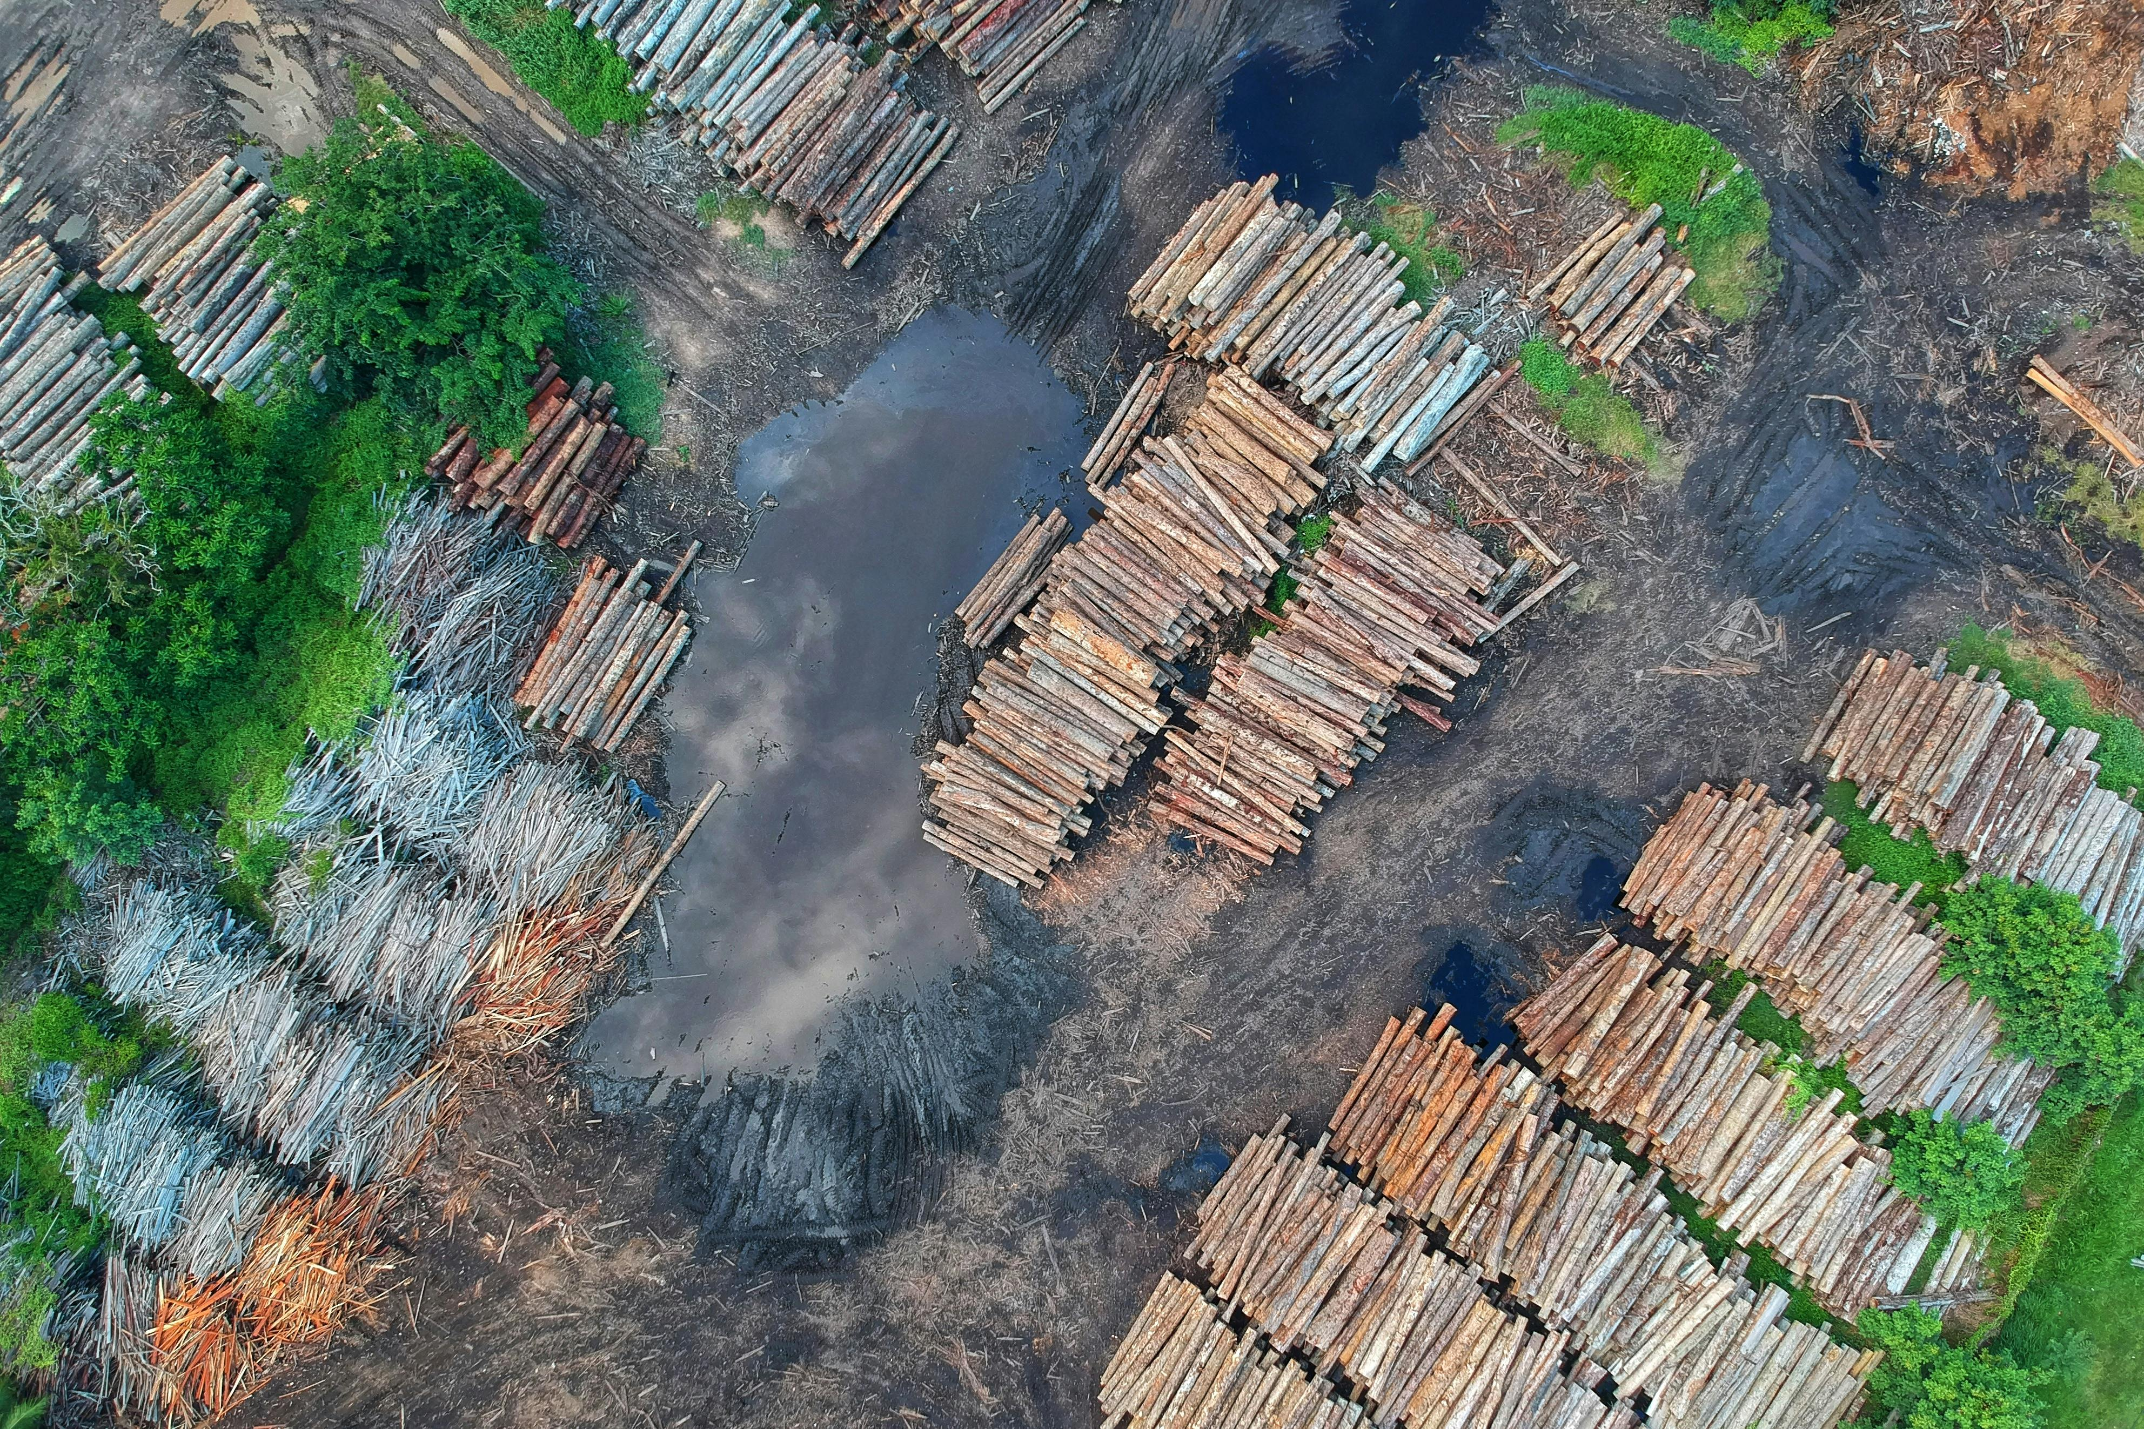
Is this harmful work?
Is this harmful work? If so, why do you think that?
Remember: Harmful work is work that can…
Harm someone physically.
Harm someone mentally.
Harm the environment.
Notes:
Teacher’s notes:
The image shows piles of wood which have been cut down by the logging industry.
Click to reveal answer on the slide.
Challenge: How can we make it as safe as possible?
Suggested answers:
Yes, it is harming the environment through deforestation. We can make it safer by recycling as much as possible or replanting trees when we cut them down.

Slide 8
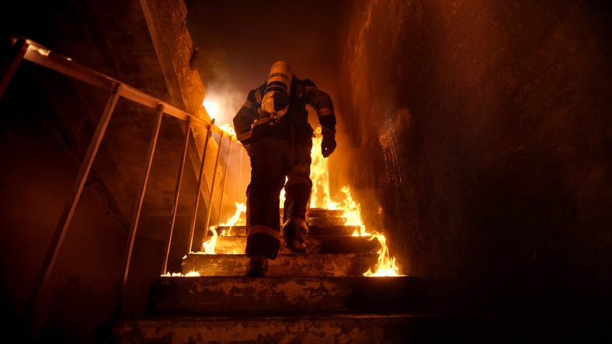
Is this harmful work?
Is this harmful work? If so, why do you think that?
Remember: Harmful work is work that can…
Harm someone physically.
Harm someone mentally.
Harm the environment.
Notes:
Teacher’s notes:
The image shows a firefighter entering house, which is on fire, to rescue someone.
Click to reveal answer on the slide.
Challenge: How can we make it as safe as possible?
Suggested answers:
Yes, firefighting is a dangerous profession. The house could collapse, and fire and smoke are harmful to physical health. This job is an essential job, but you can reduce the risks of the job through use of safety equipment like fire-resistant suits and masks to stop smoke inhalation and being trained to deal with emergency situations. The job can be stressful as it is a high-pressure environment so may lead to mental harm. They should seek medical help if feeling stressed.

Slide 9
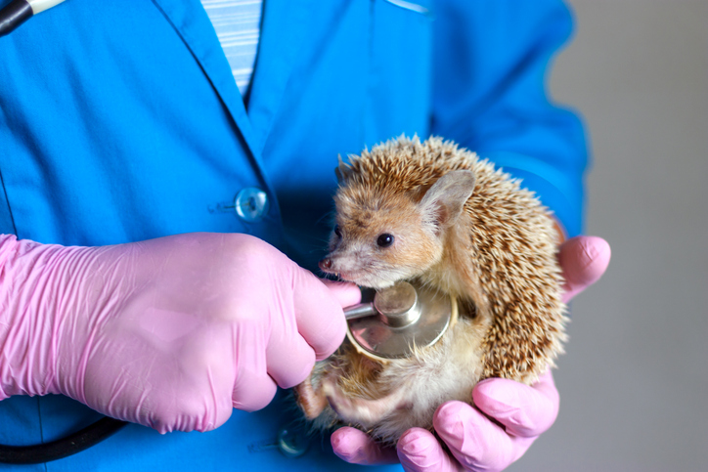
Is this harmful work?
Is this harmful work? If so, why do you think that?
Remember: Harmful work is work that can…
Harm someone physically.
Harm someone mentally.
Harm the environment.
No evidence of harmful work.
Notes:
Teacher’s notes:
The image shows a vet checking the heart rate of injured wild hedgehog.
Click to reveal answer on the slide.
Challenge: How can we make it as safe as possible?
Suggested answers:
No, the vet is treating an injured wild hedgehog and will release it back into the wild. You may discuss that organisations like RSPCA have jobs designed to help wild animals.

Slide 10
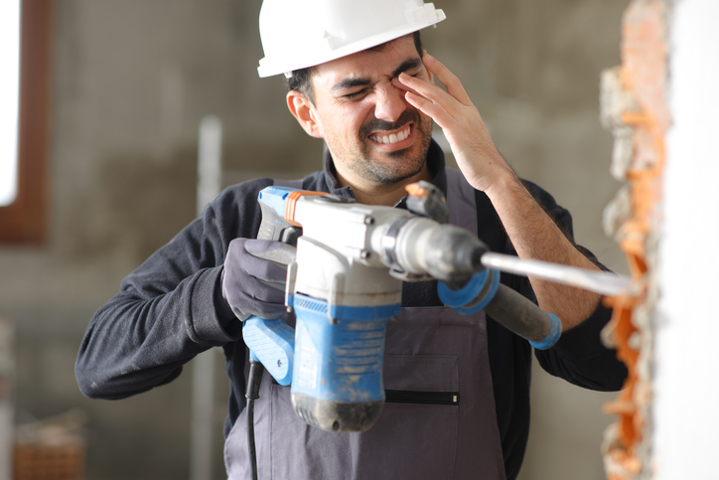
Is this harmful work?
Is this harmful work? If so, why do you think that?
Remember: Harmful work is work that can…
Harm someone physically.
Harm someone mentally.
Harm the environment.
Notes:
Teacher’s notes:
The image shows a builder drilling into brick without wearing protective goggles. Brick dust has entered his eyes.
Click to reveal answer on the slide.
Challenge: How can we make it as safe as possible?
Suggested answers:
Yes, he is using a drill without eye protection. He could put on goggles and a face mask to make it safer.

Slide 11
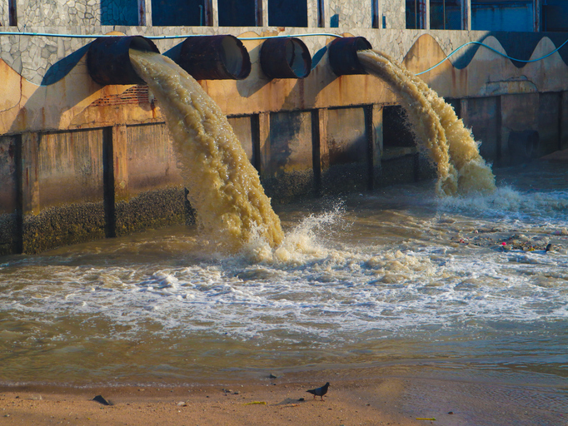
Is this harmful work?
Is this harmful work? If so, why do you think that?
Remember: Harmful work is work that can…
Harm someone physically.
Harm someone mentally.
Harm the environment.
Notes:
Teacher’s notes:
The image shows chemical waste entering the ocean from a factory.
Click to reveal answer on the slide.
Challenge: How can we make it as safe as possible?
Suggested answers:
Yes, pollution is running in the ocean. This can harm wildlife on the beach and within the sea. To make it safer, we can make sure water is properly cleaned before returning to the ocean.

Slide 12

Is this harmful work?
Is this harmful work? If so, why do you think that?
Remember: Harmful work is work that can…
Harm someone physically.
Harm someone mentally.
Harm the environment.
Notes:
Teacher’s notes:
The image shows a remote worker with hunched over posture working at his laptop. He is working beyond his work hours to meet a deadline as he has a high workload.
Click to reveal answer on the slide.
Challenge: How can we make it as safe as possible?
Suggested answers:
Yes, the office worker’s posture is bad which could lead to back damage or strain. The office worker is also looking stressed. These can lead to poor sleep and tiredness. To reduce harm, he could speak to his boss and explain that current workload is too high. He might need to take some time to speak to a doctor or take some sick days.

Slide 13
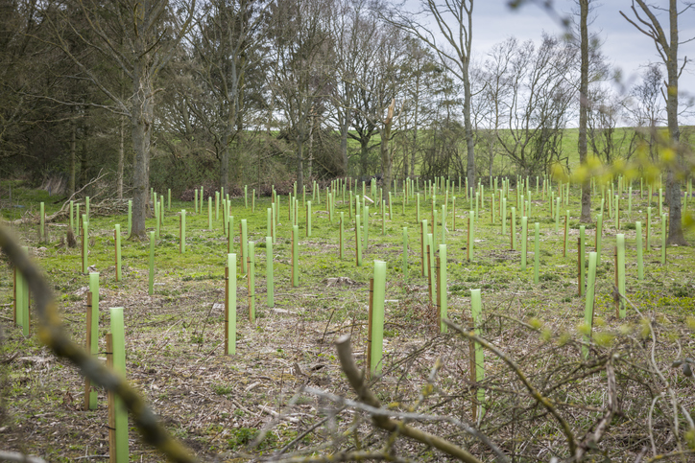
Is this harmful work?
Is this harmful work? If so, why do you think that?
Remember: Harmful work is work that can…
Harm someone physically.
Harm someone mentally.
Harm the environment.
No evidence of harmful work.
Notes:
Teacher’s notes:
The image shows new saplings planted by forestry workers in protective sleeves. This area of forest was previously cut down.
Vocabulary:
Sapling: a young tree.
Click to reveal answer on the slide.
Challenge: How can we make it as safe as possible?
Suggested answers:
No, they are protecting young trees or saplings with the green plastic protectors. You may discuss that organisations like the Woodland Trust have jobs designed to help increase woodlands and plant trees.

Slide 14
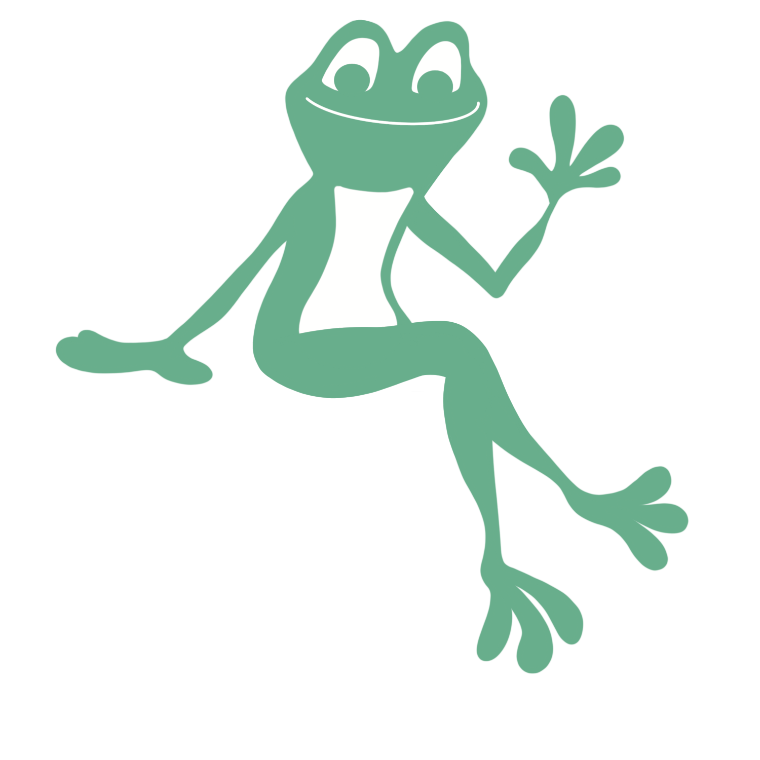
Harmful work quiz (10 mins)
1) Which of the following are examples of harmful work?
A teaching assistant stands on a chair to put up a display.
A café buys carrots from other countries instead of locally sourced ones.
A builder wears a hard hat, eye protection, and a hi-vis jacket before going to the building site.
An office worker emails their boss to ask for time off due to illness.
A fishing company catches fish in a marine protected area.
Harmful
Harmful
Not harmful
Not Harmful
Harmful
Notes:
Teacher’s notes:
Stretching task: Say whether each example is causing physical, mental, or environmental harm.
Vocabulary:
Marine protected area: areas of the ocean, seas, estuaries, or Great Lakes that are established to protect marine ecosystems, habitats, and species from human activities.

Slide 15



Harmful work quiz
2) Think of three ways we can prevent harmful work from happening.
Challenge: Think of one job that prevents harm to the environment.
Notes:
Teacher’s notes:
Suggested answers:
Use safety equipment.
Go on relevant training.
Reduce tripping hazards.
Follow the law.
Seek support from medical professionals.
Speak to your boss if ill.
Reduce unnecessary harm to the environment.
Challenge: Think of one job that prevents harm to the environment.
Jobs within the Woodland Trust.
Jobs working for the RSPCA.
Vet.
Veterinary nurse.
Police.
Jobs within recycling industry.
Vegan café workers.
Jobs within the electric car industry.
Jobs within the sustainable energy industry.

Slide 16


