Slide 1




Teacher’s slide
Key lesson information
Recommended time | 30 minutes
Objectives | By the end of the session, children should be able to: identify that jobs are shown differently in stories identify ways that technology can help people with their jobs identify that jobs in the past are different to jobs now
Main student tasks | Use the pictures to decide which of the jobs help people. Listen to Peter’s farm and identify the tools he used in his job. Listen to Julia’s farm and identify the tools she used in her job. Discuss in pairs how the farms in the stories are different. Discuss which story was set in the past and which was set in the present. Decide which farmer had the easier job.
Keywords | Farm, farmer, milk, bucket, stool, udders, sickle, scythe, wheat, basket, fruit, pump, watering can, milking machine, combine harvester, robotic harvester, irrigation system.
Benchmarks and standards
Gatsby Benchmarks | 4. Linking curriculum learning to careers
CDI Framework | See the big picture
National Curriculum | English: participate in discussion about what is read to them, taking turns and listening to what others say. History: changes within living memory. Where appropriate, these should be used to reveal aspects of change in national life.
Skills | Critical thinking, listening, speaking, communication, learning.
SEND / additional needs / TA support
Our optional, editable, and printable worksheets are designed to support all children including those with additional needs. You could adapt these to suit the needs of your class, as required. You may choose to read the stories to the class before the lesson and then again during the lesson, so the children have more familiarity with the vocabulary. On slides 9, 15, and 16 -19, you could choose to reveal the images and words to change the level of challenge for the activities. On slide 20, you could choose to take some time exploring what the past and the present is before completing the task. You could choose to delete the challenge questions on any slides which have them.
Teacher preparation
Resources | N/a - all activities are designed to be discussed.
Print | Worksheet (optional)
Notes:
Teacher’s notes:
Whilst Gatsby Benchmarks are designed for use with secondary schools and colleges, we’ve provided a best match for this lesson, for reference.
Our objectives are designed to be child friendly so please share these with your classes in way that suits you.
Our lessons are editable so you can adapt the slides and/or worksheet to suit the needs of your class.

Slide 2

How are jobs in the past different to now?

Slide 3

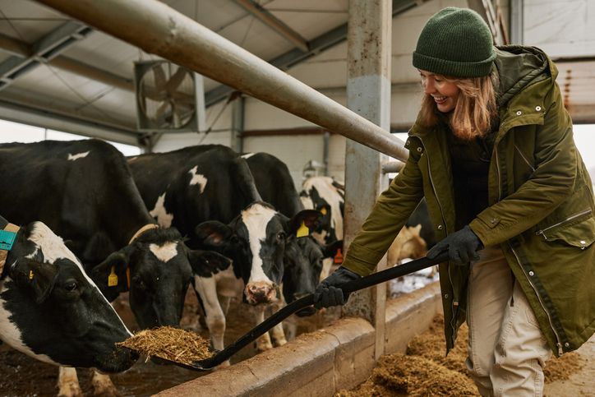
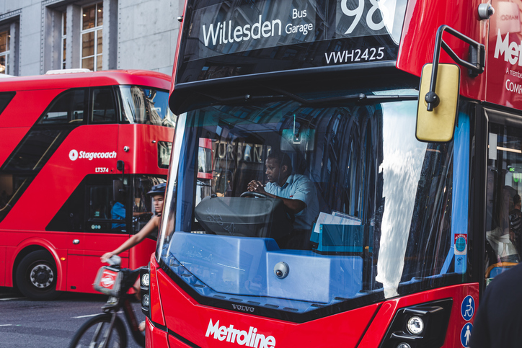
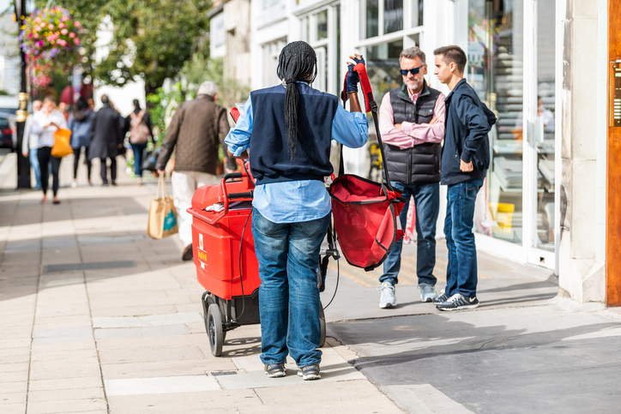
Jobs that help people (5 mins)
Which of these jobs help people?
Farmer
Bus driver
Postal worker
Challenge: How does each job help people?
Notes:
Teacher’s notes:
Suggested answers:
Farmer: grows food which people eat.
Bus driver: drives people to places they need to go.
Postal worker: delivers letters and parcels to people.

Slide 4


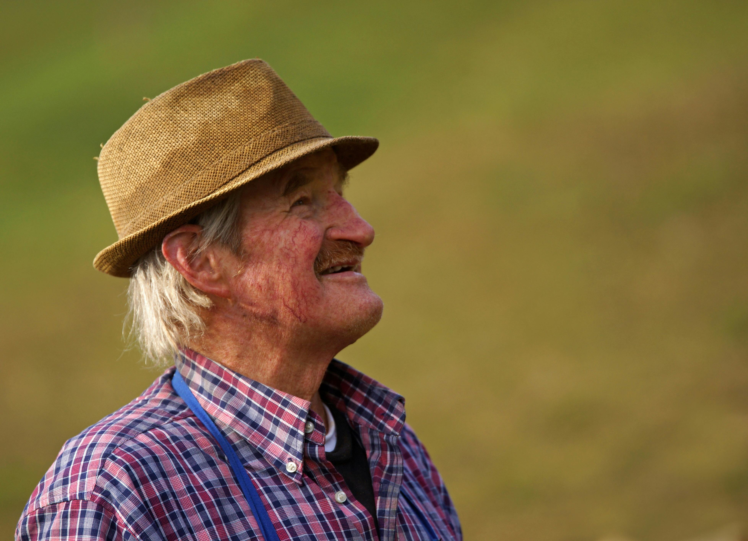
Jobs within stories (10 mins)
Listen to the story.
Farmer Peter
Peter had been a farmer for many years.
He woke up when the sun rose, ready to get the jobs done.
He grabbed his straw hat, put on his overalls, and went to work.
Notes:
Teacher’s notes:
The farm in this story uses farming equipment from the past. Whilst reading, encourage children to perform actions for each farming job.
Vocabulary:
Overalls: clothes worn over other clothes to stop them getting dirty.

Slide 5
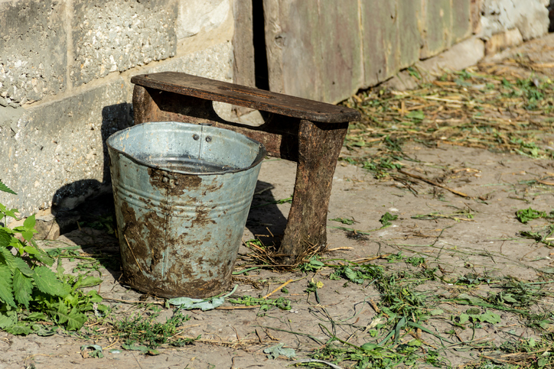
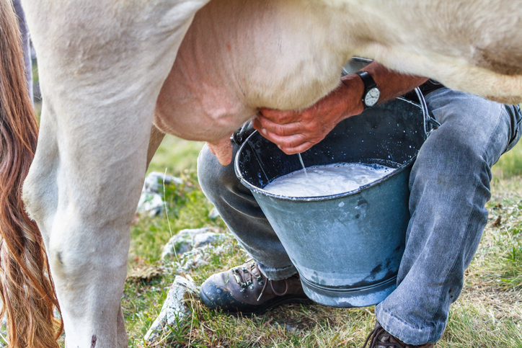
Jobs within stories
First, it was time to milk the cows.
Bucket and stool
Milking udders by hand
He got his stool and bucket and got to work, squeezing the udders by hand. It took a long time to milk all the cows!
Notes:
Teacher’s notes:
Encourage children to perform an action linked to the job or equipment used.

Slide 6
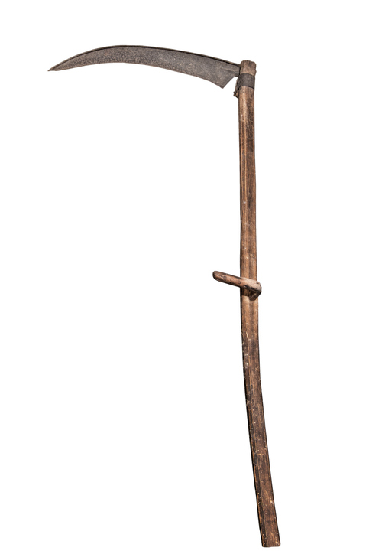
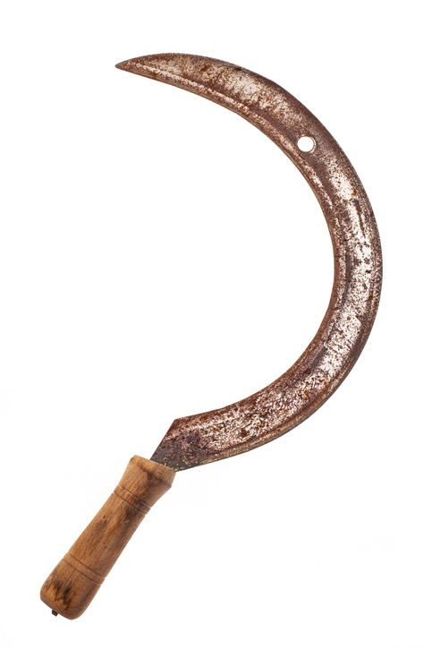
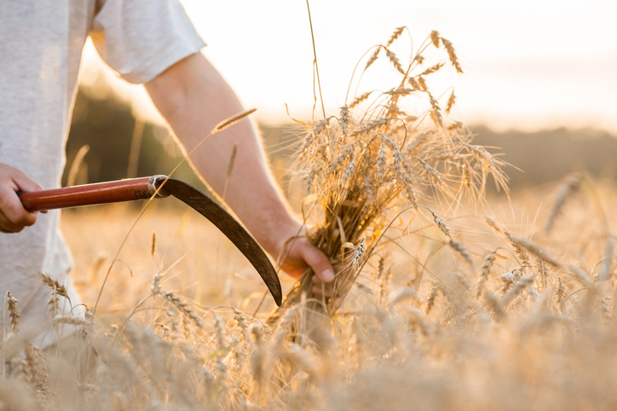
Jobs within stories
Then, it was time to cut the wheat field!
Scythe
Sickle
It was a big job, so he called the other farm workers to help. They grabbed their scythes and sickles and began cutting! It took many hours!
Notes:
Teacher’s notes:
Encourage children to perform an action linked to the job or equipment used.
Vocabulary:
Scythe: a long, curved blade used to cut crops.
Sickle: a smaller curved blade used to cut crops.

Slide 7
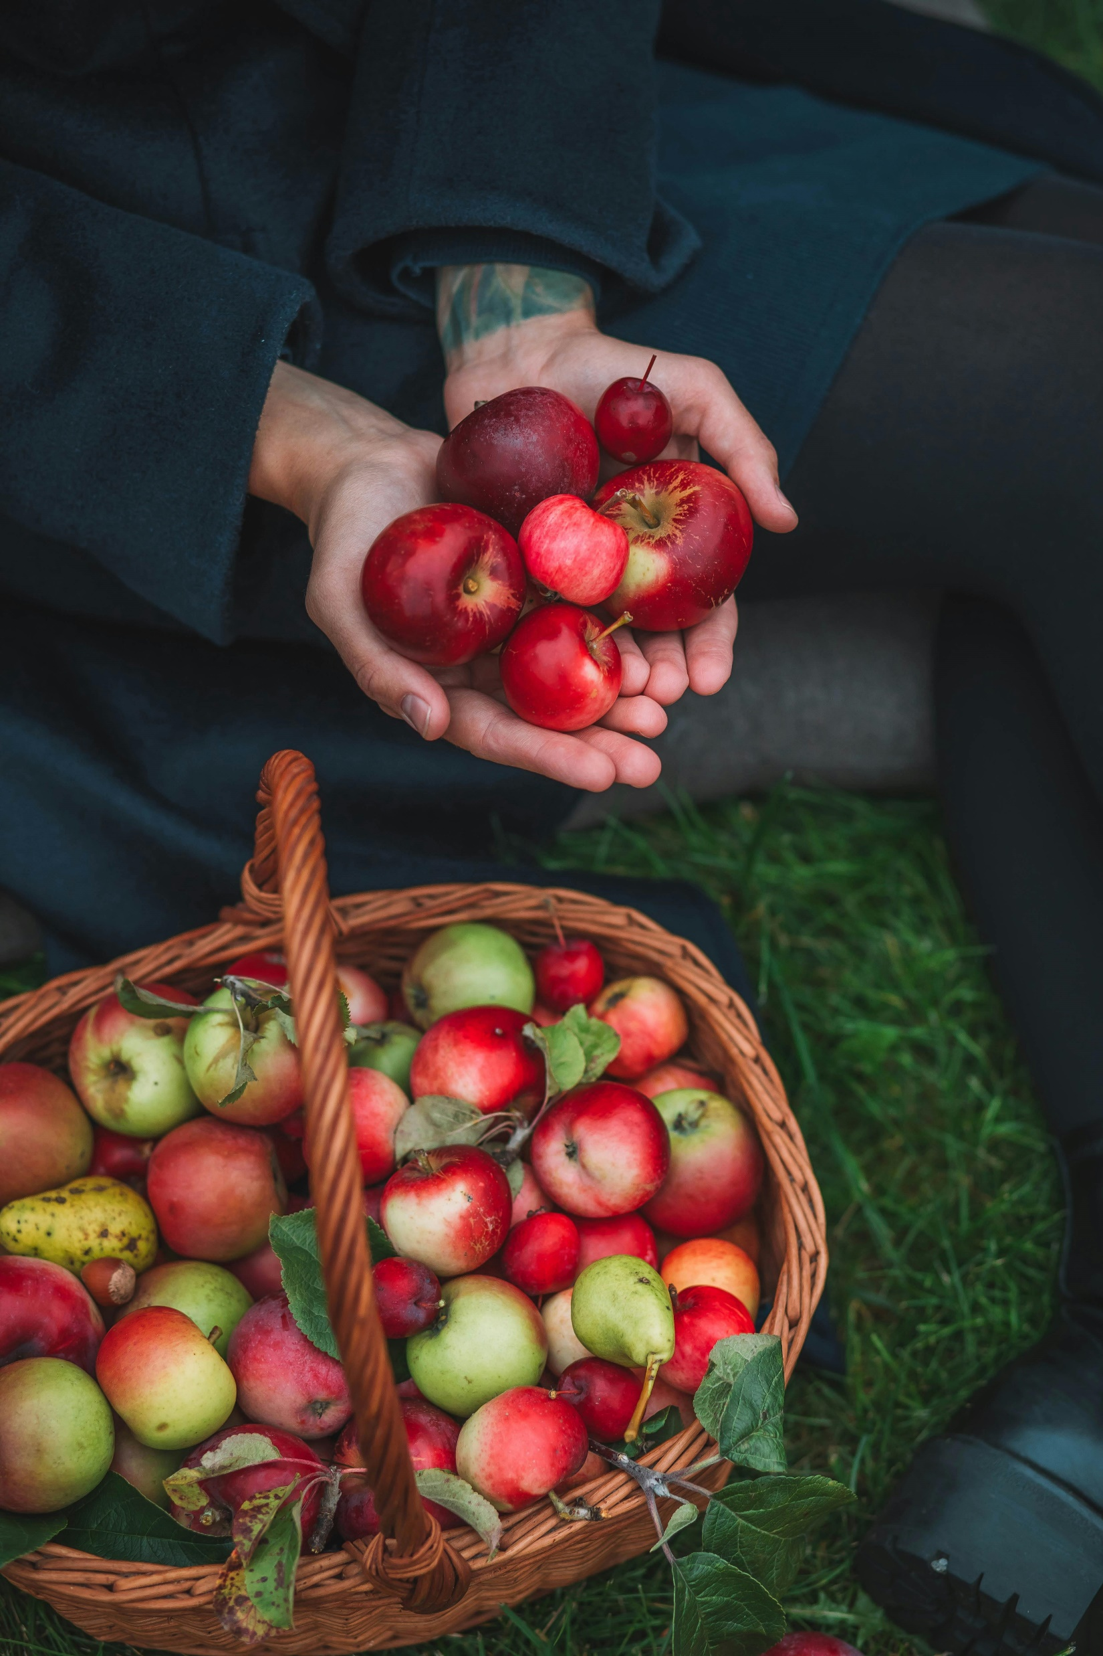
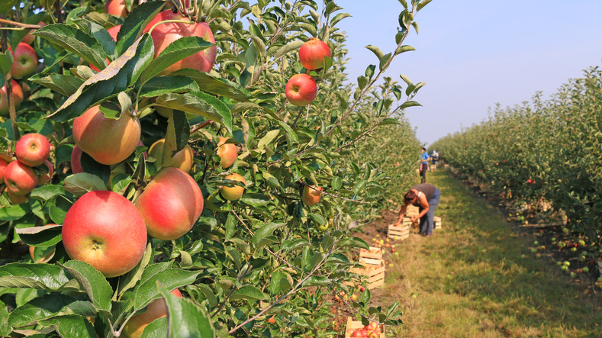
Jobs within stories
Next, the fruit needed picking.
Basket
There were many trees, so everybody helped with picking. They filled their baskets full to the brim.
Notes:
Teacher’s notes:
Encourage children to perform an action linked to the job or equipment used.

Slide 8
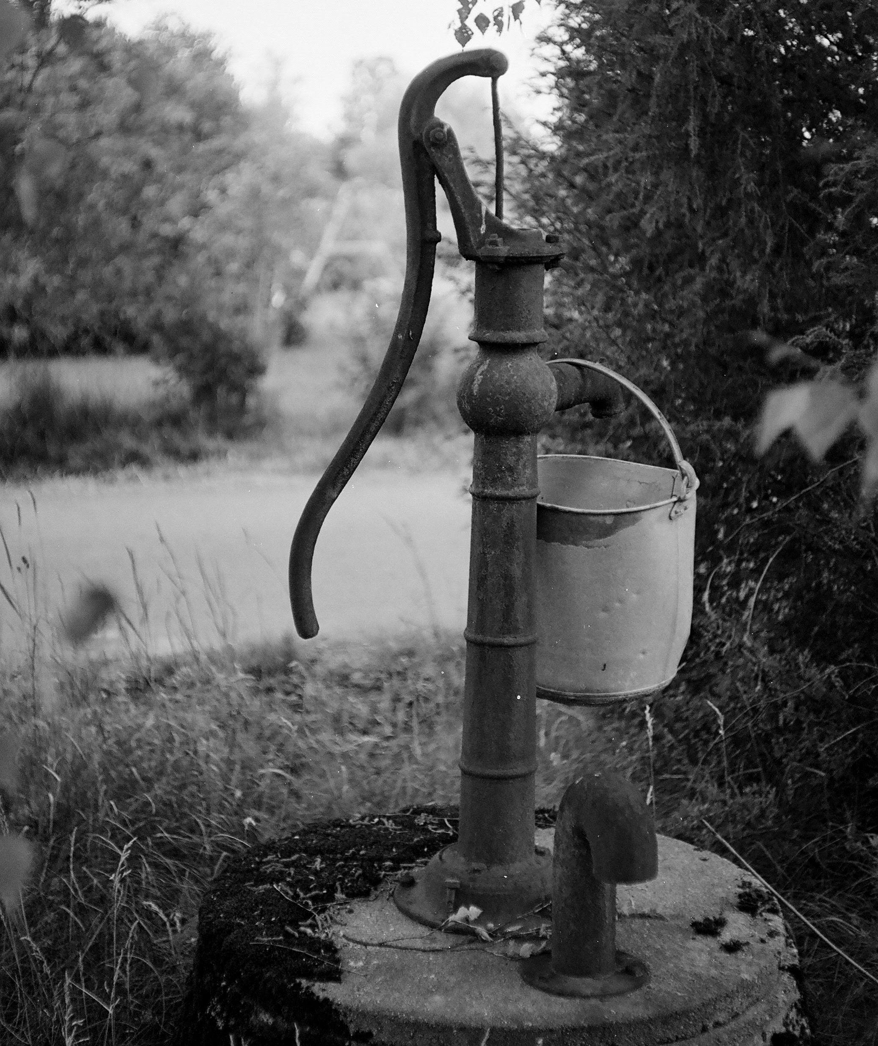
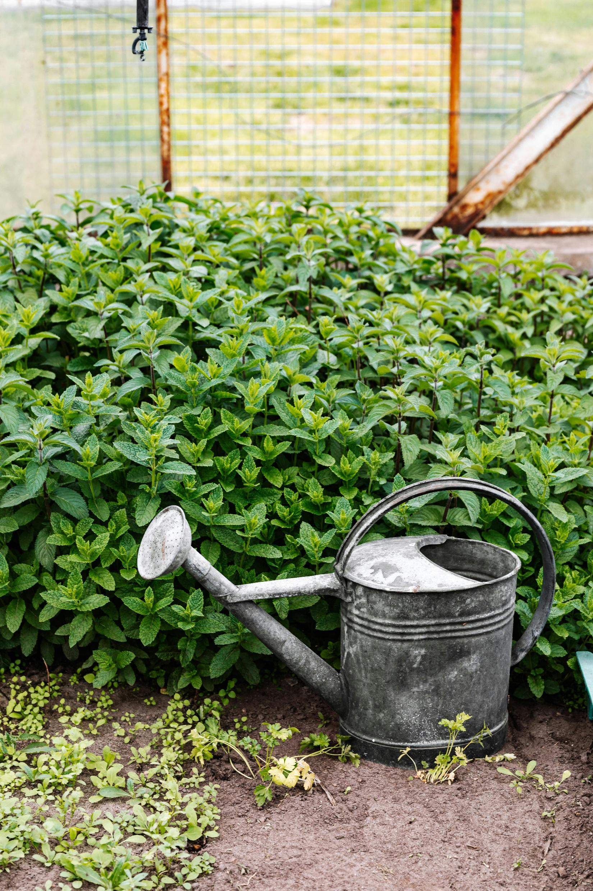
Jobs within stories
The plants also needed watering,
Water pump
Watering can
so Peter pumped up the water and filled his watering can. After a while, all the plants were watered.
Notes:
Teacher’s notes:
Encourage children to perform an action linked to the job or equipment used.

Slide 9


Jobs within stories
The sun had started to set and after a long day of work, Peter deserved a nice rest in bed.
What did Peter use to help him on his farm?
Watering can
Basket
Scythe and sickle
Water pump
Bucket
and stool
Notes:
Teacher’s notes:
Keep the images hidden for a greater challenge, or click to reveal images to use as prompts.
Suggested answers:
Stool
Bucket
Scythe
Sickle
Basket
Water pump

Slide 10


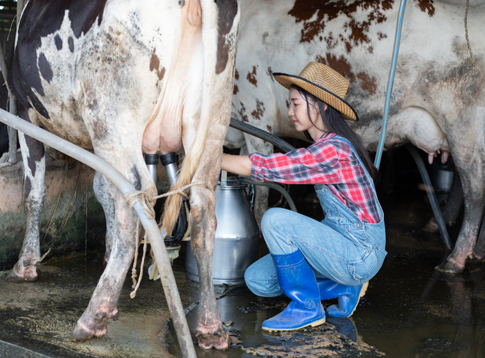
Jobs within stories
Listen to the next story.
Farmer Julia
Julia woke up and saw it was raining outside!
She put on her waterproof jacket, wellington boots, and set to work.
She had to get all the farm jobs done, even in the rain!
Notes:
Teacher’s notes:
The farm in this story uses farming equipment from the present day. Whilst reading, encourage children to perform actions for each farming job.
Vocabulary:
Waterproof jacket: a jacket which keeps water out.
Wellington boots: knee-length, waterproof rubber boots.

Slide 11
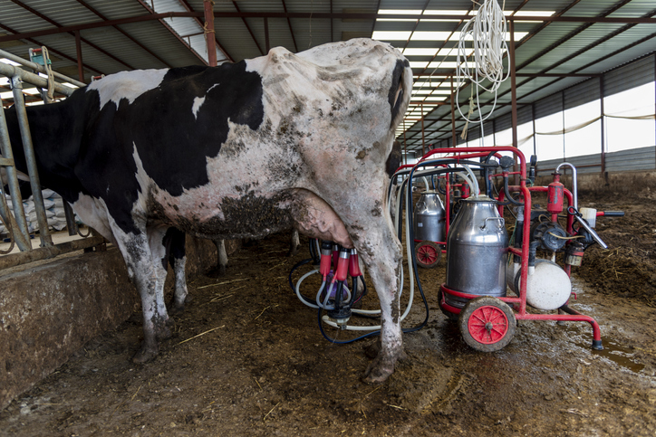
Jobs within stories
She started with the cows.
Milking machines
She led them to the machines which milked them and turned the switch on. Many cows were milked all at once.
Notes:
Teacher’s notes:
Encourage children to perform an action linked to the job or equipment used.

Slide 12
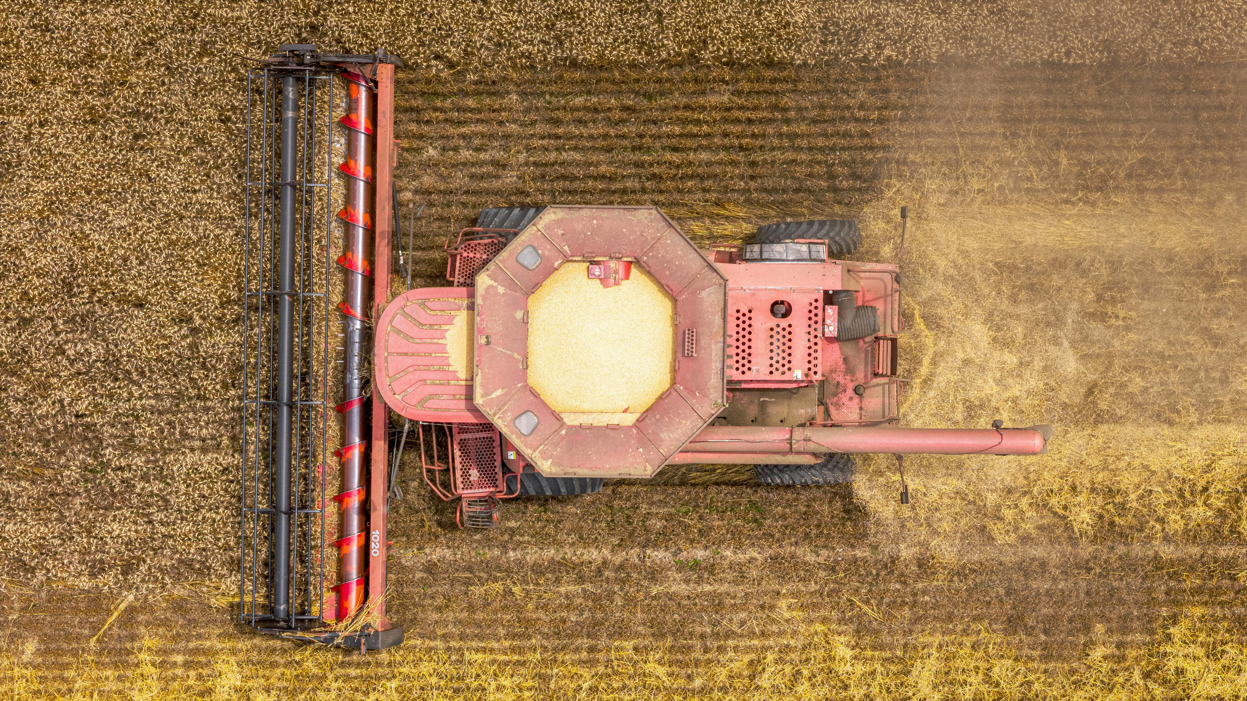
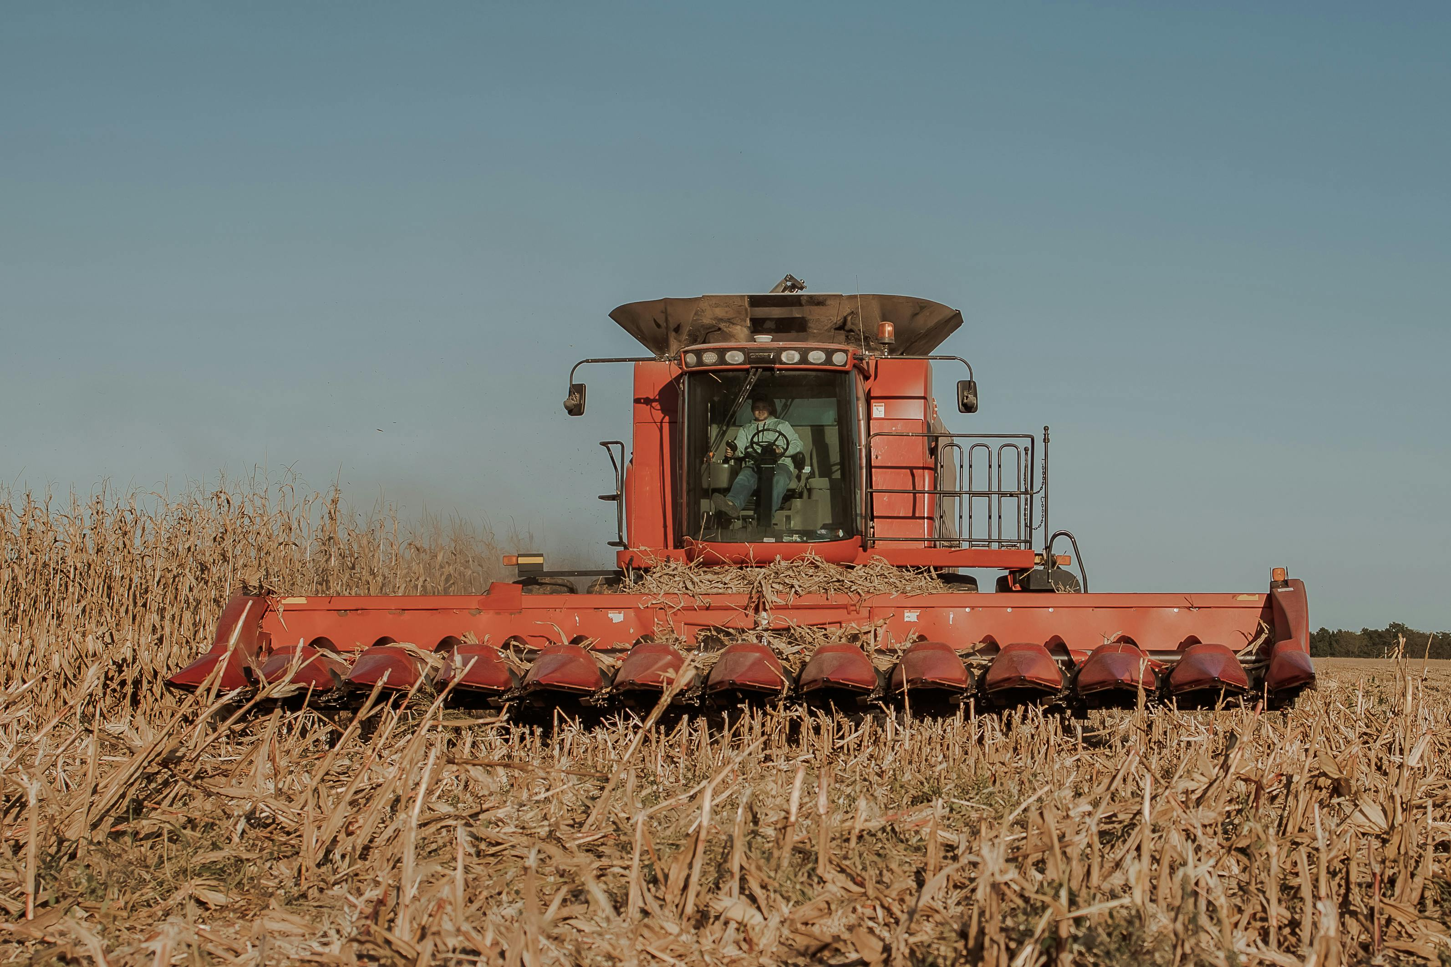

Jobs within stories
The rain stopped, and the sun shone. She thought she should cut the wheat while it was dry.
Combine harvester
Cutters
She got into her combine harvester and drove around the field. The cutters on the front of the combine harvester cut the wheat as she drove through.
Notes:
Teacher’s notes:
Encourage children to perform an action linked to the job or equipment used.
Vocabulary:
Combine harvester: a large vehicle which cuts plants whilst you drive.

Slide 13
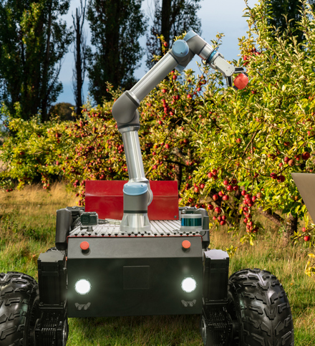
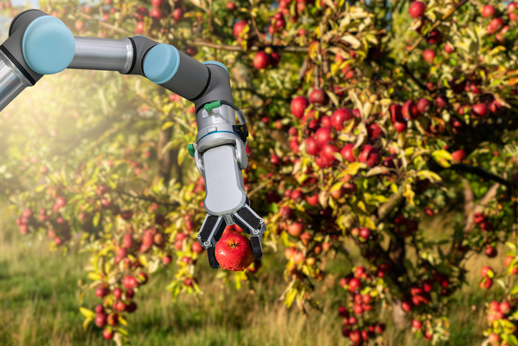
Jobs within stories
The fruit also needed picking, so Julia turned on her robot harvester which picked the fruit.
Robotic harvester
The robotic arm reached high to get the fruit at the top of the trees.
Notes:
Teacher’s notes:
Encourage children to perform an action linked to the job or equipment used.
Vocabulary:
Robotic harvester: a robot which uses a robotic arm to pick fruit.

Slide 14
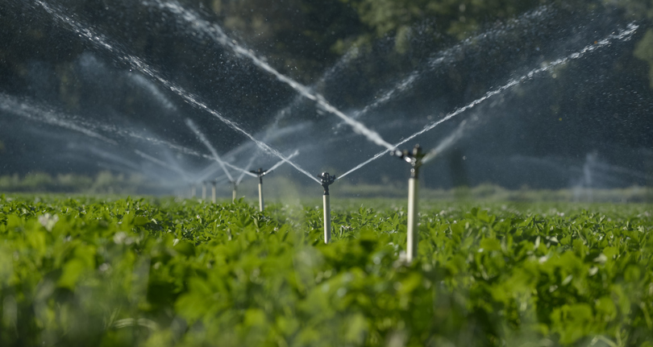
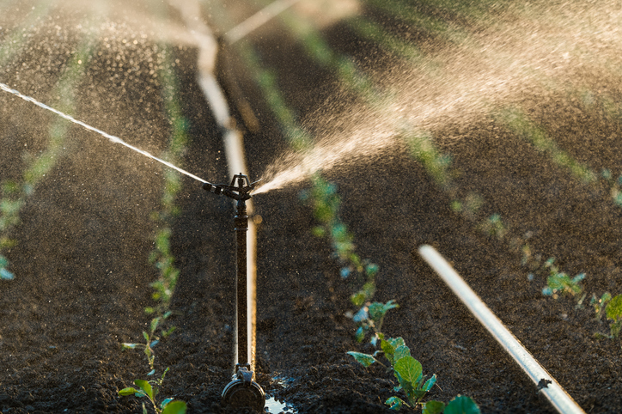
Jobs within stories
The sun was very hot now. She turned on the irrigation system which watered all the plants.
Irrigation system
The sun was setting. Julia was very tired after doing all those jobs. She sat in her armchair with a cup of tea, ready to relax.
Notes:
Teacher’s notes:
Encourage children to perform an action linked to the job or equipment used.
Vocabulary:
Irrigation system: machines which pump water automatically

Slide 15
Jobs within stories
What did Julia use to help her on her farm?
Combine harvester
Robotic harvester
Milking machines
Irrigation system
Notes:
Teacher’s notes:
Keep the images hidden for a greater challenge, or click to reveal images to use as prompts.
Suggested answers:
Milking machines
Combine harvester
Robotic harvester
Irrigation system

Slide 16

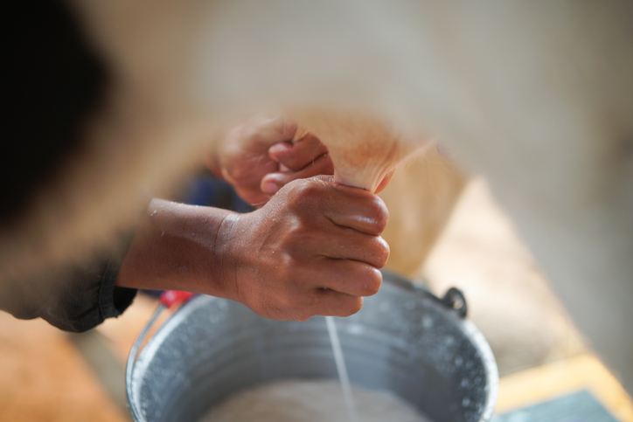
How are jobs in stories different? (12 mins)
In pairs, talk about how each farming job was different.
Let’s do the first one together: milking cows.
At Peter’s farm they milked the cows using their hands,
but in Julia’s farm they milked the using machines.
___________,
___________.
Milking by hand
Milking machines
Notes:
Teacher’s notes:
Keep the images hidden for a greater challenge, or click to reveal images to use as prompts.

Slide 17

How are jobs in stories different?
In pairs, talk about how each farming job was different.
Cutting wheat
At Peter’s farm they cut the wheat using sickles and scythes,
but in Julia’s farm they cut the wheat using a combine harvester.
_________________,
_________________.
Sickles/scythes
Combine harvester
Notes:
Teacher’s notes:
Keep the images hidden for a greater challenge, or click to reveal images to use as prompts.

Slide 18

How are jobs in stories different?
In pairs, talk about how each farming job was different.
Picking fruit
At Peter’s farm they picked fruit using their hands,
but in Julia’s farm they picked fruit using a robotic harvester.
_________________,
_________________.
Picking by hand
Robotic harvester
Notes:
Teacher’s notes:
Keep the images hidden for a greater challenge, or click to reveal images to use as prompts.

Slide 19

How are jobs in stories different?
In pairs, talk about how each farming job was different.
Watering plants
At Peter’s farm they watered the plants using a watering can,
but in Julia’s farm they watered the plants using an irrigation system.
_________________,
_________________.
Watering can
Irrigation system
Notes:
Teacher’s notes:
Keep the images hidden for a greater challenge, or click to reveal images to use as prompts.

Slide 20

How are jobs in stories different?
Which story shows a farm from the past?
Which story shows a farm from the present?
Peter
Julia
I think ____________ had a farm from the past.
I think _____________ has a farm in the present.
Peter
Julia
Challenge: Would a real farmer be able to do all those jobs in one day?
Notes:
Teacher’s notes:
Suggested answers:
Peter’s farm was from the past.
Julia’s farm is set in the present.
Highlight that stories might not always show accurate representation of jobs and sometimes show older versions of what the job looked like in the past. You may also discuss that most farms focus on doing one job e.g. just growing one type of crop, or just raising one type of animal. Many farms would have more than one worker.

Slide 21
Whose job was easier? (3 mins)
Which farmer had a more difficult job?
Peter
Julia
Challenge: Why do you think that?
Notes:
Teacher’s notes:
Suggested answers:
Peter had to do more jobs by hand which would have been more tiring.
Julia’s job would still be hard work, but science and technology has made things easier for her. She would have also had to be trained to use the equipment.

Slide 22


