Slide 1
Teacher’s slide
Key lesson information
Location | Classroom with no student access to internet
Recommended time | 15 minutes
Objectives | By the end of the session, students should be able to: Identify characteristics of a regular menstrual cycle and recognise that cycles vary between individuals and across a lifetime Recognise symptoms associated with menstrual health conditions like PCOS and endometriosis Apply the SOAP framework to build confidence and self-advocacy skills with healthcare professionals Evaluate why menstrual health literacy matters to everyone, regardless of whether they menstruate
Main student tasks | Discuss what counts as a regular menstrual cycle using seven icon prompts Apply the SOAP framework to a real-world scenario to practise self-advocacy with a healthcare professional Identify which life stages (puberty, reproductive years, perimenopause, menopause) symptoms belongs to
Keywords | Menstrual health, PCOS, endometriosis, healthcare, menorrhagia, advocacy
Know-how library
Know-how library | Open the ‘student side’ of your Unifrog account and click these links: Understanding periods Understanding PMDD Students can also search for these guides using the Know-how library tool.
Tracking progress on Unifrog
Add as an Interaction | Click Advanced view>Sort by school leaving year>[filter for specific students]>+interaction.
Track on Charts | Click Usage charts>Customise and filter> ‘Know-how library: Favouriting over time’.
Tracking individual students | Advanced view>Sort by>Library profiles in Favourites
Benchmarks and standards
PSHE Association | Reproductive health and fertility
CASEL 5 | Self-management
ISCA | SE:A1:2; SE:A1:14; SE:A2:3; SE:B1:5
Skills | Learning, speaking, confidence, reflectiveness, practical skills
Teacher preparation
Provide | Lined paper, exercise books, or laptops to work on.
Familiarise yourself | Unifrog’s Know-how library tool (Student side>Know-how library). Students can use this for independent research after the lesson.

Slide 2
Teacher’s slide – guidance on menstrual conditions
This slide gives a brief guide for teachers for handling the topic of menstrual conditions sensitively.
Distance topics from students by encouraging them to think and talk about sensitive topics in the third person. This will help to prevent personal examples from being raised and reduce emotional responses to sensitive topics discussed. For example, help students think about what someone ‘like them’ might experience, feel, think, say or do: ‘Can you imagine a young person about your age, and who…?’ ‘How might you advise a friend in this scenario…?’
In the lesson, always put the emphasis on seeking help and support. The information and activities in this lesson are intended to be practical; they are aimed at giving students the language, information, and confidence to seek support, as needed, for themselves or others.
It's important to bear in mind that the content in the lesson might resonate with students who have personal experience of menstrual health conditions. Students may have already received a diagnosis, be awaiting one, or be experiencing undiagnosed symptoms. Talk to your school mental health, wellbeing, pastoral, or safeguarding lead before delivering the lesson. They should also provide you with support and guidance for covering sensitive issues.
Menstrual health conditions like endometriosis and PCOS are often underdiagnosed and can take years to identify. Some students in your class may already be on a long and frustrating diagnostic journey. Be mindful of this when discussing diagnosis timelines and avoid framing these as straightforward processes.
This lesson contains a description of suicidal thoughts in the context of PMDD. This is clinically accurate and important content, but it may be distressing for some students. Be prepared to signpost students to pastoral support if needed, and make sure you are familiar with your school's safeguarding procedures before delivering this activity.
Use ground rules for classroom discussions. This will help keep the discussion respectful. An example of a ground rule might be to remain honest and open, but to not directly discuss your own personal experiences or the private lives of others (i.e. leave out names and identifying descriptions from examples).
Encourage students to contribute, but allow them the right to pass on a question or activity. Students might feel uncomfortable discussing certain issues, so never force anyone to share or contribute.
This lesson is designed for mixed-sex classrooms. Menstrual health affects everyone – directly or indirectly – and all students are encouraged to engage fully. Be aware that some students may initially feel the content is not relevant to them and may need gentle encouragement to participate.
Be aware of and challenge stigmatising language in class. Phrases like 'it's just period pain' or comments that dismiss or trivialise menstrual symptoms contribute to the normalisation of inadequate healthcare for people who menstruate. If comments like this come up in your lesson, ask students to consider the impact of their words on those who may be struggling in silence.

Slide 3
Teacher’s slide – FAQs
Students may have additional questions after completing this lesson. This page is intended to give you answers to questions that aren’t covered in the main lesson.
I've already been to the GP about my symptoms and been told it's nothing to worry about. What can I do? It's unfortunately common for menstrual symptoms to be dismissed or minimised by healthcare professionals. If you feel your concerns haven't been taken seriously, you are entitled to ask for a second opinion, request a referral, or see a different GP. Use the push back element of the SOAP framework – ask for your symptoms to be noted in your records and request a referral for further investigation. Keeping a symptom diary or tracking your cycle can also strengthen your case.
Is it normal to feel really low or angry before my period – or is something wrong? Mild mood changes before a period are common and linked to natural hormonal shifts. However, if those feelings are severe – significantly affecting your ability to function, your relationships, or your mental health – it may be worth speaking to a GP. There is a big difference between feeling a little low before a period and experiencing debilitating depression or rage. The latter can be a sign of PMDD, which is a recognised and treatable condition.
Can people who don't menstruate get help if they're worried about a friend or partner's menstrual health? Yes – and it matters that they do. If you're worried about someone, encourage them to speak to a GP and offer to go with them if that would help. You can share what you learned in this lesson – including the SOAP framework – so they feel more prepared for an appointment. Supporting someone to seek help is one of the most valuable things you can do.
I've heard that endometriosis takes years to diagnose. Is that true – and why? Yes. The average diagnosis time for endometriosis in the UK is currently around eight years. This is partly because severe period pain has historically been normalised and dismissed, and partly because symptoms overlap with other conditions. Awareness is improving, but it remains a significant issue. If you or someone you know has symptoms that sound like endometriosis, it is worth being persistent with healthcare professionals and asking specifically about the condition by name.
Is PCOS the same as PMOS? Polycystic ovary syndrome is in the process of being renamed polycystic ovary/metabolic syndrome (PCOS/PMOS) to better reflect the metabolic aspects of the condition. You may hear both terms used. They refer to the same condition.
Can menstrual health conditions affect fertility? Yes – some conditions covered in this lesson, including endometriosis and PCOS, can affect fertility if left undiagnosed or untreated. However, many people with these conditions go on to conceive naturally or with support. Early diagnosis and treatment significantly improves outcomes. This is one of the most important reasons to seek help early rather than waiting.

Slide 4

Understanding menstrual health: conditions and self-advocacy

Slide 5
What counts as regular? (3 minutes)
Use the icons and prompts below to discuss what you think a healthy, regular period looks like.
Duration
Flow
Cycle length
Physical feelings
Emotions
Variety between people
Notes:
Teacher’s notes:
Give students 60 seconds to discuss as many prompts as they can before taking some responses from the class. Answers are revealed on the following slides.
Reassure students that the point of this task is to find out what they already know. Most students will have a rough sense of duration and cycle length but are likely to overestimate blood loss and underestimate how much variation exists between people.

Slide 6
What counts as regular?
Duration
Flow
Cycle length
Physical feelings
Emotions
Variety between people
Bleeding typically lasts between three and seven days. Anything within that range is normal, and it can vary from cycle to cycle too, meaning someone could bleed for five days one month, and seven days the next.
Notes:
Teacher’s notes:
The three-to-seven-day range might surprise some students who assume everyone bleeds for the same number of days. It’s worth noting that a lot of imagery used online and in media to represent menstrual cycles – including diagrams and health websites – depicts bleeding as lasting a full week, which contributes to the misconception that seven days is the standard rather than the upper end of the normal range. Emphasise that anything within three to seven days is normal, and that variation from cycle to cycle within that range is also completely typical.

Slide 7
What counts as regular?
Duration
Flow
Cycle length
Physical feelings
Emotions
Variety between people
The average blood lost during a period is around three to five tablespoons – much less than it feels like. Flow is usually heavier in the first couple of days and lightens towards the end.
Notes:
Teacher’s notes:
It's well documented in research that people overestimate how much blood is lost during a period. You might want to explain briefly that menstrual fluid contains uterine lining, mucus, and tissue as well as blood, which is why it can feel like more.
Young people tend to rate a moderate blood loss as very heavy. There's also no reliable link between the number of products used and the amount of blood lost – a recent study (Fahey et al., 2025) found that pad count alone doesn't reliably indicate blood loss.
This is a good moment to clarify the difference between total blood loss across a whole period and the flow rate at any one moment. Periods aren't consistent throughout – the heaviest flow typically occurs in the first 24–48 hours before lightening significantly. The clinical definition of heavy menstrual bleeding is soaking through a pad or tampon every one to two hours for several consecutive hours (or more than 80 ml of blood per cycle) – not a single instance on the heaviest day. This distinction matters and connects directly into the conditions activity that follows.

Slide 8
What counts as regular?
Duration
Flow
Cycle length
Physical feelings
Emotions
Variety between people
A healthy cycle is anywhere between 21 and 35 days. The widely-quoted 28-day cycle is an average – most people don't actually match it, and it can vary slightly from month to month.
Notes:
Teacher’s notes:
The 28-day myth is worth addressing directly here – ask students where they think the 28-day figure comes from. The honest answer is that it has historical roots in early reproductive research that used small, non-representative samples, and it was subsequently embedded in medical textbooks, health education materials, and period tracking tools for decades. It also happens to roughly match the lunar month, which contributed to its cultural staying power.
A large-scale study (Bull et al., 2019) which analysed data from over 600,000 menstrual cycles, found that only around 13% of cycles were actually 28 days long. It highlights that this ‘28-day cycle’ is not a biological norm – most people do not match it!

Slide 9
What counts as regular?
Duration
Flow
Cycle length
Physical feelings
Emotions
Variety between people
Mild cramping, bloating, breast tenderness, headaches, and fatigue are all common around a period. Discomfort that responds to over-the-counter pain relief is within the normal range.
Notes:
Teacher’s notes:
When talking about physical feelings, make sure to keep them in the mild (to moderate) range, approaching this section sensitively – some students in the room may be experiencing pain that goes well beyond what’s described on the slide, and the distinction between normal and concerning needs to be handled carefully.
Normal physical symptoms include mild to moderate cramping, particularly in the first one to two days of bleeding, bloating, breast tenderness, headaches, lower back pain, and fatigue. Discomfort that responds to over-the-counter pain relief like ibuprofen or paracetamol, and does not stop someone from going about their daily life, is within the normal range.
Pain that does not respond to standard pain relief, that stops someone from attending school or doing everyday activities, or that is getting progressively worse over time is not something to simply push through – it warrants a GP conversation.

Slide 10
What counts as regular?
Duration
Flow
Cycle length
Physical feelings
Emotions
Variety between people
Mild mood dips, irritability, and emotional sensitivity before a period are real and common – caused by falling hormone levels. They're worth noticing and naming, but in a typical cycle they shouldn't stop someone from going about their day.
Notes:
Teacher’s notes:
The hormonal mechanism behind premenstrual mood changes is well established in research. During the luteal phase – the second half of the cycle after ovulation – oestrogen and progesterone levels rise and then fall sharply in the days before menstruation begins. Oestrogen has a direct effect on serotonin, a brain chemical linked to mood regulation, so as oestrogen drops, serotonin activity decreases with it. This is why mild low mood, irritability, fatigue, and emotional sensitivity in the days before a period are a recognised and common experience – they have a clear biological basis.
Research suggests that around 75% of people who menstruate experience some premenstrual symptoms, with mood-related symptoms among the most commonly reported. In a typical cycle, these mental and emotional sensations should be mild and shouldn't significantly disrupt daily functioning. The next activity will show students what it looks like when they do.

Slide 11
What counts as regular?
Duration
Flow
Cycle length
Physical feelings
Emotions
Variety between people
No two people experience their cycle in exactly the same way. Cycle length, flow, duration, and symptoms all vary between individuals – and there's no single "right" version. What matters is knowing your own pattern, so that shifts can be noticed when they happen.
Notes:
Teacher’s notes:
Normal is a range, not a fixed experience.
You could ask the class: "So if someone told you their cycle was different to their friend's, what would you say?" The answer you're looking for is that both can be completely normal. This sets up the activity on the next slides by establishing that variation alone is not necessarily a concern.

Slide 12
What counts as regular?
Duration
Flow
Cycle length
Physical feelings
Emotions
Variety between people
Things like stress, illness, significant changes in weight or exercise, starting or stopping contraception, travel, and disrupted sleep can all cause a shift in cycle.
A one-off change is usually nothing to worry about. A persistent (long-term) change is worth paying attention to.
What factors do you think can affect someone’s menstrual cycle?
Notes:
Teacher’s notes:
Close this activity by asking students the question on screen. Click to reveal the answers.
Suggested answers:
Stress triggers the release of cortisol, the body's primary stress hormone. High cortisol levels interfere with the brain signals that trigger ovulation, which can delay a period or stop it happening at all. This is why exam season, bereavement, or major life changes can cause cycles to shift.
Illness places significant physical demand on the body. When the body is fighting infection or recovering from illness, it puts non-essential functions – including reproduction – on hold, which can delay ovulation and therefore shift the timing of a period.
Weight and exercise affect the body's production of oestrogen. Fat tissue produces and stores oestrogen, so significant weight loss can reduce oestrogen levels enough to disrupt or stop ovulation. Equally, over-exercising – particularly in combination with low body weight – can stop the hormonal signals needed to trigger a period altogether.
Starting or stopping contraception directly changes the hormones at play in the cycle. Hormonal contraceptives work by stopping ovulation or thinning the lining of the womb, so it can take several months for the body to settle back into its natural hormonal rhythm after stopping them.
Travel – particularly across time zones – disrupts the body's circadian rhythm, which regulates the release of melatonin and cortisol. Both of these hormones interact with the hormones that control the menstrual cycle, which is why long-haul travel can shift the timing of a period.
Disrupted sleep works in a similar way to travel – poor or irregular sleep affects melatonin and cortisol levels, which in turn can affect the hormonal signals that regulate ovulation and cycle timing.
Key words:
Oestrogen: a hormone that rises and falls across the menstrual cycle and plays a role in regulating mood, alongside many other functions.
Circadian rhythm: the body's internal 24-hour clock that regulates sleep and other cycles
Melatonin: a hormone that helps regulate sleep.

Slide 13
Menstrual health conditions (4 mins)
Can you name any of these four menstrual health conditions?
A pattern of physical and emotional symptoms in the one to two weeks before a period that resolve once bleeding starts. Symptoms include low mood, irritability, fatigue, and bloating.
Soaking through a pad or tampon every one to two hours, passing clots larger than a 50p coin, or bleeding for more than seven days. Can cause iron deficiency anaemia.
A condition causing irregular or absent periods, acne, and excess hair growth (hirsutism). Caused by higher than normal levels of hormones called androgens.
Tissue similar to the uterine lining grows outside the uterus, causing severe period pain, pain during bowel movements, and heavy bleeding. Often dismissed as normal period pain.
Notes:
Teacher’s notes:
Read the four information cards out loud to the class and ask students if they know the names of any of these common menstrual health conditions. On the next slide, the four menstrual conditions are named – you could ask students to try and match each condition to its correct description.

Slide 14
Menstrual health conditions
A. Endometriosis
B. PMS
C. PCOS
D. Menorrhagia
This is PMS (premenstrual syndrome) – it exists on a spectrum. At the severe end it becomes PMDD, a separate, clinically recognised condition that needs medical support.
Soaking through a pad or tampon every one to two hours, passing clots larger than a 50p coin, or bleeding for more than seven days. Can cause iron deficiency anaemia.
A pattern of physical and emotional symptoms in the one to two weeks before a period that resolve once bleeding starts. Symptoms include low mood, irritability, fatigue, and bloating.
This is menorrhagia (heavy menstrual bleeding). It’s one of the most common reasons people visit their GP about their periods.
A condition causing irregular or absent periods, acne, and excess hair growth (hirsutism). Caused by higher than normal levels of hormones called androgens.
This is PCOS (polycystic ovary syndrome). It’s been renamed PMOS (polyendocrine metabolic ovarian syndrome) to better reflect its effect on the whole body, not just the reproductive system.
Tissue similar to the uterine lining grows outside the uterus, causing severe period pain, pain during bowel movements, and heavy bleeding. Often dismissed as normal period pain.
This is endometriosis. Despite affecting 1 in 10 people who menstruate, it’s one of the most underdiagnosed (and most painful) conditions in women’s health.
Notes:
Teacher’s notes:
Click to reveal the answers one by one, and use the information below to answer any questions students may have.
1. PMS – premenstrual syndrome (B)
PMS is caused by the drop in oestrogen and progesterone in the luteal phase – the two weeks before a period. This affects serotonin levels, which regulates mood, energy, and emotional wellbeing. At the severe end it becomes PMDD – premenstrual dysphoric disorder – which causes extreme psychological symptoms including severe depression, anxiety, and in some cases suicidal thoughts.
Treatments:
Lifestyle changes – regular exercise, reduced caffeine and alcohol, improved sleep
Hormonal contraception to regulate hormonal fluctuations
SSRIs for more severe symptoms
CBT for psychological symptoms
2. Menorrhagia – heavy menstrual bleeding (D)
Heavy menstrual bleeding is defined clinically as losing more than 80ml of blood per cycle, though the more useful markers are needing to change a pad or tampon every one to two hours, passing clots larger than a 50p coin, or bleeding for more than seven days. It affects around 1 in 3 people who menstruate and can cause iron deficiency anaemia – explaining symptoms like exhaustion, dizziness, and difficulty concentrating. Many people assume their bleeding is normal and don't seek help, which is worth highlighting. The cause always needs to be investigated as heavy bleeding can indicate underlying conditions including fibroids, adenomyosis, or endometriosis.
Treatments:
Hormonal coil (Mirena) – reduces bleeding significantly for many people
Tranexamic acid – reduces blood loss during a period
Hormonal contraception
Iron supplements if anaemia is present
Surgery in some cases
3. PCOS/PMOS – polycystic ovary/metabolic syndrome (C)
PCOS was officially renamed PMOS in May 2026 to better reflect its hormonal and metabolic nature. It occurs when the ovaries produce higher than normal levels of androgens – often referred to as male hormones, though present in everyone. This disrupts ovulation and causes the recognisable cluster of symptoms: irregular or absent periods, heavy bleeding when periods do arrive, acne, and hirsutism – excess hair growth on the face or body. PMOS is strongly linked to insulin resistance, where the body's cells don't respond effectively to insulin. This causes higher insulin levels which in turn stimulate the ovaries to produce more androgens. The hirsutism point is worth handling sensitively – excess facial hair is one of the most distressing symptoms for young people and is frequently dismissed as normal or attributed to ethnicity. It is a clinical symptom and should be named as such.
Treatments:
Lifestyle changes including diet and exercise to improve insulin sensitivity
Hormonal contraception to regulate periods and reduce acne and hair growth
Metformin to address insulin resistance
Fertility treatment may be needed later in life, though many people with PMOS conceive naturally
4. Endometriosis (A)
Endometriosis occurs when tissue similar to the uterine lining – the endometrium, which builds up and sheds each month during a period – grows outside the uterus on the ovaries, fallopian tubes, bowel, or other organs. Each month this tissue responds to hormonal changes the same way the uterine lining does, swelling and breaking down but with nowhere to go. This causes severe pain, inflammation, and over time scarring. The exact cause is not fully understood but the most widely accepted theory is retrograde menstruation – where menstrual blood flows backwards through the fallopian tubes into the pelvic cavity. Genetics also play a role. Endometriosis has an average UK diagnosis time of nine years – partly because period pain is so frequently normalised and dismissed, and partly because a GP cannot definitively diagnose it. Diagnosis requires a laparoscopy, a surgical procedure carried out by a gynaecologist. Most people had to visit their GP more than five times before being referred to a specialist. Other symptoms beyond those on the card include pain during sex, pain when urinating around the time of a period, fatigue, and difficulty conceiving.
Treatments:
Pain management including prescription pain relief and anti-inflammatory medication
Hormonal treatments to suppress the menstrual cycle and slow tissue growth – including the pill, hormonal coil, or GnRH analogues
Surgery – laparoscopy is both the diagnostic and treatment procedure
There is no cure, but early diagnosis significantly improves quality of life

Slide 15
SOAP for self-advocacy (3 mins)
You can use the SOAP framework below to help you communicate your needs effectively at medical appointments.
Symptoms
On a scale
Ask
Push back
Describe what you’re experiencing and be specific. Explain the impact this is having on your life.
How bad is it from 1 to 10? How often does it happen? How long has it been going on?
‘’What could be causing this?’’ ‘’Can I be referred for further investigation?’’
If feeling dismissed. ‘’I’d like this noted in my medical records’’ ‘’I’d like a second opinion’’
Notes:
Teacher’s notes:
The SOAP framework was developed in the 1960s by Dr. Lawrence Weed, a physician at Yale University, as a way to help healthcare professionals document patient information in a structured and consistent way. It’s now used by doctors, nurses, and allied health professionals worldwide. Here it’s being used the other way around – as a tool to help patients communicate their symptoms clearly rather than for clinicians to record them.
You might want to provide students with extra information about each of the steps:
Symptoms – encourage students to think about specificity. "I have really bad cramps" is much less useful in an appointment than "I have severe cramping that starts two days before my period, doesn't respond to ibuprofen, and stops me sleeping and attending school." The more specific the description, the harder it is to dismiss. It is also worth emphasising the impact element – symptoms that affect daily life, school attendance, relationships, or mental health are clinically relevant and should be named explicitly.
On a scale – numbers and timeframes make symptoms harder to dismiss. A pain score of 8 out of 10 that has been happening every month for two years is a very different picture to "it hurts sometimes." Encourage students to think about how long something has been going on, how often it happens, and how severe it is at its worst.
Ask – many people leave appointments passively, waiting for the doctor to connect the dots. Asking directly – "what do you think could be causing this?" or "could this be endometriosis or PCOS?" – shifts the dynamic. Students should feel empowered to name conditions they have researched or recognised in their own experience.
Push back – this is the element students find hardest to imagine doing in practice. It’s worth normalising it explicitly: asking for something to be noted in medical records, requesting a referral, or asking for a second opinion are all completely reasonable and are rights every NHS patient has. The phrase "I'd like this noted in my records" is particularly powerful because it creates a paper trail that cannot be ignored at future appointments.

Slide 16
SOAP for self-advocacy
Read the scenario
Use SOAP to write down what Amara should say at her appointment
Amara (16) has had severe period pain since she was 14 – bad enough to miss school most months. She’s seen a GP twice and been told both times it’s just cramps and to take ibuprofen, which barely helps. She’s also started experiencing pain when going to the toilet around the time of her period but hasn't mentioned it because she feels embarrassed. She has a GP appointment next week.
Symptoms
On a scale
Ask
Push back
Notes:
Teacher’s notes:
Give students some time to discuss in pairs or write down what they think Amara should say at her appointment, working through each stage of the SOAP framework. Circulate and listen to responses before taking one or two answers from the class. Then click through the answer slides one stage at a time, pausing briefly after each reveal to check understanding before moving on.

Slide 17
SOAP for self-advocacy
Amara (16) has had severe period pain since she was 14 – bad enough to miss school most months. She’s seen a GP twice and been told both times it’s just cramps and to take ibuprofen, which barely helps. She’s also started experiencing pain when going to the toilet around the time of her period but hasn't mentioned it because she feels embarrassed.
Symptoms
On a scale
Ask
Push back
‘’I’ve had severe period pain since I was 14 that stops me from going to school most months. The pain doesn’t respond to ibuprofen at all. I’ve also started experiencing pain when going to the toilet during my period.’’
Notes:
Teacher’s notes:
The specificity here is key – "stops me going to school most months" and "doesn't respond to ibuprofen" are both clinically significant details that are easy to leave out. Draw attention to the bowel pain detail specifically – this is the symptom most likely to be omitted out of embarrassment, and it’s one of the most important indicators of endometriosis.

Slide 18
SOAP for self-advocacy
Amara (16) has had severe period pain since she was 14 – bad enough to miss school most months. She’s seen a GP twice and been told both times it’s just cramps and to take ibuprofen, which barely helps. She’s also started experiencing pain when going to the toilet around the time of her period but hasn't mentioned it because she feels embarrassed.
Symptoms
On a scale
Ask
Push back
‘’The pain is around 8 or 9 out of 10 at its worst. It’s been happening every month for two years. I’ve missed roughly one to two days of school every cycle because of it.’’
Notes:
Teacher’s notes:
Numbers and timeframes make symptoms much harder to dismiss. Ask students whether "it really hurts" or "8 out of 10 pain every month for two years causing school absence" is more likely to be taken seriously in an appointment.

Slide 19
SOAP for self-advocacy
Amara (16) has had severe period pain since she was 14 – bad enough to miss school most months. She’s seen a GP twice and been told both times it’s just cramps and to take ibuprofen, which barely helps. She’s also started experiencing pain when going to the toilet around the time of her period but hasn't mentioned it because she feels embarrassed.
Symptoms
On a scale
Ask
Push back
"I've been told twice that it's just cramps but nothing has improved. Could there be another cause? Could this be endometriosis?"
Notes:
Teacher’s notes:
Naming the condition directly – "could this be endometriosis?" – shifts the dynamic of the appointment. Students may feel this is too forward, but it’s entirely appropriate and can significantly speed up the diagnostic process.

Slide 20
SOAP for self-advocacy
Amara (16) has had severe period pain since she was 14 – bad enough to miss school most months. She’s seen a GP twice and been told both times it’s just cramps and to take ibuprofen, which barely helps. She’s also started experiencing pain when going to the toilet around the time of her period but hasn't mentioned it because she feels embarrassed.
Symptoms
On a scale
Ask
Push back
"I'd like everything we've discussed today noted in my medical records. I've been dismissed twice already and I'd like a referral to a gynaecologist to investigate further."
Notes:
Teacher’s notes:
This is the most important element for Amara given she has already been dismissed twice. "I'd like this noted in my records" creates a paper trail. A referral request is a patient right under the NHS – students should know they are entitled to ask for one.
Key word:
Gynaecologist: a doctor who specialises in the female reproductive system, including conditions affecting periods, fertility, pregnancy, and menopause.

Slide 21
The menstrual cycle over a lifetime (3 mins)
Link the symptoms to the four life stages. Some symptoms may appear in more than one category!
1. Irregular cycles
2. Mood changes
3. Joint pain
4. Brain fog
5. Heart palpitations
6. Hot flushes
7. Heavy bleeding
8. More regular cycles
9. Sleep disruption
10. Memory lapses
11. Thinning hair
12. Vaginal dryness
13. Urinary incontinence
A. Puberty
(ages 8-16)
Menstruation begins
B. Reproductive years
(ages 16-45)
Cycle becomes established
C. Perimenopause
(begins approx. age 45)
Cycles become unpredictable again
D. Menopause
(average age 51)
Periods stop completely
Notes:
Teacher’s notes:
Give students two minutes to work individually or in pairs, linking each symptom to the stage or stages where they think it belongs. Remind them that some symptoms appear in more than one stage.
Answers:
A: 1, 2, 8
B: 2, 7, 8
C: 1, 2, 3, 4, 5, 6, 7, 9, 10, 11, 12, 13
D: 2, 3, 4, 5, 6, 9, 10, 11, 12, 13
Information on symptoms:
Irregular cycles – caused by fluctuating hormone levels as the body either establishes (puberty) or winds down (perimenopause) its hormonal rhythm.
Mood changes – oestrogen directly affects serotonin levels. When oestrogen fluctuates or declines, serotonin drops with it, affecting mood, energy, and emotional regulation.
Joint pain – oestrogen has an anti-inflammatory effect on joints. As levels decline during perimenopause and menopause, inflammation increases and joints can become painful and stiff.
Brain fog – oestrogen supports cognitive function and memory. As levels decline, many people experience difficulty concentrating, forgetfulness, and mental fatigue.
Heart palpitations – fluctuating oestrogen affects the autonomic nervous system which regulates heart rate, causing episodes of racing or irregular heartbeat.
Hot flushes – caused by declining oestrogen affecting the hypothalamus, the part of the brain that regulates body temperature, causing it to misread the body's temperature and trigger sudden heat.
Heavy bleeding – caused by hormonal imbalance affecting the thickness of the uterine lining. Common during perimenopause as oestrogen fluctuates, but can occur at any stage.
More regular cycles – as the hormonal system matures during puberty, the body establishes a more consistent pattern of ovulation and menstruation.
Sleep disruption – declining oestrogen and progesterone directly affect sleep quality. Night sweats caused by hot flushes also frequently disturb sleep during perimenopause and menopause.
Memory lapses – oestrogen plays a role in memory consolidation in the hippocampus. As levels decline, specific episodes of forgetfulness can occur. Usually temporary.
Thinning hair – oestrogen supports hair growth. As levels decline, hair can thin and grow more slowly. Often dismissed as stress or ageing rather than recognised as a hormonal symptom.
Vaginal dryness – declining oestrogen causes the vaginal tissues to thin and lose moisture, leading to dryness, discomfort, and increased susceptibility to infection. Common and treatable.
Urinary incontinence – declining oestrogen weakens the tissues of the bladder and urethra, causing leaking when coughing, sneezing, or exercising, or a sudden urgent need to urinate.

Slide 22
The menstrual cycle over a lifetime
Link the symptoms to the four life stages. Some symptoms may appear in more than one category!
1. Irregular cycles
2. Mood changes
3. Joint pain
4. Brain fog
5. Heart palpitations
6. Hot flushes
7. Heavy bleeding
8. More regular cycles
9. Sleep disruption
10. Memory lapses
11. Thinning hair
12. Vaginal dryness
13. Urinary incontinence
A. Puberty
Menstruation begins
B. Reproductive years
Cycle becomes established
C. Perimenopause
Cycles become unpredictable again
D. Menopause
Periods stop completely
Notes:
Teacher’s notes:
Answers:
A: 1, 2, 8
Both irregular and more regular cycles are shaded here because puberty is a transition rather than a fixed moment – cycles start irregular and gradually settle into a more regular pattern over the first one to two years. Mood changes appear here for the same reason they appear later in perimenopause – the oestrogen-serotonin connection covered in the starter, now activating for the first time.

Slide 23
The menstrual cycle over a lifetime
Link the symptoms to the four life stages. Some symptoms may appear in more than one category!
1. Irregular cycles
2. Mood changes
3. Joint pain
4. Brain fog
5. Heart palpitations
6. Hot flushes
7. Heavy bleeding
8. More regular cycles
9. Sleep disruption
10. Memory lapses
11. Thinning hair
12. Vaginal dryness
13. Urinary incontinence
A. Puberty
Menstruation begins
B. Reproductive years
Cycle becomes established
C. Perimenopause
Cycles become unpredictable again
D. Menopause
Periods stop completely
Notes:
Teacher’s notes:
Answers:
B: 2, 7, 8
This is the smallest cluster of symptoms as the reproductive years are the most stable stage of the menstrual lifespan. Heavy bleeding appears here as a reminder that it can occur at any point, not just during perimenopause, and may indicate an underlying condition rather than a hormonal transition. Mood changes continue from puberty for the same hormonal reasons – most notably in the luteal phase before a period.

Slide 24
The menstrual cycle over a lifetime
Link the symptoms to the four life stages. Some symptoms may appear in more than one category!
1. Irregular cycles
2. Mood changes
3. Joint pain
4. Brain fog
5. Heart palpitations
6. Hot flushes
7. Heavy bleeding
8. More regular cycles
9. Sleep disruption
10. Memory lapses
11. Thinning hair
12. Vaginal dryness
13. Urinary incontinence
A. Puberty
Menstruation begins
B. Reproductive years
Cycle becomes established
C. Perimenopause
Cycles become unpredictable again
D. Menopause
Periods stop completely
Notes:
Teacher’s notes:
Answers:
C: 1, 2, 3, 4, 5, 6, 7, 9, 10, 11, 12, 13
Students may be surprised to see so many symptoms shaded for this stage. You could ask students “What do you notice?” The number of symptoms associated with perimenopause highlights that this is a significant whole-body transition, not just irregular periods.
It’s also worth noting that these symptoms can begin years before periods stop, meaning many people experience perimenopause without realising that is what it is. People might link symptoms like brain fog, joint pain, anxiety, and heart palpitations to stress, ageing, or other causes instead of the decline in oestrogen.
Perimenopause is one of the most under-discussed stages of reproductive health despite affecting everyone who menstruates – and the people around them.

Slide 25
The menstrual cycle over a lifetime
Link the symptoms to the four life stages. Some symptoms may appear in more than one category!
1. Irregular cycles
2. Mood changes
3. Joint pain
4. Brain fog
5. Heart palpitations
6. Hot flushes
7. Heavy bleeding
8. More regular cycles
9. Sleep disruption
10. Memory lapses
11. Thinning hair
12. Vaginal dryness
13. Urinary incontinence
A. Puberty
Menstruation begins
B. Reproductive years
Cycle becomes established
C. Perimenopause
Cycles become unpredictable again
D. Menopause
Periods stop completely
Notes:
Teacher’s notes:
Answers:
D: 2, 3, 4, 5, 6, 9, 10, 11, 12, 13
The symptom list for the menopause is almost identical to the perimenopause. Menopause is not a sudden event but the continuation of a transition that has often been underway for years. It is defined as 12 consecutive months without a period, with an average age of 51 in the UK – but the experience of it varies enormously between individuals.
Some people have minimal symptoms; others find it significantly impacts their quality of life. All of the symptoms shown here are real, recognised, and treatable – but only if people feel able to raise them with a healthcare professional.
This is where the self-advocacy skills from earlier in the lesson become relevant again – the same barriers that make it hard to advocate for menstrual health in your teens and twenties apply just as much at this stage of life.

Slide 26
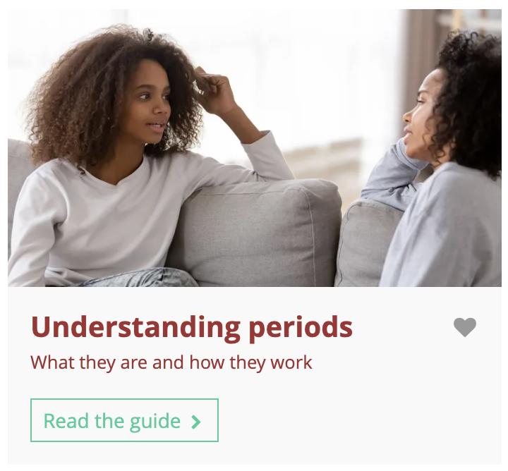
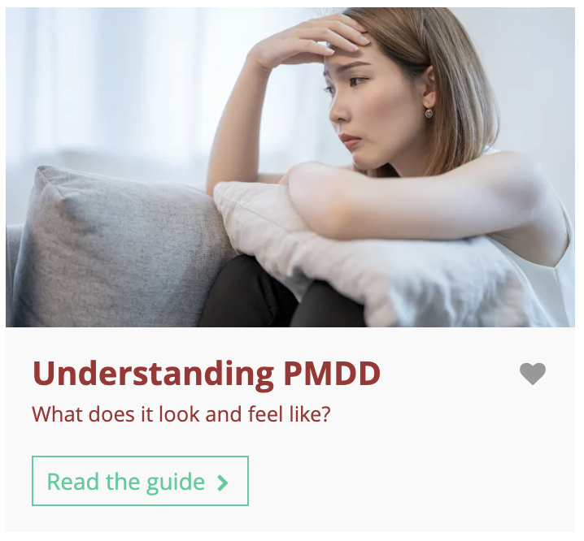
Independent learning
It can be difficult to know which information you can trust online.
The Know-how library is a reliable source of information about this topic and lots of others.
Search by the keyword ‘menstrual’ in the Know-how library to find guides on this topic. Remember to favourite guides you’d like to come back to later!
Notes:
Teacher’s notes:
Unifrog’s Know-how library has information on all kinds of topics – including periods.
Students can find Know-how library guides by logging into their Unifrog accounts and scrolling down to ‘Exploring’ on the Home page until they find the Know-how library. They can search by keyword, e.g. ‘PMDD’.
Helpful guides might include:
Understanding periods
Understanding PMDD
Students’ favourited guides will be shown in the Know-how library banner every time they click on the page (Student side>Know-how library). They will also be able to see a full list of their favourite profiles by going to the top of their webpage and clicking Favourites>Exploration tools.
You can track guides favourited by students by clicking Advanced view>Sort by>Library profiles in Favourites.

Slide 27
Why does menstrual health matter to everyone? (2 mins)
Who benefits from understanding menstrual health – and how?
Males
Females
Friends
Family
Teachers
Employers
Society
Notes:
Teacher’s notes:
For the plenary, give students a minute to brainstorm individually (using the icons for assistance – click to reveal) before taking responses from the class. Encourage contributions from across the room, particularly from male students who may initially feel the question doesn’t apply to them.
Suggested answers:
People who menstruate: Can recognise when something isn't normal, know the language to use in a GP appointment, feel less alone in their experience, and are better equipped to advocate for themselves throughout their lives
Male students: Can challenge the stereotype that periods make people irrational, can support friends, partners, and family members more effectively, and can advocate for people they care about in medical and social settings
Partners: Can offer informed support rather than dismissing or minimising symptoms, and can understand what a partner may be experiencing at different stages of their life
Friends: Can recognise when someone they care about might need encouragement to seek help, and can use the language from this lesson to support them
Family members: Can better understand and support relatives who may be experiencing conditions like endometriosis or PCOS, or who may be going through perimenopause or menopause and feeling unheard
Teachers and employers: Can recognise when menstrual health may be affecting attendance, performance, or wellbeing, and can respond with understanding rather than dismissal
Society: Medical dismissal of menstrual symptoms is a documented systemic issue – an informed generation is better placed to challenge it, both as patients and as future healthcare professionals, employers, and policymakers

Slide 28
Organisations that help with menstrual health
Searching ‘menstrual health’, ‘endometriosis’, ‘PCOS’, ‘PMDD’ in your internet browser will bring up helpful resources and guide you with the first step in finding support.
Endometriosis UK (Support, information, and
helpline for those affected) – endometriosis-uk.org
Verity (Charity dedicated to PCOS/PMOS – information, support groups, and community) – verity-pcos.org.uk
The PMDD Project (Information, awareness, and
support for those affected) – thepmddproject.org
NHS (Information on periods, conditions, and when to see a GP) – nhs.uk/conditions/periods
Menstrual Health Project (Education, advocacy, and resources for menstrual health conditions) – menstrualhealthproject.org.uk
Wellbeing of Women (UK charity funding research and raising awareness across all areas of women's health) – wellbeingofwomen.org.uk
Mind (Mental health support – relevant for those experiencing psychological symptoms linked to PMS or PMDD) – mind.org.uk
Notes:
Teacher’s notes:
This slide has information on organisations that can offer more information about menstrual health conditions.
Leave this slide up at the end of the lesson so that students can note down these resources as they leave the classroom. Let students know they can talk to you or another member of staff if they are struggling and need support.

Slide 29
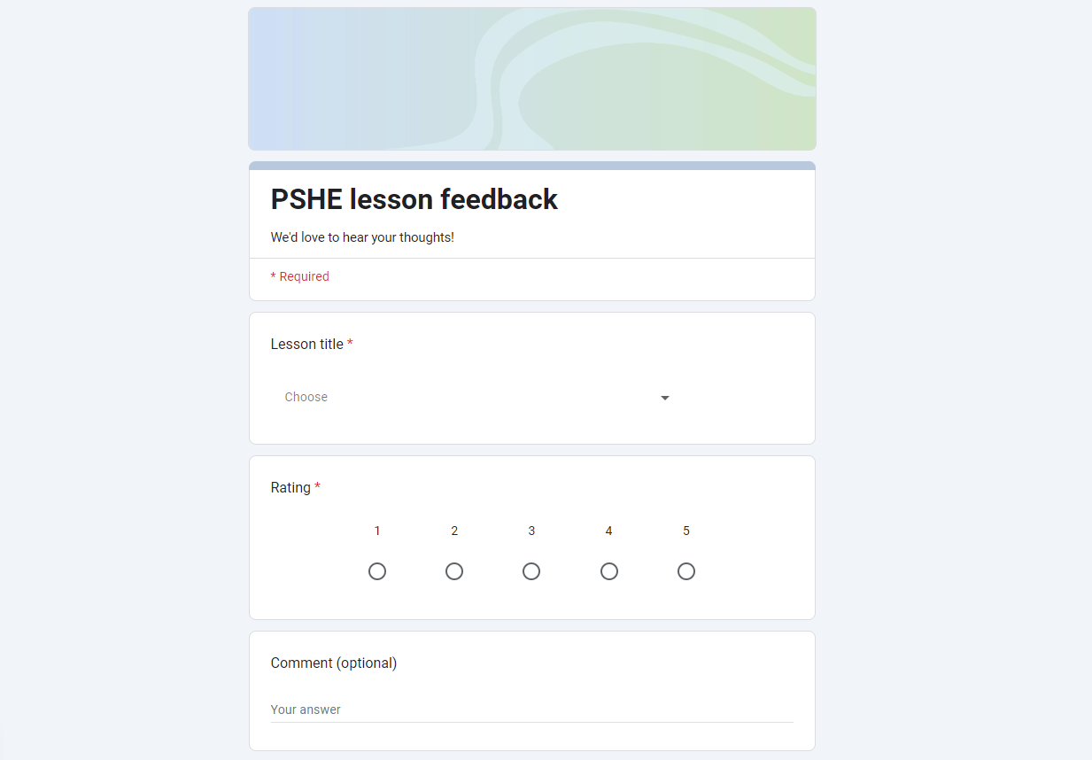
We’d love your feedback!
What did you think of this lesson? We’d love to hear from you!
to rate this lesson out of 5. You can also add a comment if you have time!
Click here

Slide 30


