Slide 1




Teacher’s slide
Key lesson information
Recommended time | 15 minutes
Objectives | By the end of the session, children should be able to: Identify jobs in a story. Explain which jobs in a story took place outside and which can help us. Explain differences between the jobs in the story and the real versions of the jobs.
Main student tasks | Look at a book front cover and make a prediction about what it might be about. Listen to a story. Listen to the story a second time, this time joining in with words and actions. Identify which jobs each character has in the story. Identify which jobs happened outside in the story. Match the pictures of the jobs in the story to the real-world jobs.
Keywords | Farmer, bus driver, post person, jobs, outdoor, help, crops, aboard.
Benchmarks and standards
Gatsby Benchmarks | 4. Linking curriculum learning to careers
CDI Framework | See the big picture
Early Learning Goals | Communication & Language: Listening, attention & understanding Literacy: Comprehension Understanding the world: Past and present
Skills | Observation, communication, learning, listening, reading.
SEND / additional needs / TA support
Our optional, editable, and printable worksheets are designed to support all children including those with additional needs. You could adapt these to suit the needs of your class, as required. Provide printed copies of the story for children with dyslexia to use a covered overlay with. You may choose to read story prior to the lesson to familiarise children with the plot and vocabulary.
Teacher preparation
Resources | Pencils, pens, paper, exercise books.
Print | Story, character illustrations (optional).
Continuous provision | Additional activities to support this lesson can be found in the See the big picture continuous provision suggestions.
Notes:
Teacher’s notes:
Whilst Gatsby Benchmarks are designed for use with secondary schools and colleges, we’ve provided a best match for this lesson, for reference.
Our objectives are designed to be child friendly so please share these with your classes in way that suits you.
Our lessons are editable so you can adapt the slides and/or worksheet to suit the needs of your class.

Slide 2

What can we learn about jobs from a story?

Slide 3


Story time (6 min)
We are going to listen to a story called ‘The Frog Who Wanted a Job’.
What do you think the story will be about?
Notes:
Teacher’s notes:
Introduce story and front cover. Encourage children to make a prediction about what might happen using the title and front cover images.

Slide 4
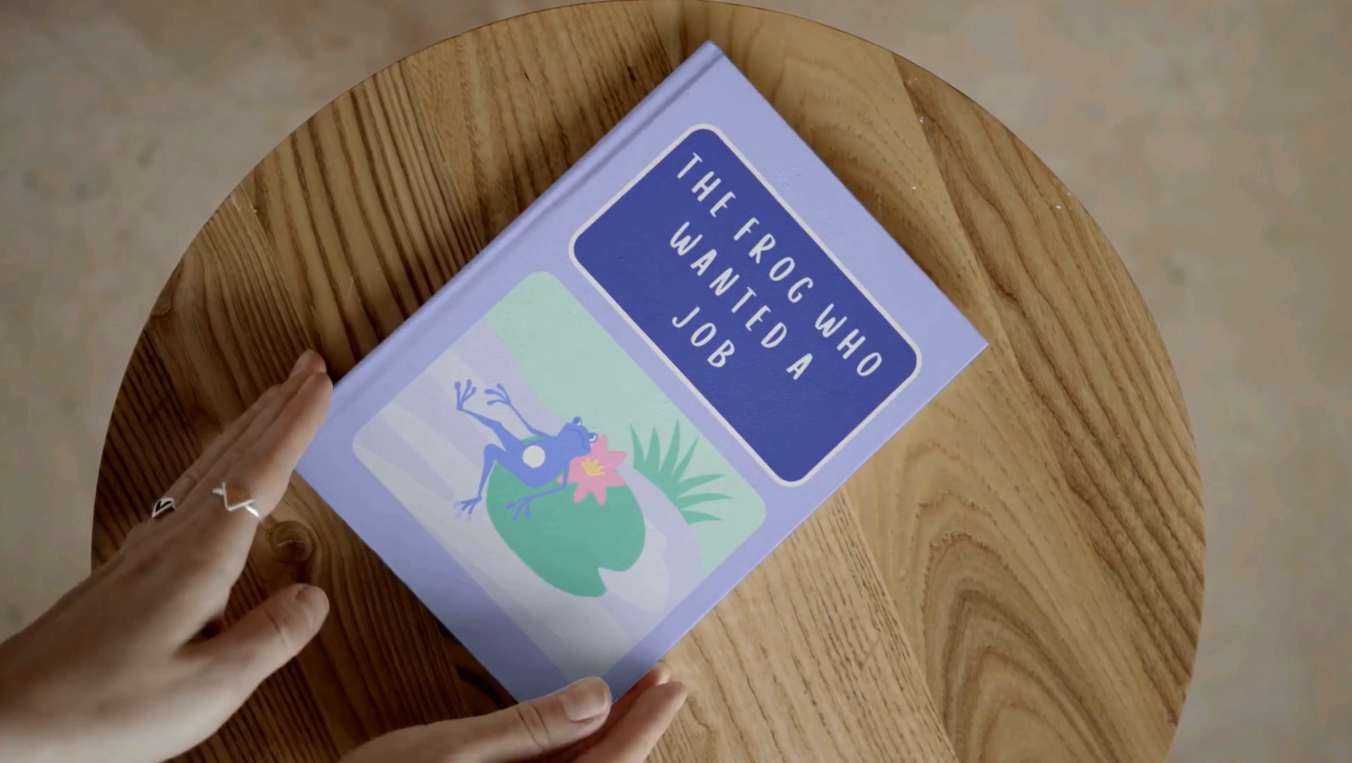
Notes:
Teacher’s notes:
Click to animate the front cover of the story.

Slide 5













In an enormous pond,
lived a tiny frog,
who loved the outdoors,
and wanted a job.
Notes:
Teacher’s notes:
Click to animate the text and illustrations of the story.

Slide 6










“I’m going to find a job!”
the froggy said,
so she stretched out her arms,
and hopped out of bed.
Notes:
Teacher’s notes:
Click to animate the text and illustrations of the story.

Slide 7



She hopped onto land,
and onto a farm,
a farmer was there,
putting straw in the barn.
Notes:
Teacher’s notes:
Click to animate the text and illustrations of the story.

Slide 8



“A farmer!” she thought.
“Is this the job for me?”
but she carried on looking
and I guess we will see.
Notes:
Teacher’s notes:
Click to animate the text and illustrations of the story.

Slide 9




She hopped on a street,
a postperson she saw,
putting letters and parcels,
through a front door.
Notes:
Teacher’s notes:
Click to animate the text and illustrations of the story.

Slide 10
“A postperson!” she thought.
“Is this the job for me?”
but she carried on looking,
and I guess we will see.
Notes:
Teacher’s notes:
Click to animate the text and illustrations of the story.

Slide 11
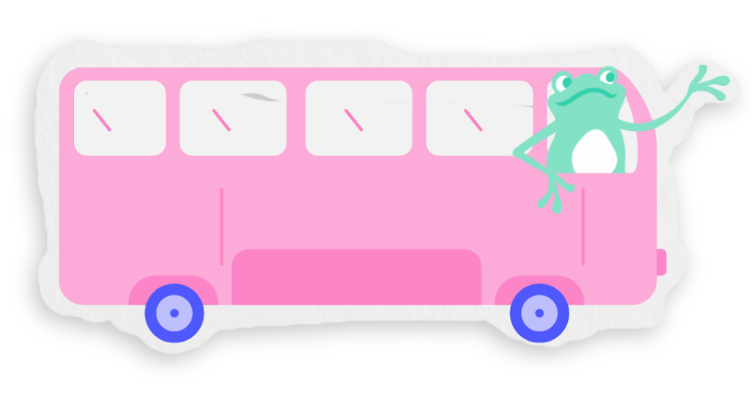


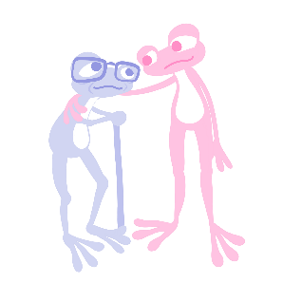


A bus driver stopped,
“All aboard, come on!”
The passengers paid,
and the bus was gone.
Notes:
Teacher’s notes:
Click to animate the text and illustrations of the story.

Slide 12
“A bus driver!” she thought,
“Is this the job for me?”
but she carried on looking,
and I guess we will see.
Notes:
Teacher’s notes:
Click to animate the text and illustrations of the story.

Slide 13





Three jobs to choose from,
Froggy couldn’t decide.
“I want an outdoor job.”
She said with pride.
Notes:
Teacher’s notes:
Click to animate the text and illustrations of the story.

Slide 14



The postperson and farmer,
were working outdoors,
but the bus driver didn’t,
the bus had windows and floors.
Notes:
Teacher’s notes:
Click to animate the text and illustrations of the story.

Slide 15

Postperson or farmer?
Which to pick?
The farm had a lake,
Which was a big tick.
Notes:
Teacher’s notes:
Click to animate the text and illustrations of the story.

Slide 16





Froggy had chosen.
She loved her new farm.
Planting crops outdoors,
it made her feel calm.
Notes:
Teacher’s notes:
Click to animate the text and illustrations of the story.

Slide 17

Jobs in the story (3 mins)
Which job does each character have?
Farmer
Bus driver
Postperson
Notes:
Teacher’s notes:
Click to reveal names of the jobs from the story, or leave hidden for greater level of challenge.
Answers revealed on next slide.

Slide 18
Jobs in the story (3 mins)
Which job does each character have?
Farmer
Bus driver
Postperson
Notes:
Teacher’s notes:

Slide 19

Outdoor jobs (3 mins)
Which jobs in the story took place outside?
Farmer
Bus driver
Postperson
Challenge: Can you think of any other jobs which take place outside?
Notes:
Teacher’s notes:
The aim of this task is to get the children to think about the jobs in the story which took place outside.
Click to reveal names of the jobs from the story, or leave hidden for greater level of challenge.
Answers revealed on next slide.
Stretching question: Do you know anyone who does an outside job?
Suggested answers:
Which jobs in the story took place outside?
Farmer
Postman
Challenge: Can you think of any other jobs which take place outside?
Lifeguard
Builder
Park ranger
Gardener

Slide 20
Outdoor jobs (3 mins)
Which jobs in the story took place outside?
Farmer
Postperson
Challenge: Can you think of any other jobs which take place outside?
Notes:
Teacher’s notes:

Slide 21

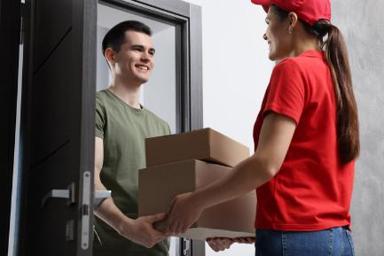
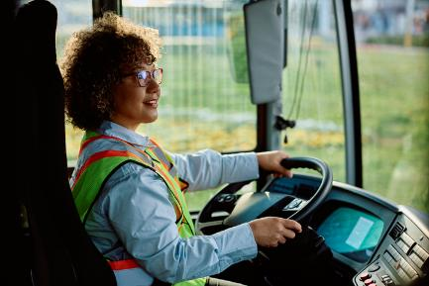
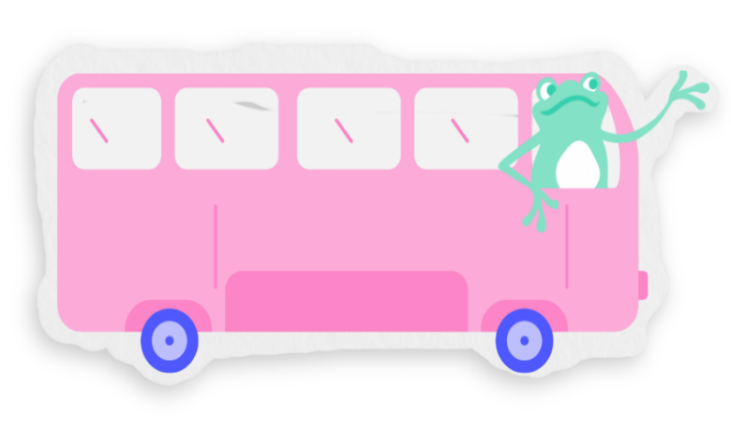
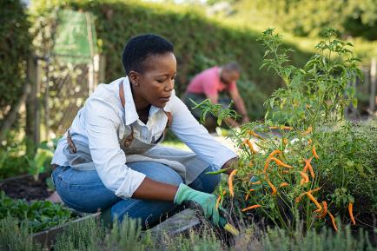
Real world helpers (3 min)
Which is the real bus driver?
Notes:
Teacher’s notes:
Challenge: How are the jobs in the story different to the real jobs?
Suggested answers:
Click to reveal answers on slide.

Slide 22
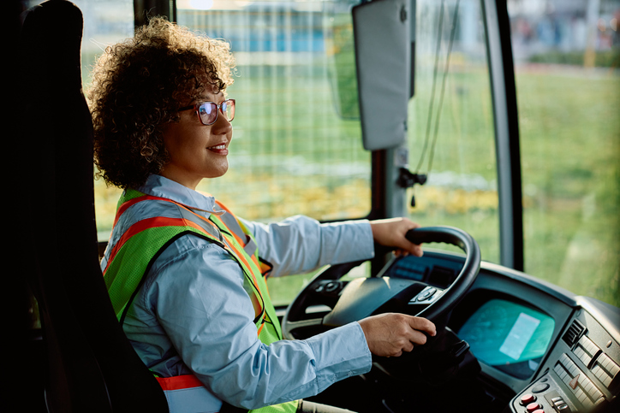
Real world helpers (3 min)
Which is the real bus driver?
Notes:
Teacher’s notes:
Challenge: How are the jobs in the story different to the real jobs?
Suggested answers:
Click to reveal answers on slide.

Slide 23

Real world helpers
Which is the real postperson?
Notes:
Teacher’s notes:
Challenge: How are the jobs in the story different to the real jobs?
Suggested answers:
Click to reveal answers on slide.

Slide 24

Real world helpers
Which is the real postperson?
Notes:
Teacher’s notes:
Challenge: How are the jobs in the story different to the real jobs?
Suggested answers:
Click to reveal answers on slide.

Slide 25

Real world helpers
Which is the real farmer?
Notes:
Teacher’s notes:
Challenge: How are the jobs in the story different to the real jobs?
Suggested answers:
Click to reveal answers on slide.

Slide 26

Real world helpers
Which is the real farmer?
Notes:
Teacher’s notes:
Challenge: How are the jobs in the story different to the real jobs?
Suggested answers:
Click to reveal answers on slide.

Slide 27


