Slide 1
Teacher’s slide
Benchmarks and standards
DfE RSHE | The characteristics of safe and happy family life, such as commitment to each other, including in times of difficulty, protection and care for children and other family members, the importance of spending time together and sharing each other’s lives. That stable, caring relationships are at the heart of safe and happy families and are important for children’s security as they grow up. How to recognise feelings and use varied vocabulary to talk about their own and others’ feelings.
Early Learning Goals | Building relationships: Form positive attachments to adults and friendships with peers. Building relationships: Show sensitivity to their own and to others’ needs. Self-regulation: Show an understanding of their own feelings and those of others and begin to regulate their behaviour accordingly. Comprehension*
Skills | Accountability, caring, independence, reading, speaking.
Key lesson information
Recommended time | 30 minutes
Recommended age | 4 - 5
Objectives | By the end of the session, children should be able to: Recognise which emotions people might experience at home and why they might feel them. Explain some ways they might use manners at home.
Main student tasks | Look at the book front cover and make a prediction about what it might be about. Listen to the story. Listen to the story a second time, this time joining in with words and actions. Recognise the emotions that characters might be feeling in the story and why they are feeling that way. Learn some words you can say to show good manners and role play where the characters might have used them in the story. Reflect on what you might do if you are angry and how to show manners in your own family.
Keywords | Manners, anger, emotions, lonely, tired, sad, scared, calm, please, thank you, you’re welcome, sorry.
Teacher preparation
Resources | Pencils, pens, paper, exercise books.
Print | Story, character illustrations (optional).
Continuous provision | Additional activities to support this lesson can be found in the Families and close relationships continuous provision suggestions.
Assessment | Click here for assessment materials (optional).
SEND / additional needs / TA support
Our optional, editable, and printable worksheets are designed to support all children including those with additional needs. You could adapt these to suit the needs of your class, as required. Provide printed copies of the story for children with dyslexia to use a covered overlay with.
Notes:
Teacher’s notes:
Our objectives are designed to be child friendly so please share these with your classes in way that suits you.
Our lessons are editable so you can adapt the slides and/or worksheet to suit the needs of your class.
*All our PSHE reception lessons help support the coverage of the following comprehension Early Learning Goals:
Demonstrate understanding of what has been read to them by retelling stories and narratives using their own words and recently introduced vocabulary.
Anticipate – where appropriate – key events in stories.
Use and understand recently introduced vocabulary during discussions about stories, non-fiction, rhymes and poems and during role-play.

Slide 2
Teacher slide – creating a safe learning environment
Why it matters:
Every PSHE topic may be sensitive or personal.
Children must feel safe, respected, and supported to fully engage.
Build a supportive environment:
Setting up an emotional check-in zone.
Be sensitive to diverse needs and experiences.
Be mindful that someone in the class might be affected by topics covered.
Use provided stories, scenarios, or clips to depersonalise discussions.
Make it clear that discrimination is never acceptable.
Share balanced, factual information.
Signpost trusted support in and out of school (relevant support organisations provided at the end of this presentation).
Establish ground rules with children, every lesson, like:
Be open, but don’t share our own personal/private lives directly (don’t use names we can identify people with).
Respect others’ views even if they might be different to ours.
Use appropriate, respectful language, and avoid slang.
Take part in activities, but you have the right to pass on questions.
Ask questions, but not questions intended to embarrass others.
No personal stories will be repeated outside of the lesson, unless we are at risk from harm.
Notes:
Teacher’s notes:
Adapt the ground rules based on your school and classroom setting.
Be careful with sharing your own personal view and remember that you are in an influential position.
Remember: Always follow school safeguarding and confidentiality policies.

Slide 3
Teacher slide – Personal, social, and emotional development
All our early years PSHE lessons aim to help children improve their ability to self-regulate their emotions. To support this, the following research-based strategies should be integrated into lessons:
Recognising and identifying feelings: Research shows that helping children name and label what they are feeling significantly improves their emotional understanding.
Co-regulation: This occurs when a practitioner works directly with a child to help them navigate intense emotions. Research highlights co-regulation as a vital first step toward independent self-regulation.
Modelling positive interactions: Educators and peers should actively demonstrate positive social behaviours. Research indicates that this helps children build strong relationships and improves their overall social skills.
Introducing vocabulary and scaffolding scripts: Because oral language skills are crucial for sustaining relationships, educators can provide specific scripts and vocabulary to help children express their needs and resolve conflicts.
Explicitly modelling emotion management: Demonstrating how to handle difficult emotions gives children a practical, real-time scaffold to mirror in their own lives.
Discussing emotions through stories: Using storybooks and literature supports children’s awareness of feelings by allowing them to explore emotions in a safe, relatable context.
Notes:
Teacher’s notes:

Slide 4
Teacher slide – FAQs
How can I show I care at home?
You can use kind words and manners like ‘please’ and ‘thanks’, help to tidy up your toys, and listen when someone is talking. Little acts of kindness help people feel happy and cared for.
What can I do if I feel angry at home?
It's okay to feel angry sometimes. Take some deep breaths or go to a quiet place to help you calm down. When you are ready, tell a grown-up how you are feeling so they can help you.
My brother or sister won’t let me play with them. What should I do?
You can ask nicely if you can play. If they say no, that's okay. You can find something else to play with and ask again later. If you feel sad, tell a grown-up you trust.
What if I forget to say thank you?
That’s okay to forget sometimes. It is never too late to say thank you so tell the person you want to thank when you have remembered.
I’m worried about something at home. What should I do?
If you are worried, tell an adult you trust. You could tell a parent, carer, or teacher. Grown-ups can help you and listen to how you are feeling.
Notes:
Teacher’s notes:
This slide contains model answers to questions that children might ask about the theme of the lesson.

Slide 5

How can we show care at home?

Slide 6
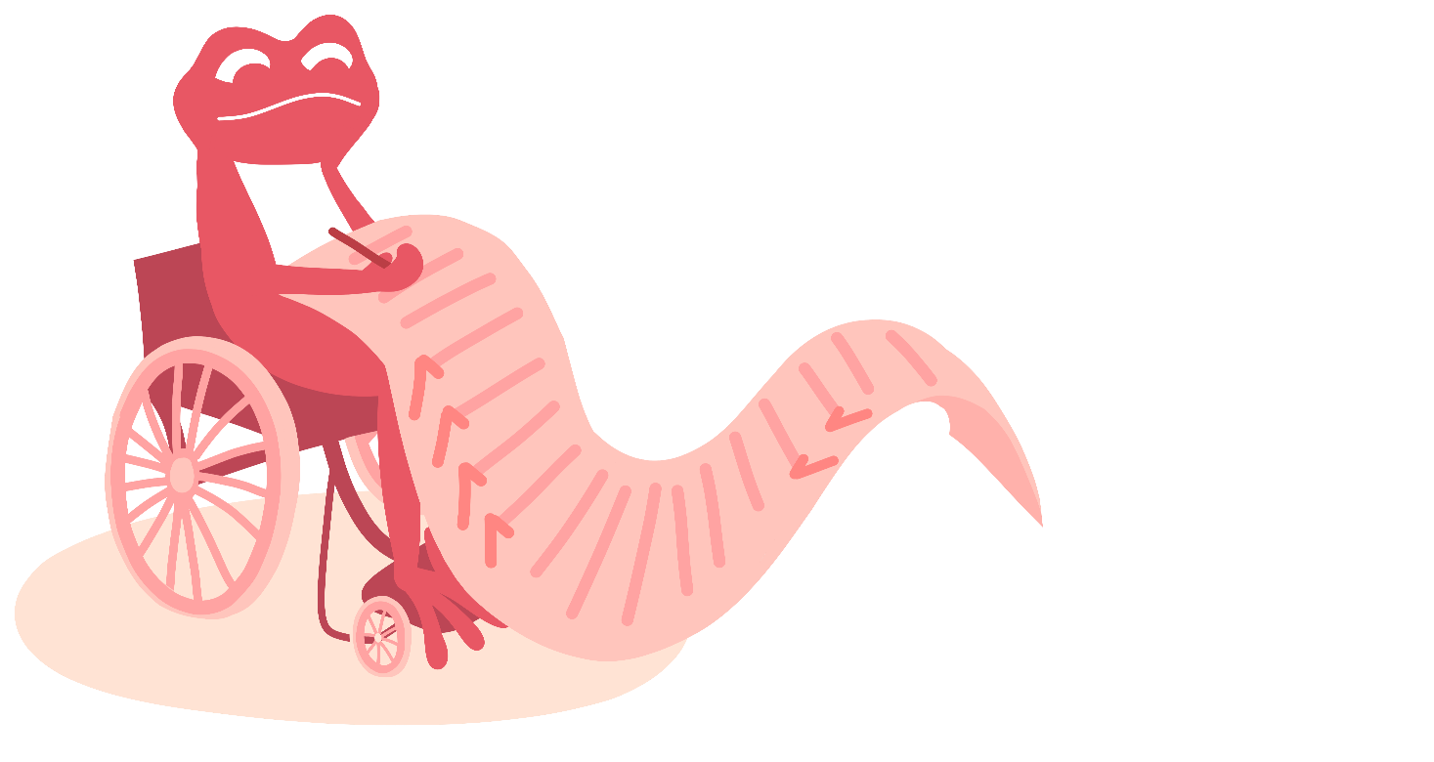
Ground rules (4 mins)
Let’s create some ground rules for our lesson.
_________________________________________
_________________________________________
_________________________________________
_________________________________________
_________________________________________
Notes:
Teacher’s notes:
At the start of the lesson, agree on some ground rules as a class. Some suggestions are provided on the ‘creating a safe learning environment’ teacher slide.
If you’re using a question box in your class, let children know that it’s available during and after the lesson. Explain that if anyone has a question or worry they don’t feel comfortable sharing out loud, they can write or draw it on a piece of paper, with their name or anonymously, and place it in the box. This way, everyone has a safe way to share their thoughts.

Slide 7
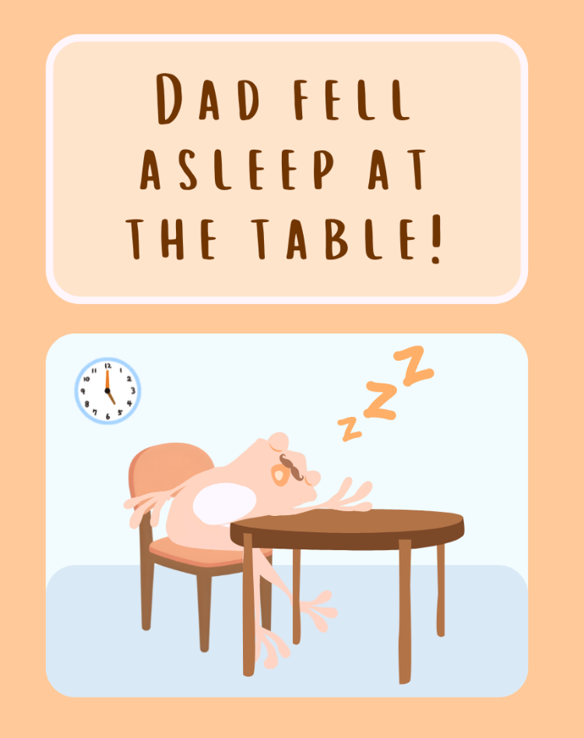
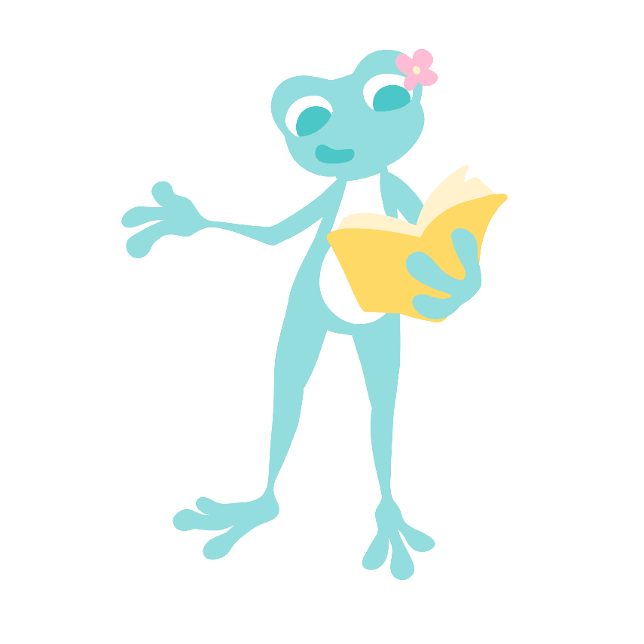
Story time (8 min)
We are going to listen to a story called ‘Dad Fell Asleep At The Table!’
What do you think the story will be about?
Notes:
Teacher’s notes:
Introduce story and front cover. Encourage children to make a prediction about what might happen using the title and front cover images.

Slide 8

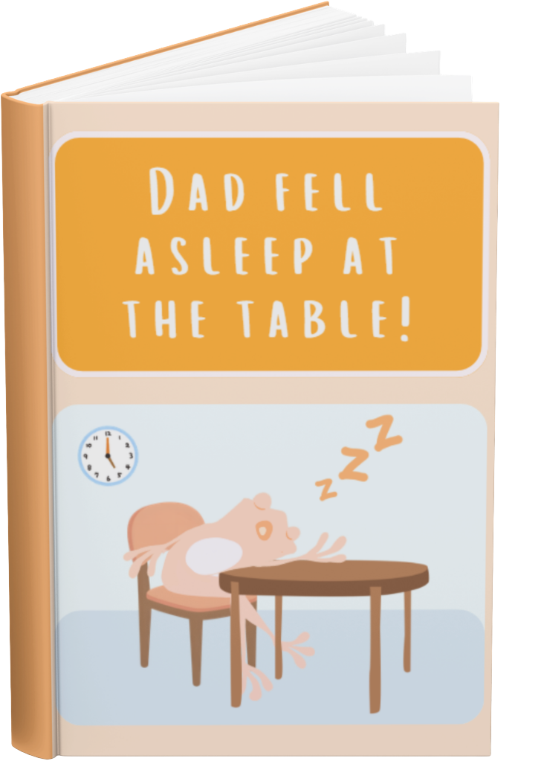
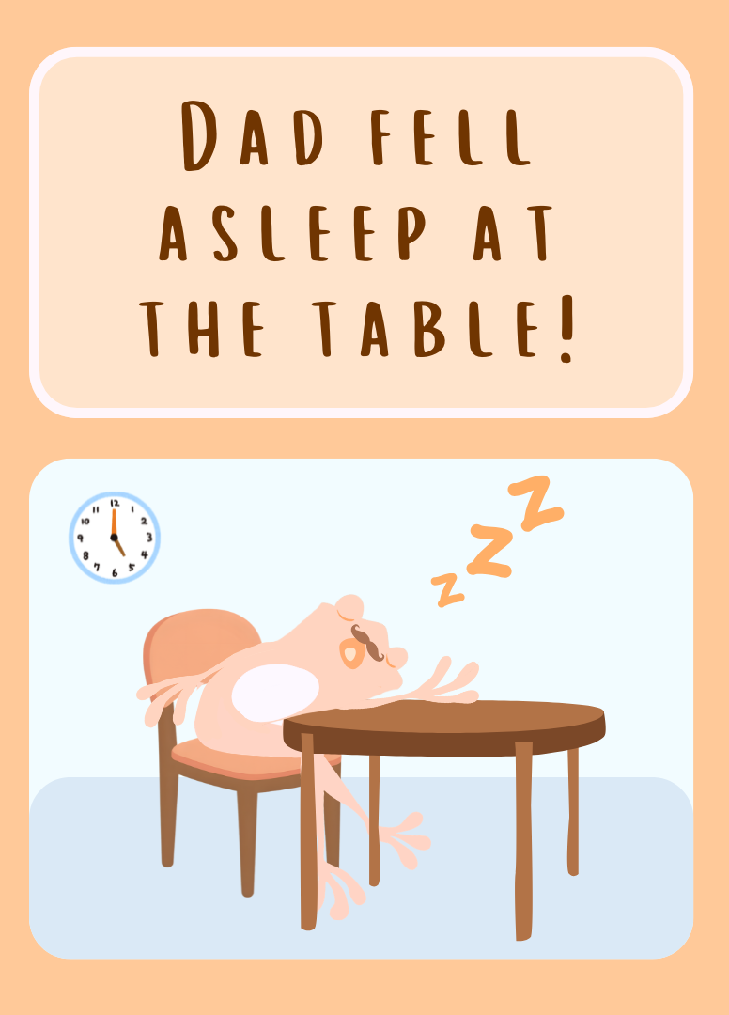
Notes:
Teacher’s notes:

Slide 9
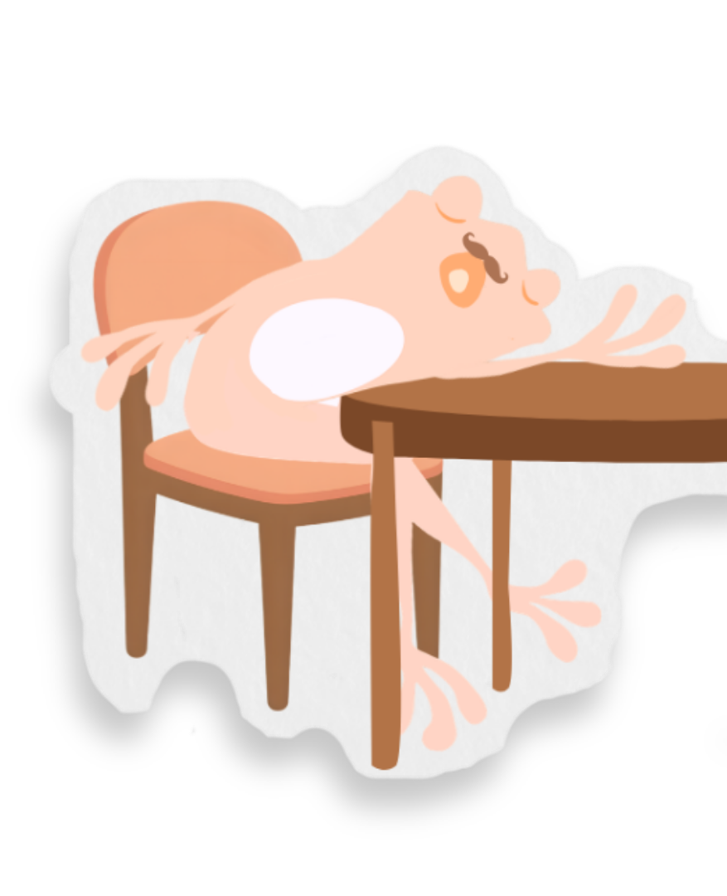







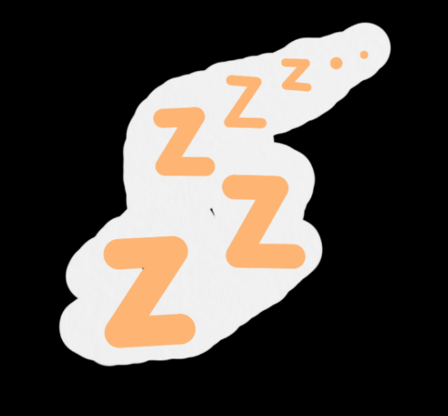
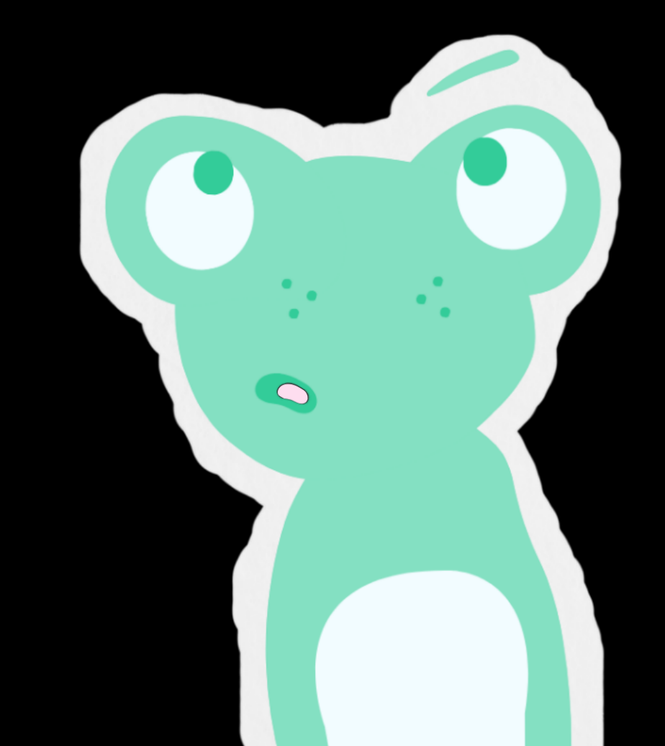

What’s that loud noise?
Is that snoring in my ear?
It’s Dad asleep at the table!
But why was he here?
Notes:
Teacher’s notes:
Click to animate the text and illustrations of the story.

Slide 10
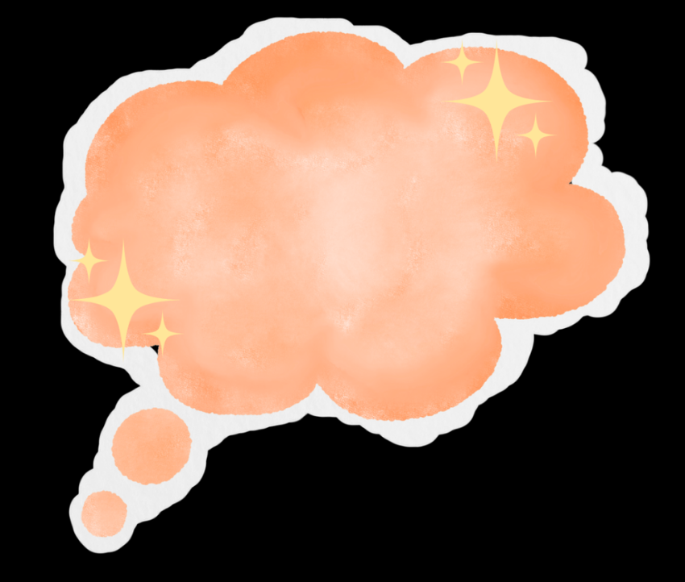

Yesterday
He must have been so tired.
I thought back to yesterday.
It must have been so busy,
to make him feel this way!
Notes:
Teacher’s notes:
Click to animate the text and illustrations of the story.

Slide 11
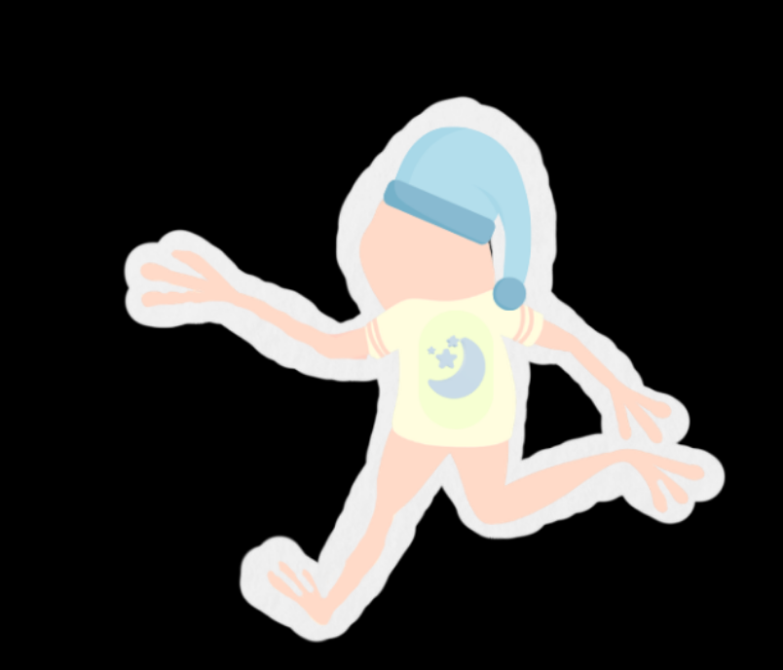
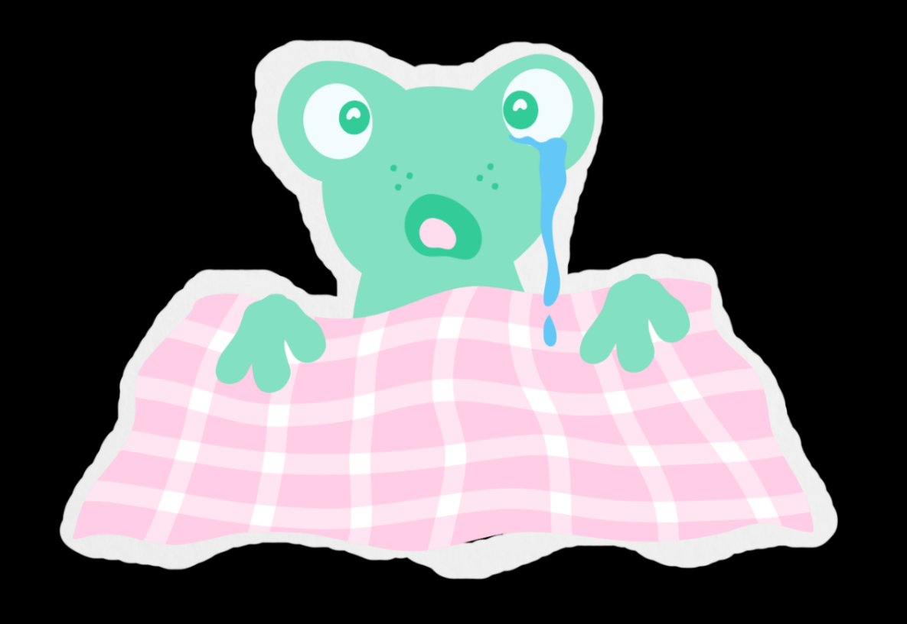
Dad came running in
to help stop my scares!
Yesterday…
In the middle of the night,
I had some nightmares.
Notes:
Teacher’s notes:
Click to animate the text and illustrations of the story.

Slide 12

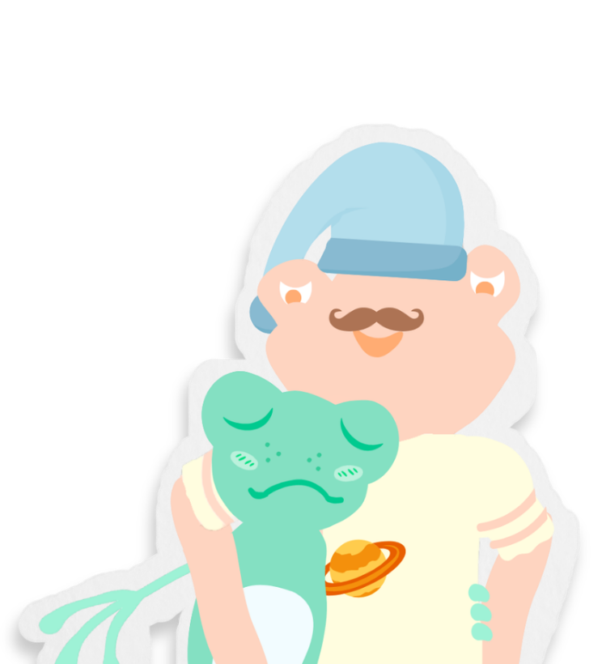
As he held me tight,
I sat on his knee.
“Come on darling,
you can sleep with me.”
Notes:
Teacher’s notes:
Click to animate the text and illustrations of the story.

Slide 13

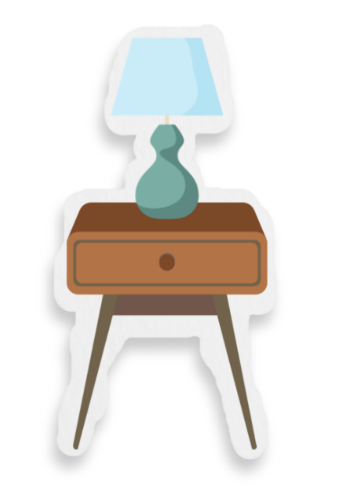
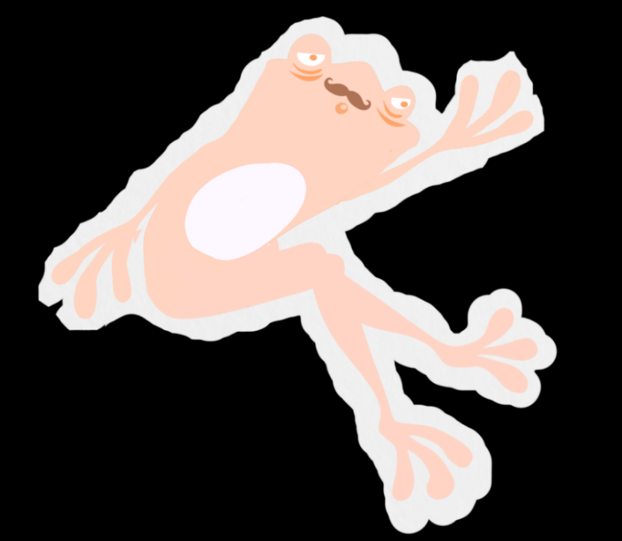
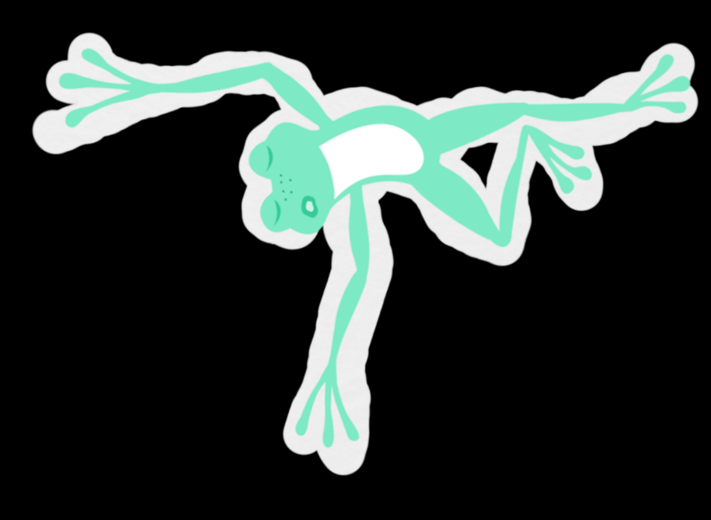
Dad tucked me in
and I stretched out and spread.
But I could have given him
more room in his bed.
Notes:
Teacher’s notes:
Click to animate the text and illustrations of the story.

Slide 14
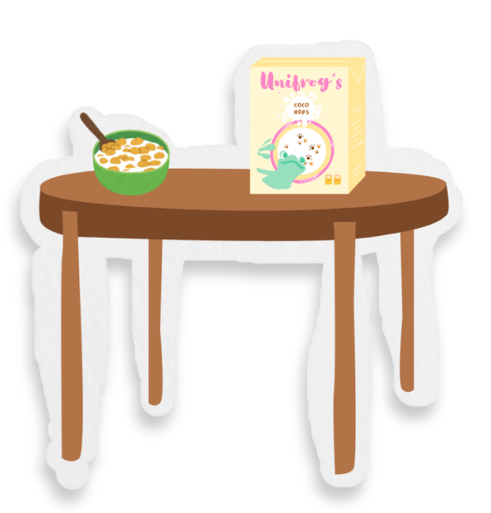
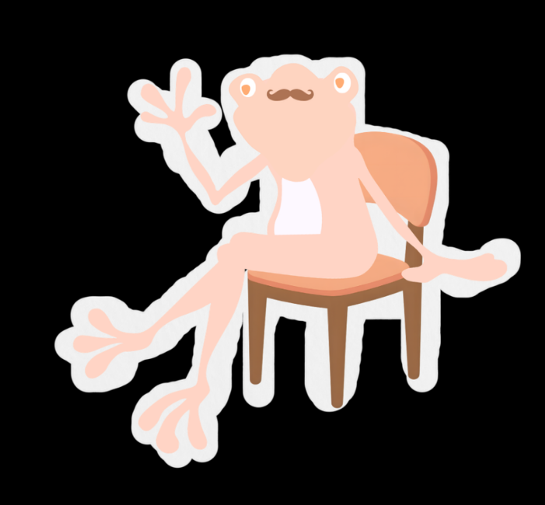
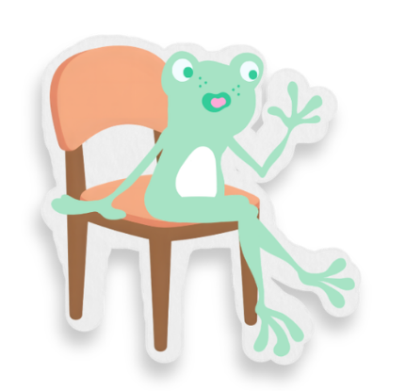
Dad made me my breakfast,
and I scoffed every bite.
But I forgot to say thanks,
to show I’m polite.
Morning, cereal!
Morning, darling!
Notes:
Teacher’s notes:
Click to animate the text and illustrations of the story.
Vocabulary:
Scoffed: ate something very quickly.
Polite: using kind words and good manners.

Slide 15
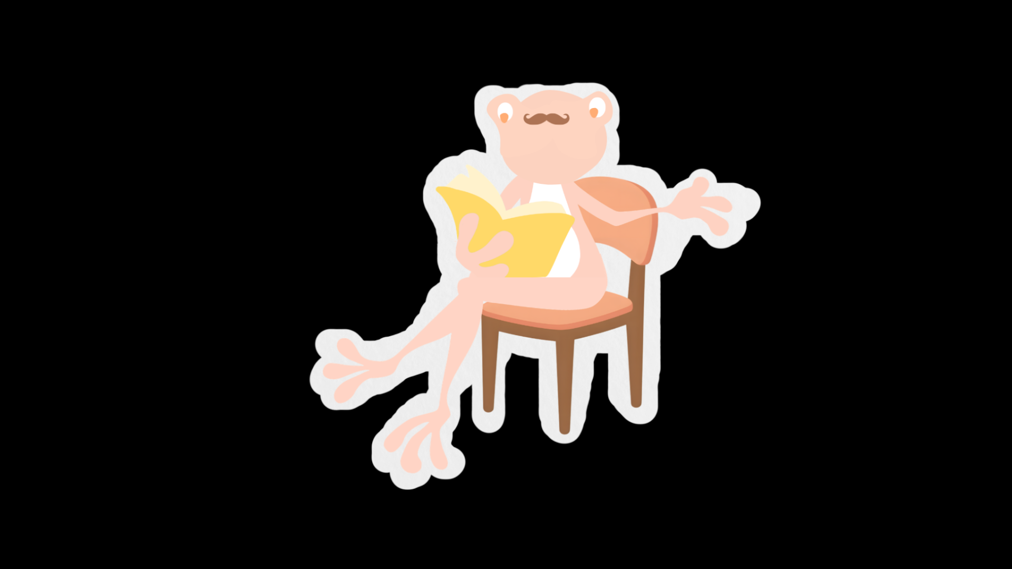
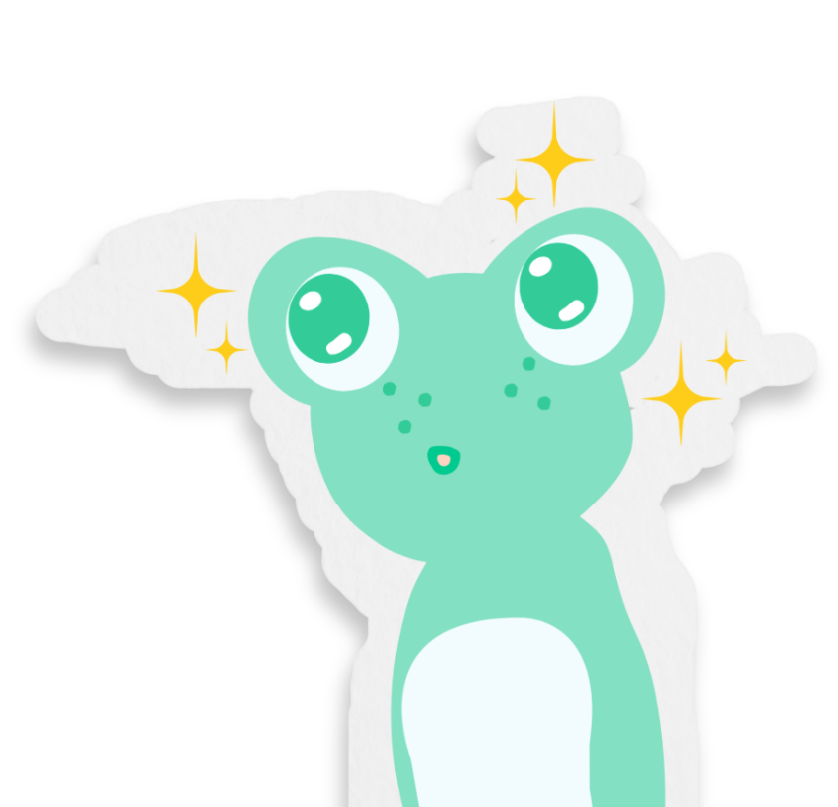
Dad sat down to read.
He opened his book.
“Read to me instead!”
and I gave him that “look”.
Notes:
Teacher’s notes:
Click to animate the text and illustrations of the story.

Slide 16

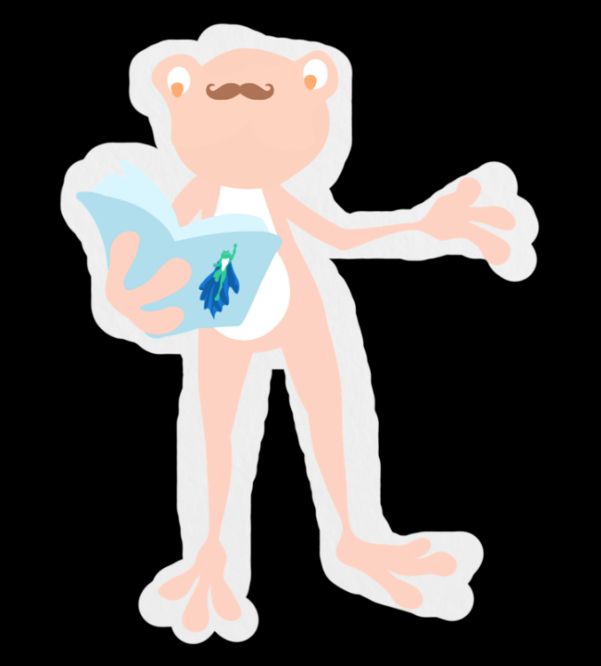
He read me my favourite:
“Turbo Toad and the Elf!”
But I should have given him
time to read for himself.
Notes:
Teacher’s notes:
Click to animate the text and illustrations of the story.
Vocabulary:
Elf: a magical creature found in many children’s stories.

Slide 17

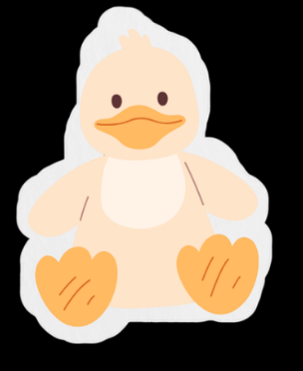
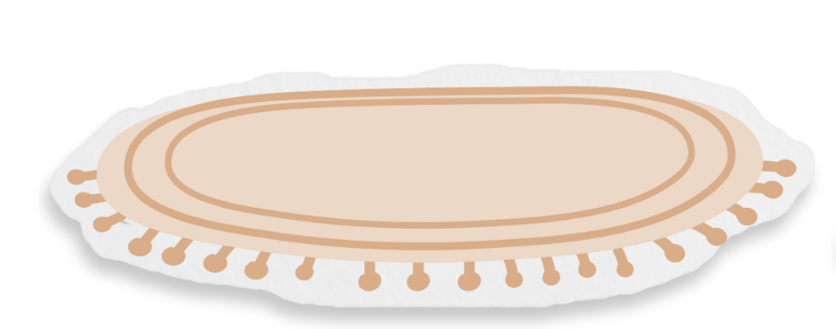
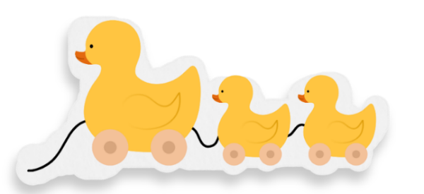



I then played with my toys.
I filled the whole room!
Dad wanted to clean,
but there was no space to vacuum.
Notes:
Teacher’s notes:
Click to animate the text and illustrations of the story.
Vocabulary:
Vacuum: a special machine that sucks up dirt on the floor.

Slide 18
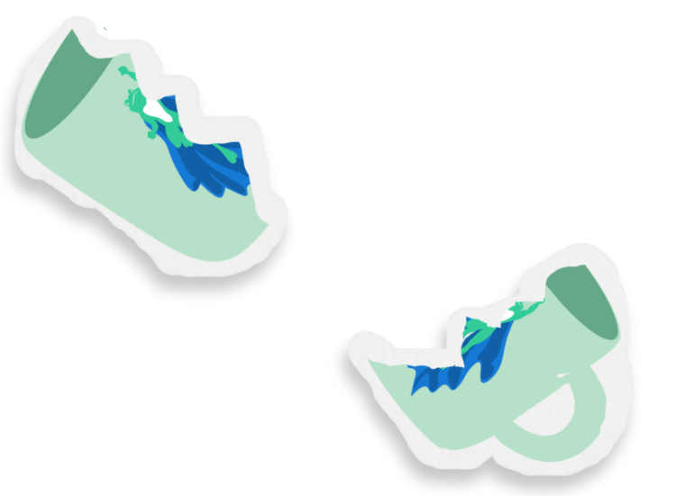
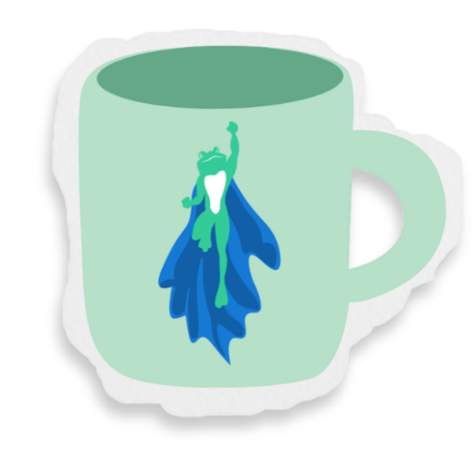
When I did something else,
I left my toys on the rug.
Dad tripped over them,
and smashed his favourite mug!
Notes:
Teacher’s notes:
Click to animate the text and illustrations of the story.

Slide 19


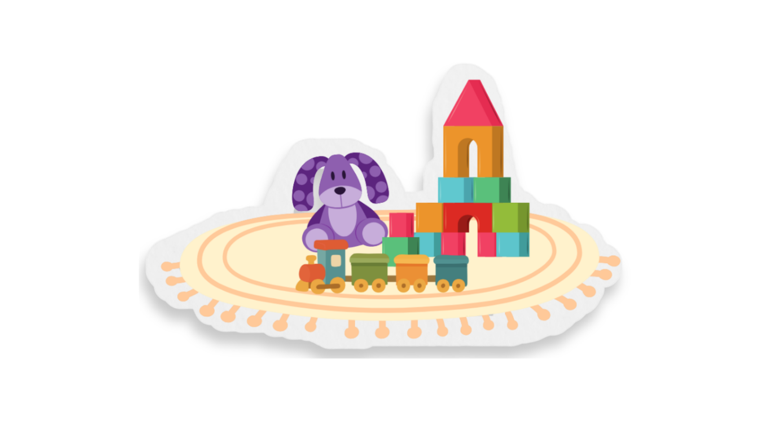
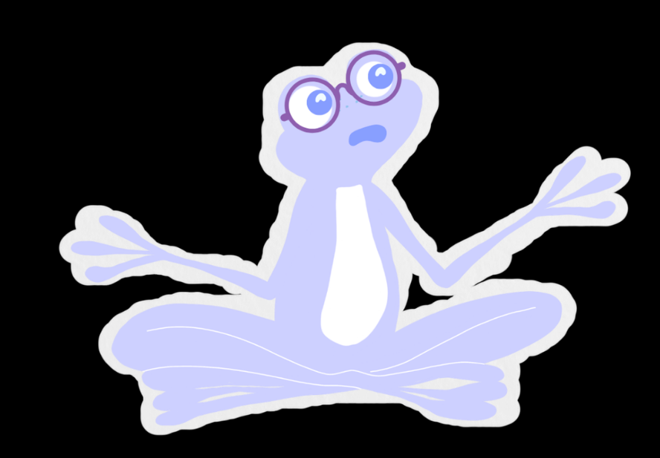

My sister Sue was playing,
a nice game on her own.
“But I want to play alone!”
“Hey, let me play too!”
Notes:
Teacher’s notes:
Click to animate the text and illustrations of the story.

Slide 20
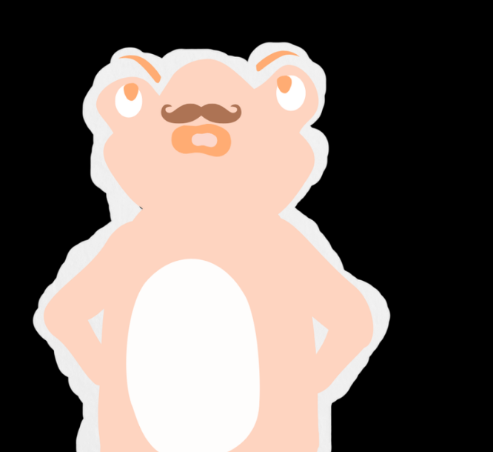
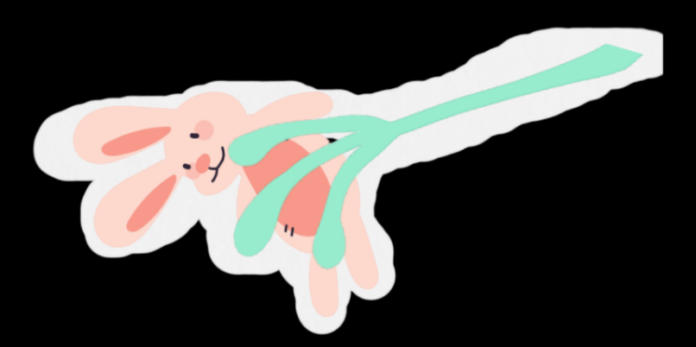
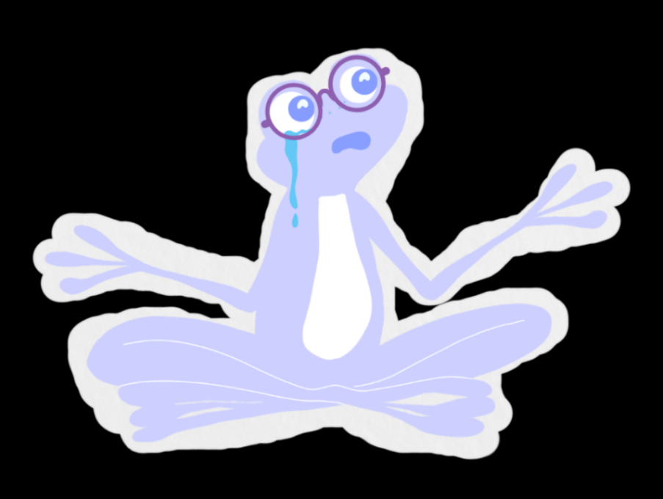
I snatched off her toy,
until she played with me!
Dad asked us calmly,
to play together nicely.
Notes:
Teacher’s notes:
Click to animate the text and illustrations of the story.

Slide 21

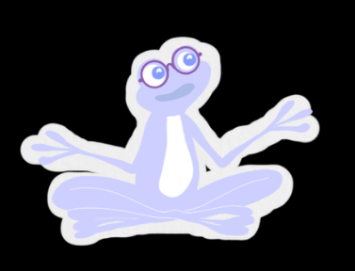
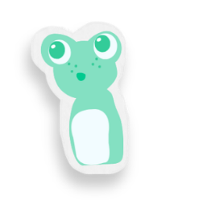

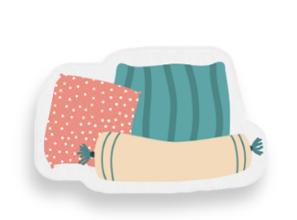

When I fell over,
Dad gave me a hug.
Then, he helped make a den,
where we felt snug as a bug.
Notes:
Teacher’s notes:
Click to animate the text and illustrations of the story.
Vocabulary:
Den: a small, cosy place to play or hide.

Slide 22
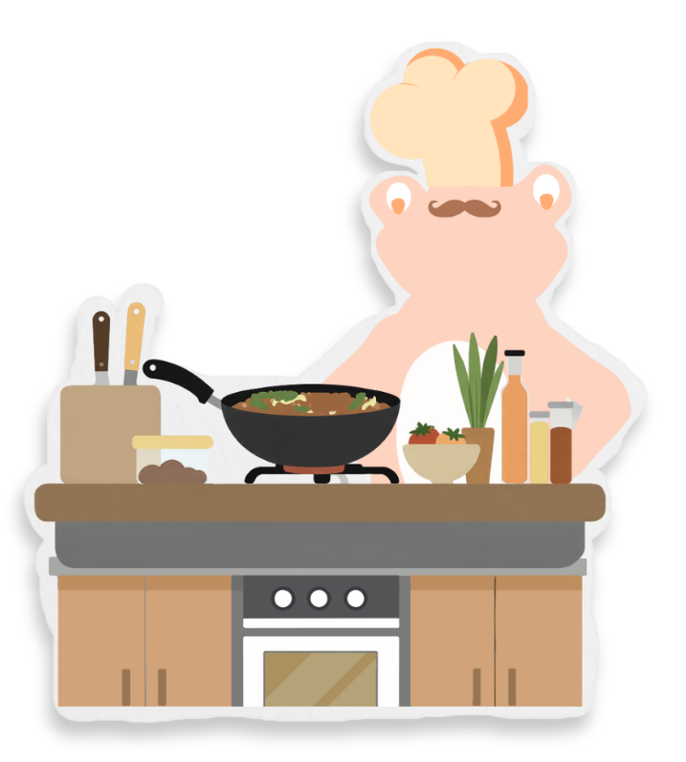
Dad made us all dinner.
We had it in our den.
We ate up everything,
but I forgot to say thank you again.
Notes:
Teacher’s notes:
Click to animate the text and illustrations of the story.

Slide 23
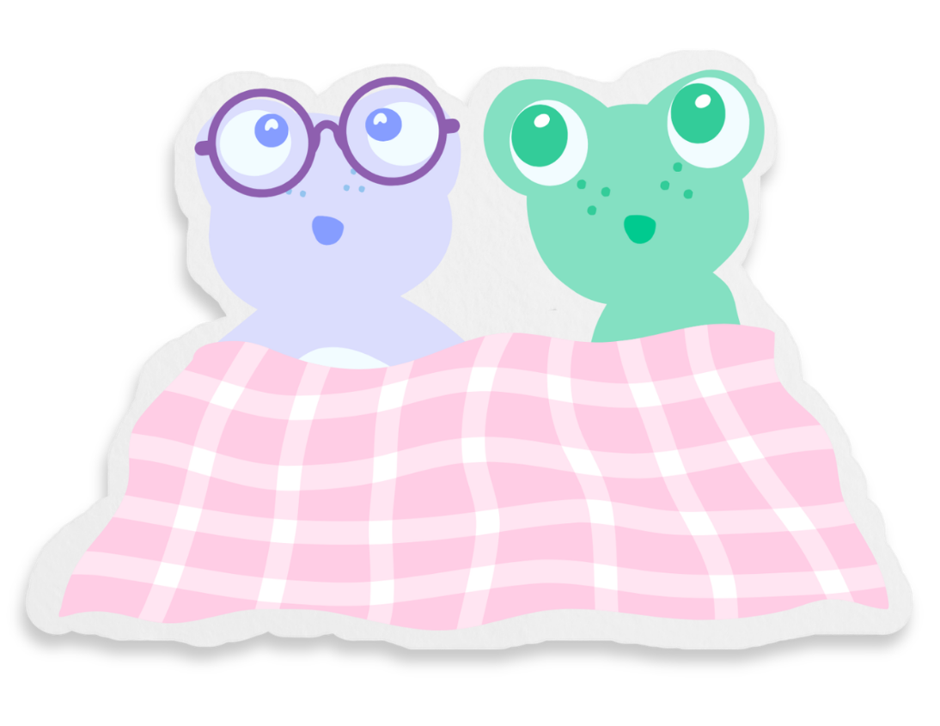
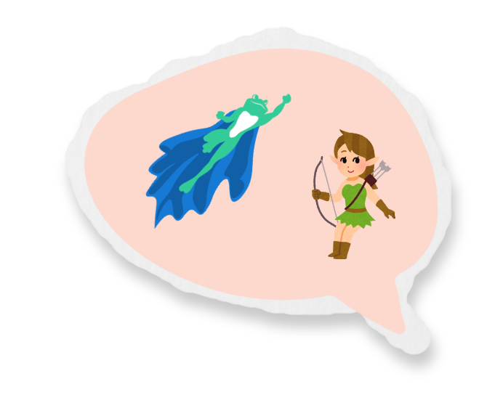
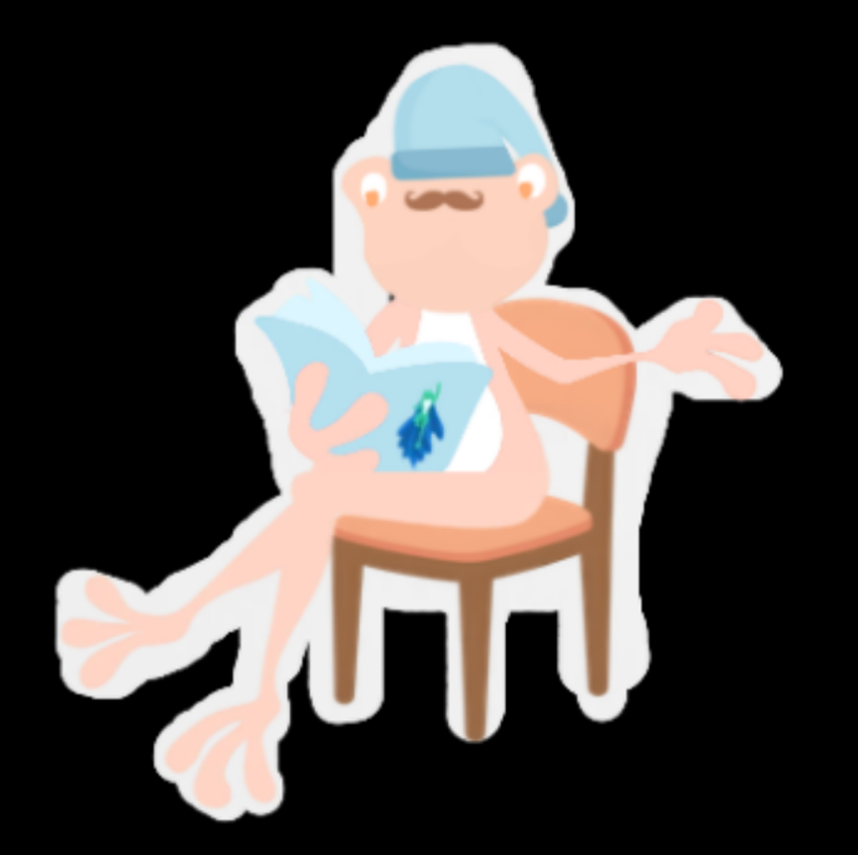
Dad tucked us into bed
and finished reading “Turbo Toad”.
He did all the silly voices,
as we drifted into sleep mode.
Notes:
Teacher’s notes:
Click to animate the text and illustrations of the story.

Slide 24

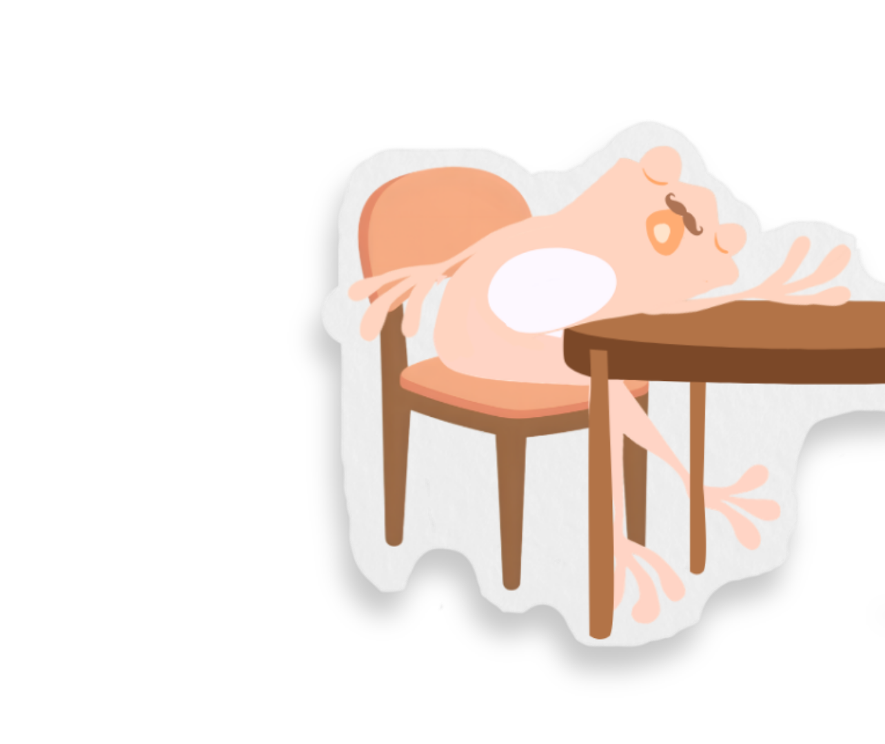
Dad does so much for us,
He looks after me and Sue.
But I need to remember:
He needs looking after too!
Today…
Notes:
Teacher’s notes:
Click to animate the text and illustrations of the story.

Slide 25

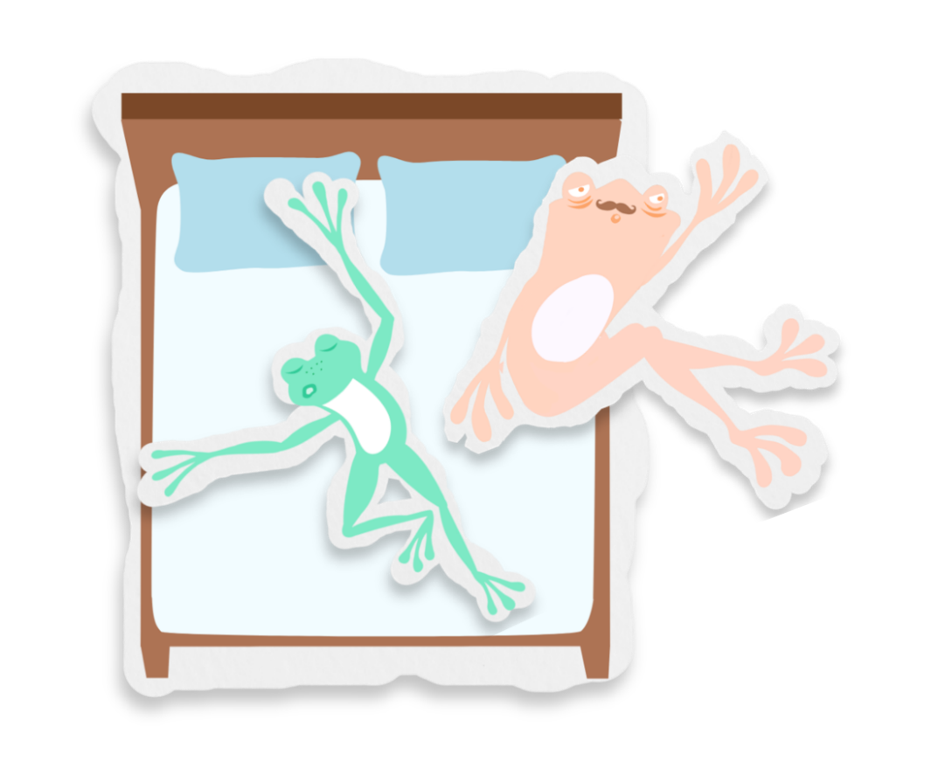

Recognising and naming emotions (8 mins)
How might Dad be feeling in each of the pictures? How do you know?
Choose from below or think of your own:
Dad
Dad
angry
lonely
tired
sad
calm
scared
Sam
Why is Dad feeling that way?
Notes:
Teacher’s notes:
Stretching question: When have you felt tired before?
Suggested answers:
Dad might feel tired as he is sleeping. He might be feeling that way because he had a busy day looking after the children.
Dad might be feeling angry, tired, or sad because he can’t get to sleep. He might be feeling that way because Sam has taken all the room in the bed.

Slide 26

Recognising and naming emotions
How might Sam be feeling in each of the pictures? How do you know?
Dad
Choose from below or think of your own:
Sam
angry
lonely
tired
sad
calm
scared
Sam
Why is Sam feeling that way?
Notes:
Teacher’s notes:
Stretching questions:
When have you felt scared before?
When have you felt calm before?
Have you had a bad dream before? How did you feel? What did you do?
Suggested answers:
Sam might be feeling scared, worried, frightened, sad, tired or upset. They might be feeling that way because they just had a scary nightmare.
Sam might be feeling calm, happy, or relaxed because their dad is hugging them and making them feel better.

Slide 27
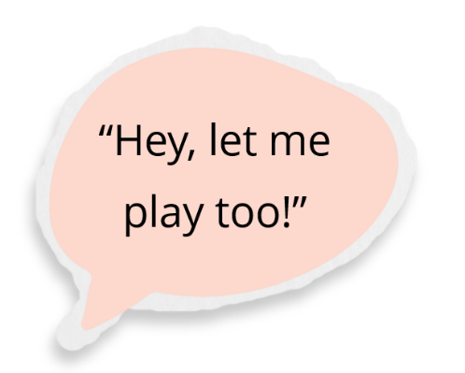
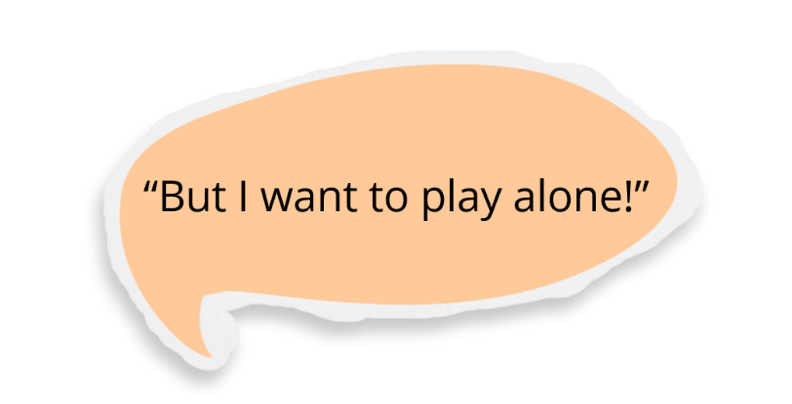

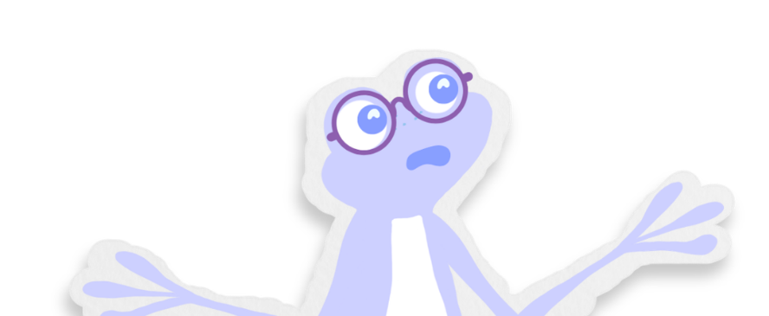
Recognising and naming emotions
How might Sam be feeling when Sue said she wanted to play alone?
Sam
Sue
Choose from below or think of your own:
angry
lonely
tired
sad
calm
scared
Is it okay to want to play alone sometimes?
Notes:
Teacher’s notes:
Stretching questions:
When have you felt angry before?
When have you felt sad before?
When have you felt lonely before?
Suggested answers:
How might Sam be feeling when Sue said she wanted to play alone?
Angry
Lonely
Sad
Is it okay to want to play alone sometimes?
Yes, it is okay to want to be alone sometimes.
It is also kind to include other people too.

Slide 28

Recognising and naming emotions
How might Sue be feeling when her toy got snatched from her? How do you know?
Which of Sam’s feelings might have made them snatch?
What could Sam have done instead of snatching?
Took a deep breath to help to help feel calmer.
Said to Sue, “That’s okay. Can we play later?”
or
Notes:
Teacher’s notes:
For the question: What could have Sam done instead of snatching?, you may choose to leave the two options hidden for a greater level of challenge, or click to reveal them for more support.
Stretching questions:
When have you felt sad before?
How would you feel if someone snatched something from you?
Suggested answers:
Which of Sam’s feelings might have made them snatch?
Anger
Annoyance
Sadness
Loneliness
What could have Sam done instead of snatching?
Both answers are acceptable. This is an opportunity for children to reflect on different choices they might make and what might work for them.

Slide 29
Using manners (8 mins)
Parents and carers look after us like Dad looks after Sam and Sue.
We can use manners like ‘please’ and ‘thank you’ to show the people who look after us that we care about them.
Can you think of any words we might use to show our manners?
Please
Thank you
Excuse me
Sorry
You’re welcome
Listen to and repeat these words.
Notes:
Teacher’s notes:
Click to reveal the following answers on the slide:
Please
Thank you
Excuse me
Sorry
You’re welcome

Slide 30
Using manners
Which words from below could Sam have said to Dad after he made breakfast?
Please
Thank you
Sorry
You’re welcome
Thanks for breakfast, Dad!
You’re welcome, Sam!
In pairs, role play having breakfast and using manners.
Notes:
Teacher’s notes:
Discuss the question in the context of the story and then allow children to role play the scenario in pairs whilst practising using different words to show their manners.
Optional extension activity: Role play having dinner and using manners.
Possible things children might say in their role play:
Child 1: Thank you for my breakfast.
Child 2: You’re welcome.

Slide 31
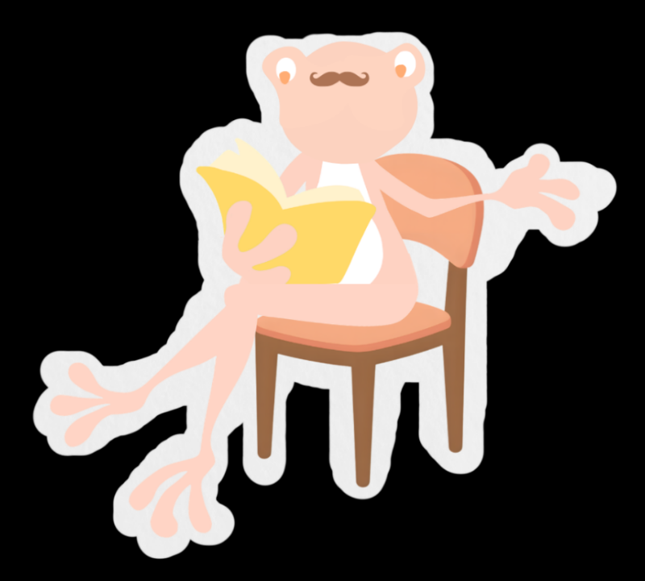

Using manners
Which words from below could Sam have said to Dad when he wanted him to read?
Please
Thank you
Sorry
You’re welcome
Of course, Sam. Let me finish this page first.
Please will you read with me?
In pairs, role play showing manners when asking for something.
Notes:
Teacher’s notes:
Discuss the question in the context of the story and then allow children to role play the scenario in pairs whilst practising using different words to show their manners.
You may choose to discuss that sometimes you might have to wait patiently for a parent or carer to do something as they might already be doing something else important.
Possible things children might say in their role play:
Child 1: Please will you read me a story?
Child 2: Of course. Let me finish this page first.

Slide 32
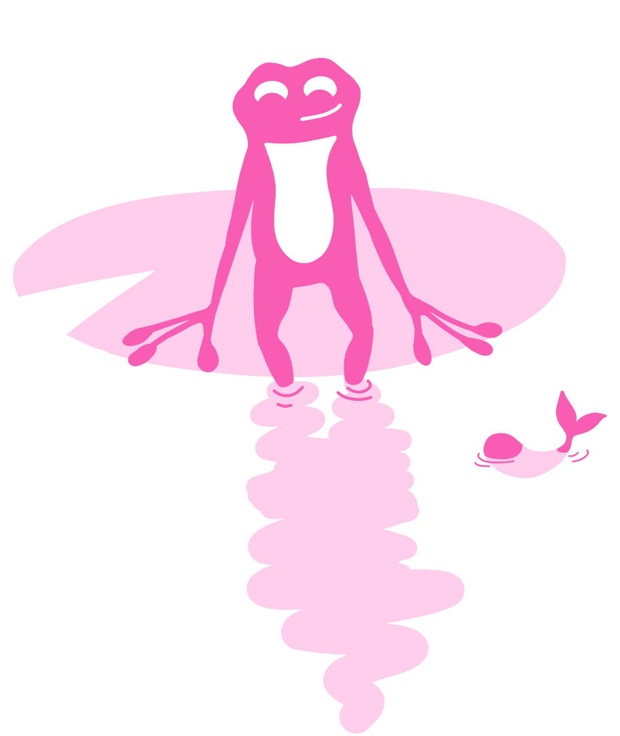
Reflection (2 mins)
What could you do if you feel angry with someone in your family?
What could you say to someone in your family to show you care?
Take some deep breaths to calm down.
Say ‘please’ and ‘thank you.’
Let’s try taking a deep breath as a class.
When might you say these?
Notes:
Teacher’s notes:
Stretching questions:
How did you feel after the deep breath?
Why is it better to be calm when dealing with a situation?
Suggested answers:
What could you do if you feel angry with someone in your family?
Take some deep breaths to calm down.
Walk away from the situation until you feel calmer.
What could you say to someone in your family to show you care?
Say ‘please’, ‘thank you’, ‘you’re welcome’ or ‘sorry.’
When might you say these?
Please: When you ask for something.
Thank you: When someone does something nice for you.
You’re welcome: A response when someone says thank you.
Sorry: If you do something bad on purpose or accidentally to someone.

Slide 33

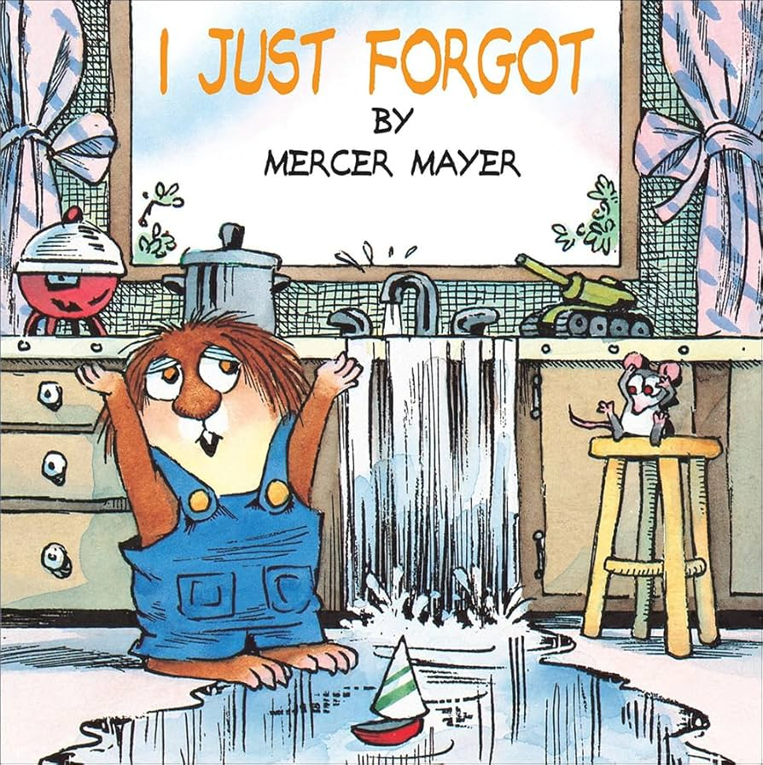


Suggested reads:
‘Five Minutes Peace’ by Jill Murphy
‘A Chair for My Mother’ by Vera B. Williams
‘I Just Forgot’ by Mercer Mayer
‘Peace at Last’ by Jill Murphy
Notes:
Teacher’s notes:
This slide has other recommended stories that children might read linked to the themes of this lesson.
You may choose to read these to the class or place them in the reading area for children to explore by themselves.

Slide 34


