Slide 1
Teacher’s slide
Key lesson information
Recommended time | 30 minutes
Recommended age | 9 - 10
Objectives | By the end of the session, children should be able to: Give reasons why different people choose different careers. Explain that different choices can lead to different career paths.
Main student tasks | Look at the activities and think about the skills that could be learnt by doing them. Read two scenarios and reflect on the different opportunities the people had and how these influenced the choices they made. Read scenarios and offer advice on how to make sensible choices. Read scenarios and offer advice on how to make safe choices. Reflect on their own life choices and weigh up pros and cons for different options.
Keywords | Skills, opportunities, decisions, safety, choices.
Benchmarks and standards
Gatsby Benchmarks | 2. Learning from career and labour market information 4. Linking curriculum learning to careers
Careers focus | Learning about the world of work Linking skills and interests with careers Linking subjects with careers Exploring pathways into work
CDI Framework | Manage career
PSHE Association | Careers education: aspirations, learning and work
Skills | Problem solving, reflectiveness, planning, organising, time management.
SEND / additional needs / TA support
Our optional, editable, and printable worksheets are designed to support all children including those with additional needs. You could adapt these to suit the needs of your class, as required.
Teacher preparation
Resources | Pencils, pens, paper, exercise books.
Print | Worksheet (optional).
Assessment | Use the suggested task in the resource profile or click here for editable assessment materials (optional).
Notes:
Teacher’s notes:
Whilst Gatsby Benchmarks are designed for use with secondary schools and colleges, we’ve provided a best match for this lesson, for reference.
Our objectives are designed to be child friendly so please share these with your classes in way that suits you.
Our lessons are editable so you can adapt the slides and/or worksheet to suit the needs of your class.
You may choose to use the optional assessment activity found in the individual resource profile for this lesson. Children should record initial ideas in one colour either before a lesson or at the beginning of the lesson. This can then be revisited at the end of the lesson or after the lesson, with children adding new drawings, information, ideas, and attitudes, or editing earlier misconceptions and errors in a second colour to demonstrate progress. Encourage children to neatly cross through anything they want to edit so it can still be clearly seen.

Slide 2

How can I make a good decision?

Slide 3



Learning and using skills (3 mins)
1. Choose one activity from below and give one example of it.
Lessons at school
Clubs / hobbies
Sports / exercise
Volunteering
Example: An example of a sport is ice hockey.
Challenge: Think of one career that might use this skill.
2. Think of one skill you might learn doing this.
Example: A skill you might learn in ice hockey is teamwork.
Notes:
Teacher’s notes:
You may also choose to list some skills like teamwork, problem solving, creativity, attention to detail, leadership, resilience, or communication.
Suggested answers:
Answers will vary, but may be structured like this:
Lessons at school
Example: Science lessons
Skill: Problem solving
Job: Forensic scientist, civil engineer, or doctor
Clubs / hobbies:
Example: Playing a musical instrument
Skill: Creativity
Job: Singer, choreographer, or classical musician
Sports / exercise
Example: Football team
Skill: Teamwork
Job: Sports professional, sports development officer, or sports scientist
Volunteering
Example: Litter picking
Skill: Attention to detail
Job: Recycling officer, volunteer organiser, or ecologist

Slide 4

Different opportunities (8 mins)
Winnie and Jobu both want to become landscape architects. Landscape architects design parks, gardens, and outdoor spaces so people can enjoy them.
They both have the same dream: to design their own park.
We all get different opportunities in our lives. Listen to the scenarios and reflect on the choices each character makes.
Notes:
Teacher’s notes:
The aim of this activity is to help children understand that people have different opportunities in life, and these can affect the choices they make and the jobs they do in the future.
You may want to explain that sometimes people choose what feels like the easier option. This isn’t always a bad thing, but it can sometimes limit what they go on to achieve. It’s important for children to understand that everyone’s situation is different, and what works well for one person may not be the same for someone else.
Encourage pupils to think about how their choices can shape their future, while also respecting that different people may take different paths.
The scenario follows on the next two slides.

Slide 5

Winnie’s journey
Different opportunities
Winnie’s aunt runs a landscape architecture business. After finishing school, Winnie is offered a job straight away in her aunt’s business. She doesn’t have to train or study and quickly learns some basic skills. She doesn’t get to design her own parks yet but helps her aunt with existing projects.
Over time, Winnie continues working for her aunt. She gains enough experience to assist with garden and park designs, but never leads her own project. She enjoys the work and chooses to stay, keeping a similar level of pay throughout her career.
Notes:
Teacher’s notes:

Slide 6

Jobu’s journey
Different opportunities
Jobu doesn’t know any landscape architects. At school, he joins gardening club and volunteers at a local park to get experience. After finishing school, he decides to study landscape architecture at university.
After university, Jobu applies for lots of jobs and, after some tricky interviews, joins a landscape architecture company. A few years on, he leads his own project to design a park garden. Jobu takes on more responsibilities, earns pay rises, works at different companies, and starts his own business, designing gardens and parks on his own.
Notes:
Teacher’s notes:

Slide 7

Different opportunities
As a class, answer the following questions:
Did Winnie and Jobu have the same opportunities? Why do you think that?
What choices did Winnie make?
Could Winnie have done anything differently if she wanted to achieve her dream of designing her own park? Could she still achieve her dream?
Notes:
Teacher’s notes:
Work through the questions together as a class, modelling how to give clear, full answers. Think aloud as you answer, explaining your reasoning and referring back to the scenario so children can see what a good response looks like. Encourage the use of full sentences and evidence from the text. This will support children when they move on to answering similar questions in pairs on the next slide.
Questions 4-7 continue over the next two slides.
Suggested answers:
1. Did Winnie and Jobu have the same opportunities? Why do you think that?
No, they did not have the same opportunities.
Winnie had an advantage because her aunt already had a business and gave her a job straight away.
Jobu did not have this connection, so he had to find his own opportunities by joining clubs, volunteering, and going to university.
2. What choices did Winnie make?
She chose to work for her aunt straight after school.
She chose not to train further.
She decided to stay in the same job.
3. Could Winnie have done anything differently if she wanted to achieve her dream of designing her own park? Could she still achieve her dream?
Yes, she could have made different choices.
She could have gone to university or taken courses to improve her skills.
She could have asked for more responsibility or applied for other jobs.
She could still achieve her dream, but it might take more time and effort later in life.

Slide 8
Different opportunities
In pairs, answer the following questions:
What choices did Jobu make?
How did these choices help him achieve his dream?
Sometimes people are offered opportunities that make things easier. Is it always best to take the easiest option? Why or why not?
Notes:
Teacher’s notes:
Encourage children to work in pairs or trios to answer these questions, reminding them to refer back to the scenarios when answering. You may choose to provide a printed copy of slides 5 and 6 to make this easier.
The final question follows on the next slide.
Suggested answers:
4. What choices did Jobu make?
He joined a gardening club and volunteered to gain experience.
He chose to study landscape architecture at university.
He applied for jobs and kept trying even when it was difficult.
He took on more responsibility and eventually started his own business.
5. How did these choices help him achieve his dream?
These choices helped Jobu build skills, knowledge, and experience.
Because he kept challenging himself and learning, he was able to design his own park and eventually run his own business.
6. Sometimes people are offered opportunities that make things easier. Is it always best to take the easiest option? Why or why not?
No, it is not always best to take the easiest option.
The easier option might feel comfortable, but it may not help you learn new skills or reach bigger goals.
However, sometimes the easier option can still work well for some people, depending on their situation.

Slide 9
Different opportunities
On your own, answer the following question:
Do you think one person made better choices than the other? Why or why not?
Winnie
Jobu
Notes:
Teacher’s notes:
Encourage children to work in pairs or trios to answer these questions, reminding them to refer back to the scenarios when answering. You may choose to provide a printed copy of slides 5 and 6 to make this easier.
Suggested answers:
7. Do you think one person made better choices than the other? Why or why not? (answers will vary)
There is no single “better” set of choices.
Jobu’s choices helped him reach his goal of designing his own park, but Winnie may be happy and comfortable in her job.
Different people have different goals, and what works best depends on the person.

Slide 10
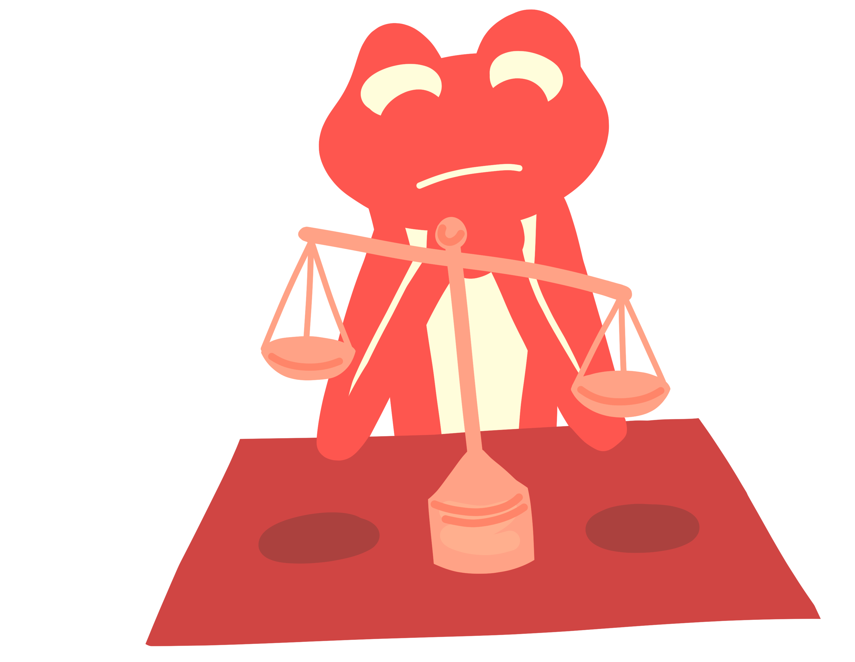
Sensible decisions (9 mins)
Read the scenarios on the next slides and help the characters make sensible decisions.
Top tips:
There are sometimes no wrong or right answers. Weigh up the pros and cons for different options they might take.
Challenge: Sometimes things in our lives are out of our control. Try and identify the things out of the character’s control in each scenario.
Notes:
Teacher’s notes:
Scenarios follow on the next four slides.
Vocabulary:
Pro: a good thing or a reason for something.
Con: a bad thing or a reason against something.

Slide 11
Sensible decisions
Read the scenarios and help the characters make sensible decisions.
Roda is looking for a job working with animals. She has never done anything like this before. She is applying for every animal-related job she can find, but there aren’t many available. So far, she hasn’t even got an interview.
What could Roda do? Explain your reasoning.
Challenge: Is there anything out of Rhoda’s control?
Notes:
Teacher’s notes:
You could provide more structure to this task by providing specific options that the character could take and asking children to explain which decision they should make and why. Suggested choices are provided for each scenario.
Choice 1: Volunteer with an animal charity to get some experience.
Choice 2: Ask someone for advice.
Choice 3: Continue applying for animal related jobs.
Suggested answers:
1. What could Roda do? Explain your reasoning.
Choice 1: Volunteer with an animal charity to get some experience.
This is a good choice because it helps Roda gain experience working with animals. Employers are more likely to give her a job if she can show she has done this before. It may take time and she might not get paid, but it will help her in the long term.
Choice 2: Ask someone for advice.
This is helpful because someone (like a teacher or someone who works with animals) could give her ideas on how to improve her chances. They might suggest training, places to volunteer, or how to make her application better. However, she will still need to take action after getting the advice.
Choice 3: Continue applying for animal-related jobs.
This shows determination, which is good. She might eventually get lucky and be offered an interview. However, without experience, it may be difficult for her to succeed, so this might not be the most effective choice on its own.
Best overall answer:
The best option would be to volunteer first, while also asking for advice and continuing to apply. This way, Roda is building experience, improving her chances, and not giving up.
2. Challenge: Is there anything out of Rhoda’s control?
Rhoda can’t control whether she gets picked for an interview, but can improve her chances by taking action.

Slide 12
Sensible decisions
Read the scenarios and help the characters make sensible decisions.
What could Geo do? Explain your reasoning.
Challenge: Is there anything out of Geo’s control?
Geo loves writing, badminton, and drawing. Geo really wants a job as a children’s author. His dad tells Geo there is a story writing competition and the deadline is tomorrow. However, Geo already made plans today to play badminton with his friends, followed by a trip to the cinema.
Notes:
Teacher’s notes:
You could provide more structure to this task by providing specific options that the character could take and asking children to explain which decision they should make and why. Suggested choices are provided for each scenario.
Choice 1: Cancel on his friends and write the story.
Choice 2: Cancel badminton and write the story, but still go to the cinema.
Choice 3: Don’t write the story and go to badminton and the cinema.
Suggested answers:
1. What could Geo do? Explain your reasoning.
Choice 1: Cancel on his friends and write the story.
This would give Geo the most time to focus on writing a really good story, which could help him achieve his dream of becoming an author. However, it might upset his friends and he could miss out on spending time with them.
Choice 2: Cancel badminton and write the story, but still go to the cinema.
This is a balanced choice. Geo would still have time to write his story and also spend some time with his friends later. However, he would have less time to write, so he would need to manage his time carefully.
Choice 3: Don’t write the story and go to badminton and the cinema.
This means Geo gets to enjoy time with his friends and keep his plans. However, he would miss the opportunity to enter the competition, which could help him move towards his dream of becoming a children’s author.
Best overall answer:
The best choice might be option 2, as it allows Geo to work towards his goal while still spending time with friends.
2. Challenge: Is there anything out of Geo’s control?
He doesn’t have time to fit everything in because of the deadline for the competition.

Slide 13
Sensible decisions
Read the scenarios and help the characters make sensible decisions.
Toby just lost his job as a retail assistant. He wasn’t really enjoying it anyway. He’s not sure whether to stay in the same type of work, try a different role, or retrain for a new career.
What could Toby do? Explain your reasoning.
Challenge: Is there anything out of Toby’s control?
Notes:
Teacher’s notes:
You could provide more structure to this task by providing specific options that the character could take and asking children to explain which decision they should make and why. Suggested choices are provided for each scenario.
Choice 1: Apply for similar retail jobs.
Choice 2: Retrain in something else that interests him.
Choice 3: Get another part-time job in retail and then train in something else in any spare time.
Suggested answers:
1. What could Toby do? Explain your reasoning.
Choice 1: Apply for similar retail jobs.
This could be a quick way for Toby to earn money again because he already has experience in retail. However, he said he didn’t enjoy the job, so he might feel the same way again and not be very happy.
Choice 2: Retrain in something else that interests him.
This could help Toby find a job he enjoys more in the future. He could learn new skills and follow his interests. However, retraining might take time and he might not earn money straight away.
Choice 3: Get another part-time job in retail and then train in something else in any spare time.
This is a balanced option. Toby can earn money while also working towards a new career he might enjoy more. It could be hard work to manage both, but it gives him security and helps him plan for the future.
Best overall answer:
The best option might be choice 3, as it allows Toby to earn money now while also improving his chances of a more enjoyable career in the future.
2. Challenge: Is there anything out of Toby’s control?
He lost his job.

Slide 14
Sensible decisions
Read the scenarios and help the characters make sensible decisions.
Alex is an adult with a busy week. They work as a nail technician on Monday, Tuesday, and Wednesday. On Thursday evening, they volunteer at a community club. Alex is also learning German online, and they have an important test on Friday evening. Alex promised to help their friend move house, before the weekend. Alex is worried they might run out of time to revise for their test.
Help Alex manage their time for the week.
Challenge: Is there anything out of Alex’s control?
Notes:
Teacher’s notes:
You may choose to skip this slide if short on time.
You may choose to provide the optional worksheet for this task to help children to structure the time management task. A timetable is provided on the worksheet to further structure this task. You may choose to model how to manage Alex’s time, by filling in some of the things that Alex can’t change into the provided timetable before letting children finish the task independently.
Suggested answers: (answers will vary)
1. Help Alex manage their time for the week.
Alex might offer to help their friends move on Monday, Tuesday, or Wednesday evening.
Alex could revise all day Thursday and Friday before the test.
2. Challenge: Is there anything out of Alex’s control?
The date of the test.
The days Alex works.
The day Alex volunteers.
The date Alex’s friends are moving.

Slide 15

Making safe decisions (5 mins)
Listen to the scenarios and decide how each character can keep themselves and others safe at school.
Janet sees a wet floor in the corridor.
Sandy notices someone leaning back on their chair.
Lilu finds a sharp, broken ruler in the classroom.
Nola sees a bag blocking the fire exit.
Challenge: Think about the different pros and cons of each decision they could make.
Notes:
Teacher’s notes:
You may choose to provide the optional worksheet to further scaffold this task.
Vocabulary:
Pro: a good thing or a reason for something.
Con: a bad thing or a reason against something.
Suggested answers:
Janet sees a wet floor in the corridor.
Try to avoid walking on the wet patch.
Pro: Keeps Janet safe from slipping.
Con: Other people might still slip if they don’t notice it.
Tell a teacher or caretaker about the wet floor.
Pro: An adult can fix the problem properly like put up a sign or clear it.
Con: It might take a little time before it is sorted.
Warn other pupils around to be careful.
Pro: Helps others stay safe straight away.
Con: Some people might not listen or still take risks.
2. Sandy notices someone leaning back on their chair.
Ask the person to sit properly.
Pro: Can stop the unsafe behaviour quickly.
Con: The person might not listen.
Tell them it could be dangerous if they fall.
Pro: Helps them understand why it’s unsafe.
Con: They might ignore the advice.
If they don’t listen, alert a teacher.
Pro: An adult can deal with the situation safely.
Con: The person might feel annoyed about being told off.
3. Lilu finds a sharp, broken ruler in the classroom.
Don’t try to fix it or dispose of it themselves.
Pro: Keeps Lilu safe from getting hurt.
Con: The broken ruler is still a danger if left there.
Move away from it so nobody gets hurt.
Pro: Keeps Lilu safe.
Con: Others might still touch it if they don’t know it’s dangerous.
Tell a teacher so it can be repaired or disposed of safely.
Pro: The problem gets sorted safely by an adult.
Con: It might take a little time before it is removed.
4. Nola sees a bag blocking the fire exit.
Move the bag away from the area so it’s not blocked.
Pro: Makes the area safe straight away.
Con: Nola might not know whose bag it is or where to put it.
Tell a teacher to remind the class not to leave things in front of the fire exit.
Pro: Helps stop the problem happening again.
Con: The exit might stay blocked until the teacher deals with it.

Slide 16

Life choices (5 mins)
Are there any important choices you want to make in your own lives?
They might be linked to:
home
school
friendships
clubs / hobbies
careers
improving skills
Reflect on the all the options available for your choice.
Weigh up the pros and cons to help decide which option might be best.
Notes:
Teacher’s notes:
Go through the modelled examples on the following two slides to help children structure their answer for this task. You may choose to provide the following stems sentences:
One important choice I want to make is…
My first option for this choice is…
The pros are…
The cons are…
The second option for this choice is…
My final decision is... because…

Slide 17
Life choices
Let’s look at an example:
One important choice I want to make is whether to join a running club.
Option 1: Join the running club.
Pro: I can get fitter, improve my running, and spend time with friends.
Con: I might feel tired after school and have less free time.
clubs / hobbies
Notes:
Teacher’s notes:
Go through the modelled example. The example continues on the next slide.

Slide 18
Life choices
Let’s look at an example:
Option 2: Don’t join the running club.
Pro: I will have more time to do other hobbies.
Con: I might miss the chance to get fitter and improve my running skills.
clubs / hobbies
Decision: I think I will join the running club, but I will plan my time carefully so I can still rest, do other hobbies, and complete my homework.
Notes:
Teacher’s notes:
Continue going through the modelled example.

Slide 19
Life choices
Now think of an important choice you want to make in your own life.
It might be linked to:
home
school
friendships
clubs / hobbies
careers
improving skills
Reflect on the all the options available for your choice.
Weigh up the pros and cons to help decide which option might be best.
Notes:
Teacher’s notes:
Encourage children to use the modelled example to help them scaffold this task. You may choose to provide stems sentences like:
One important choice I want to make is…
My first option for this choice is…
The pros are…
The cons are…
The second option for this choice is…
My final decision is... because…
If you chose to use an assessment activity at the start of the lesson, you may wish to revisit it after completing this task. Encourage children to add new drawings, information, ideas, and attitudes, or to edit any earlier misconceptions or errors using a second colour to demonstrate their progress. Remind children to neatly cross through anything they want to edit so it can still be clearly seen.

Slide 20


